Slide 1
Module 3: Using Local Data

Slide 2
Previous Assignments
Data needed to complete this process for your district or IHE
Familiarize yourself and your team with the text of TEC Section 28.014 and College Readiness Standards
Explore the Avatar Website – www.untavatar.org
  Select Files
  College Prep Courses
Gather any courses you would like to present to the group for consideration (ELA/MATH College Prep courses already developed) – Did anyone bring something for the group?
Complete the College Prep Course Considerations form

Slide 3

Today is all about things to consider as we move forward in this process.
Data
Considerations by entity
What is our plan?
http://untavatar.org
Notes:
Leaders, please note. This module requires substitution of local data for the sample data provided here. Follow the directions on the ”Local Data Powerpoint Instructions, 2015 update.”

Slide 4

What is your evidence?
The Texas Education Agency (TEA) and Texas Higher Education Coordinating Board (THECB) collect many useful indicators and make them available to the public.
http://untavatar.org

Slide 5

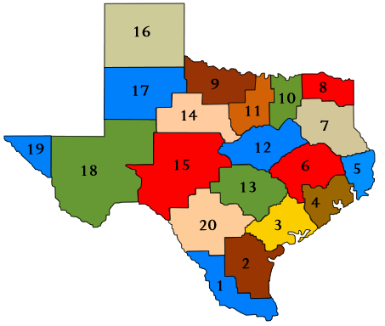
What is the demography of Region 5 High School Students?
http://untavatar.org

Slide 6
Student Demographics:
Region 5, 2013-14
Student Demographic | Number Students
TOTAL | 22,687
Grade 9 | 6,309
Grade 10 | 5,864
Grade 11 | 5,330
Grade 12 | 5,184
Graduating class 2013 | 5,106
Minimum curriculum | 21.5%*
Recommended curriculum | 78.5%*
*State Comparison:
Minimum 18.4%
Recommended 81.6%
http://untavatar.org

Slide 7
Student Ethnicity:
Region 5, 2013-14
Ethnic Group | Percentage
African American | 27.1%
Hispanic | 17.8%
White | 50.0%
American Indian | .6%
Asian | 2.4%
Pacific Islander | .1%
2 or more races | 1.9%

Slide 8
Student Subgroups:
Region 5, 2013-14
Demographic groups | Percentage (Region 5) | Percentage (Texas)
Economically disadvantaged | 60.3% | 60.2%
Limited English Proficient (LEP) | 7.0% | 17.5%
At risk* | 42.7% | 49.9%
*At risk of dropping out of school based on the performance and status indicators listed in the TAPR Glossary.

Slide 9

    How ready are Region 5 students for college?
http://untavatar.org

Slide 10
College Ready Graduates
Percentage based on test scores | Region 5 2013 | Texas 2013 | Region 5 2012 | Texas 2012
ELA | 59% | 65% | 65% | 69%
Mathematics | 73% | 74% | 68% | 70%
Both subjects | 51% | 56% | 53% | 57%

Slide 11
Percent Advanced Course Dual Credit Completion in 2013-14
Students, 2013-2014 | Region 5 | Texas
2013 | 24.5% | 31.4%
2012 | 23.8% | 30.6%

Slide 12
Percent AP/IB Enrollees Tested and Meeting Criteria in 2013-14
Students | Region 5 | Texas
Tested (2013) | 7.9 | 22.1
Met Criteria (2013) | 30.9 | 50.9
Tested (2012) | 6.5 | 21.9
Met Criteria (2012 | 34.1 | 50.8

Slide 13
Percent 2013 Graduates Enrolled in IHE and Completing One Year without Remediation
Graduates Class of 2012 | Region 5 | Texas
Enrolled | 54.3 | 57.3
Completed One Year no Remediation | 68.3 | 69.0
Graduates Class of 2011 | Region 5 | Texas
Enrolled | 56.0 | 58.3
Completed One Year no Remediation | 65.3 | 66.1

Slide 14
Notes:
It is very obvious where our students enroll. We are blessed to have a university system very close to home. In addition to feeder patterns…. What data do you think you will need to complete this process?

Slide 15
First Time In College (FTIC) Student Entry Profiles, Fall 2012 Cohort
Demographic | LU | LSCO | LSCPA | LIT
First Time in College (FTIC)Students | 786 | 383 | 389 | 634
Met entry standard, all three academic areas | 1165 | 153 | 159 | 154
Did not meet, math | 405 | 198 | 180 | 360
Did not meet, reading | 334 | 129 | 92 | 297
Did not meet, writing | 340 | 122 | 59 | 303
  Student Body:

Slide 16
Numbers are not enough!
We know some of our students are not college ready.
The CPC development process is a mandate.
So NOW WHAT?
  We develop the CPCs for ELA & Math for your partnerships.
  Develop an MOU agreement. If one already exists- Do not reinvent!
  Develop a training plan and implementation plan for your district/IHE and prepare a “blank” version for others in our region who wish to partner with our IHEs.

Slide 17
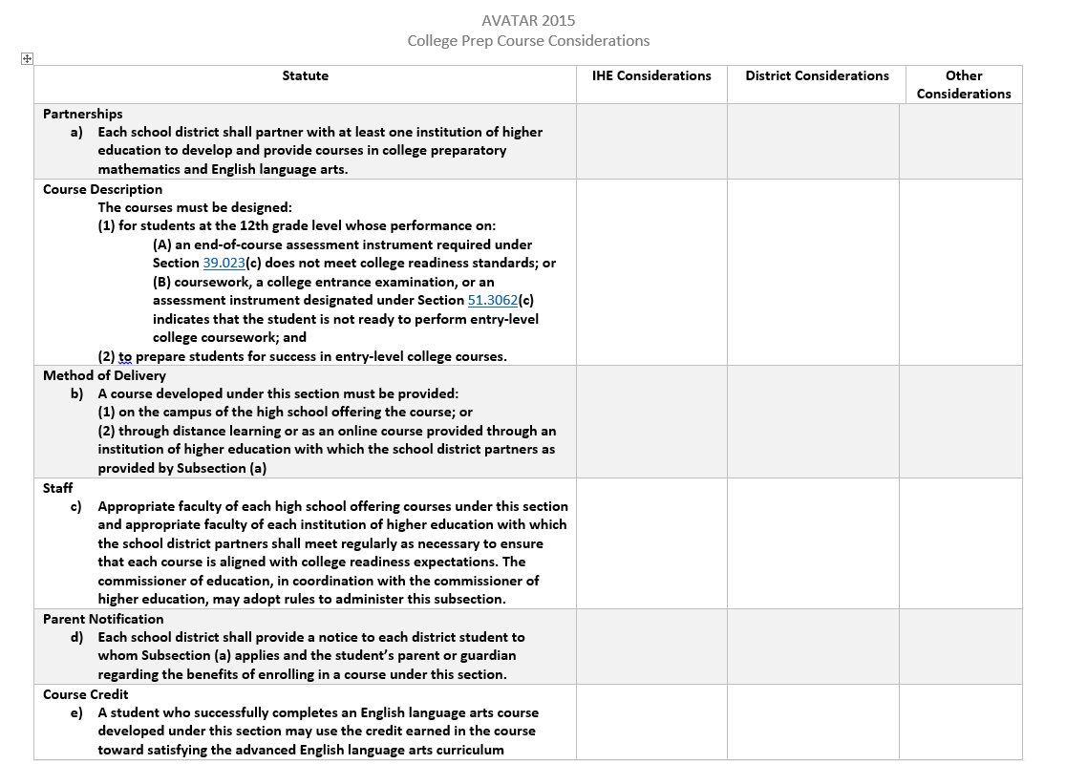
IHE Partners
MOU
School Districts
MOU
Learning Outcomes
Alignment to College Readiness Expectations
Assessment
Learning Outcomes
Alignment to College Readiness Expectations
Scope and Sequence
Current Course Offerings
Assessment
High School
Distance Learning
Online
High School
Distance Learning
Online
IHE Faculty
Dept Expertise
Alignment
District/Campus Faculty
ELA/Math Curriculum Experts
Alignment
Current Staff/ Vacancy
Staff Development
Communication Plan

Slide 18
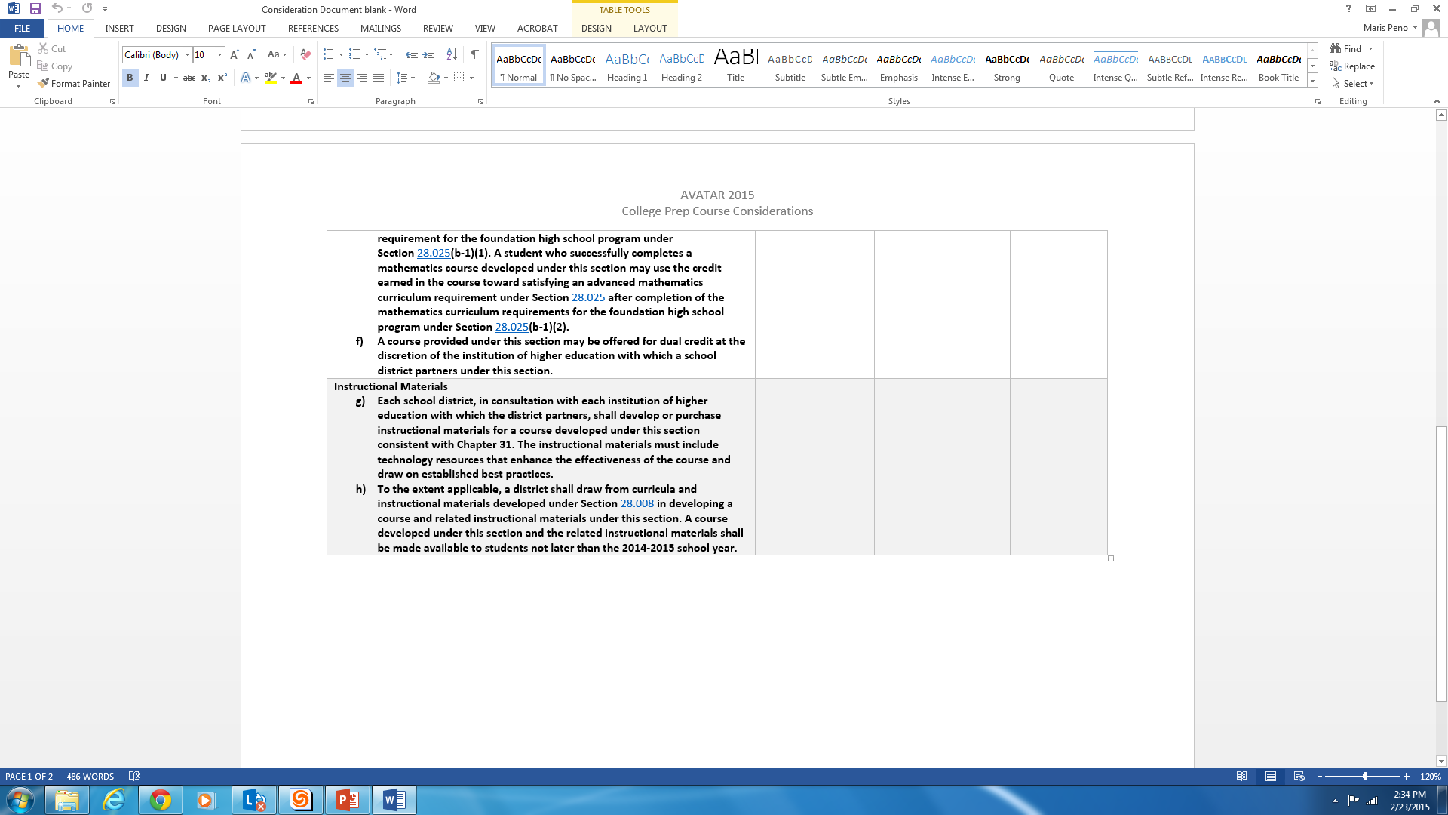
Dual Credit
Transcript
Course PEIMS Code
Graduation Program
Course Sequence
Dual Credit
Transcript
Course PEIMS Code
Consultation
Instructional Materials
Technology Resources
Develop or purchase
Instructional Material
Technology Resources
Aligned to learning outcomes
Big questions to begin…Group Discussions
ELA/MATH TEAMS - Develop from scratch or use a syllabus previously created?
ADMIN TEAM- One MOU/ Syllabus for all IHE/District partners or separate?

Slide 19
What’s Next?
Each Vertical Alignment Team will decide when they will meet.
  Best time for most Tuesday & Thursday 1:00-4:00pm
Meetings can be held anywhere ….Region 5 Conference Rooms are always open. (There will be snacks.)
Necessary Documents:
  Course Syllabus for Developmental Ed courses in ELA and Math
  Course Syllabus from other districts/IHEs – Sharing is caring.
  Curriculum Standards
  Critical Conversation Guide to use as a checklist

Slide 20

Steps toward AVATAR Outcomes
Facilitator Meeting 1
  Identify key leaders and educators who make up a regional “pipeline” needed for students to be college and career ready and successful
  Establish Understanding of the AVATAR Process
Facilitator Meeting 2
  Use regional data to guide decision-making
  Establish shared regional college and career readiness foundation and understanding of HB 5 College Prep Course Guidelines
  Design and implement a vertical alignment action plan which will include critical conversations around specific courses needed for students to make academic progress
VAT Meetings…Creating, Evaluating, Processing, Collaborating
Facilitator Meeting 3
  Design and implement a sustainability plan
http://untavatar.org

Slide 21

http://untavatar.org

