Slide 1
Region 5 ESC VAT
Beaumont ISD
Hardin-Jefferson ISD
Port Arthur ISD
Nederland ISD
Evolution Academy
Evadale ISD
Lamar University
Lamar State College – Orange
Lamar State College – Port Arthur
Lamar Institute of Technology

Slide 2
Overview
AVATAR: Academic Vertical Alignment
Training and Renewal

Slide 3
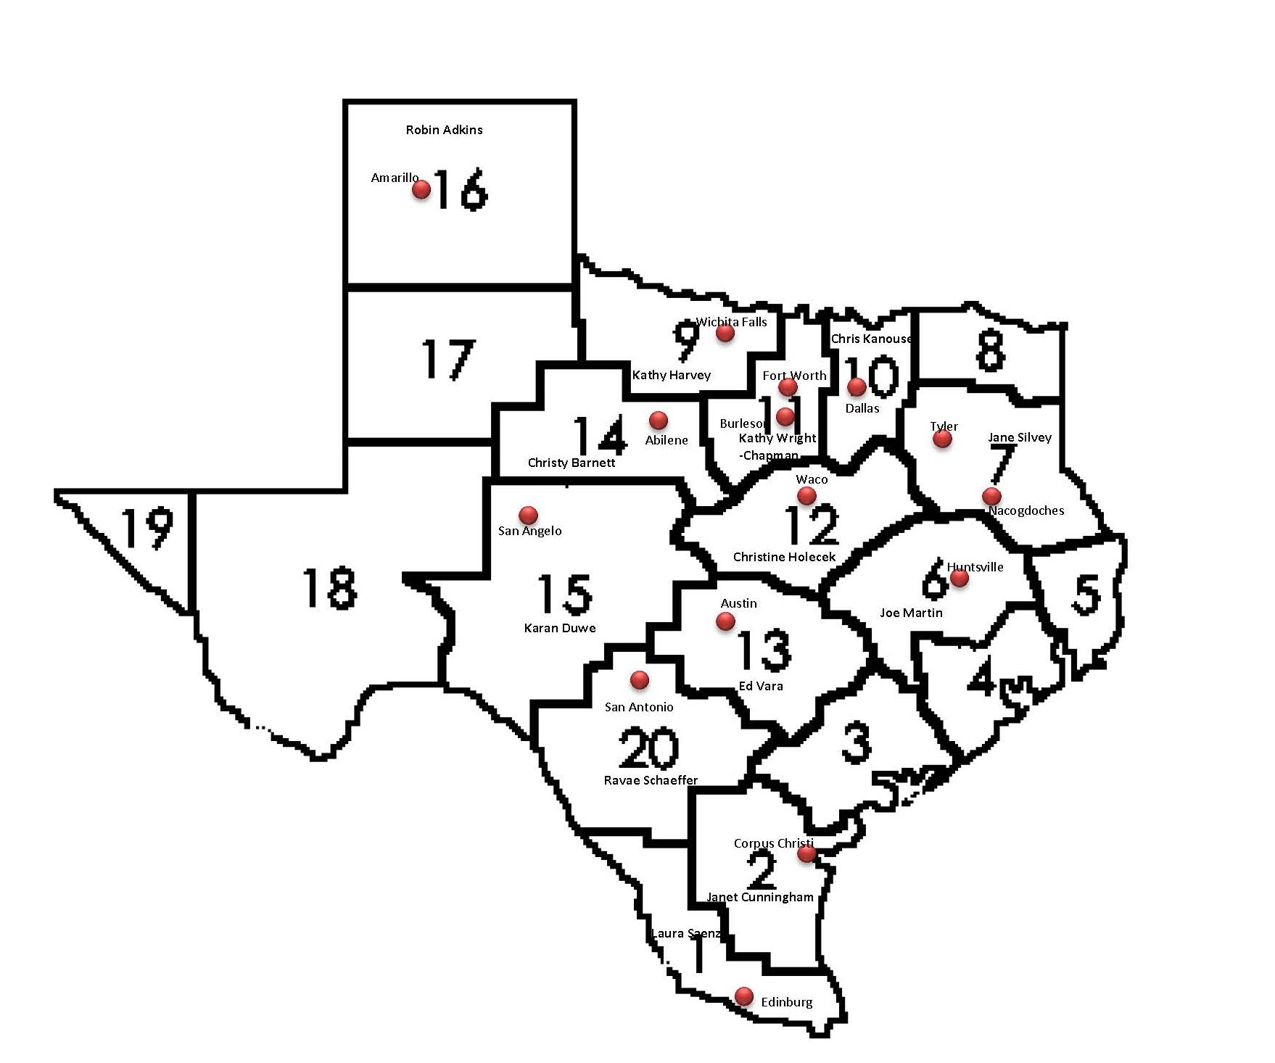
Statewide Regional Partnerships
http://untavatar.org
Notes:
Intro to the AVATAR process – How this came about..

Slide 4
Team Member Introductions
Introductions:
  What institution/campus do you represent?
  What is your role with students?
http://untavatar.org
Notes:
Introductions

Slide 5

Rationale & Purpose
http://untavatar.org

Slide 6
AVATAR Goals
Expand awareness of career and college readiness and vertical alignment.
Create regional vertical alignment initiatives.
Implement strategies to close regional academic course and expectation gaps.
Identify processes to assess and celebrate regional progress.
Share best practices statewide.
Notes:
Avatar Goals
Expand awareness of career and college readiness and vertical alignment.
Create regional vertical alignment initiatives.
Implement strategies to close regional academic course and expectation gaps.
Identify processes to assess and celebrate regional progress.
Share best practices statewide. – Upon completion of this project, our work will be posted as an example of what an alignment should look like.

Slide 7
AVATAR Rationale
The AVATAR Process is built on Critical Conversations between secondary and postsecondary leaders and educators. The conversation is structured and facilitated in order to achieve course vertical alignment in content, cross-disciplinary, and college preparatory skills.
http://untavatar.org
Notes:
The AVATAR Process is built on Critical Conversations between secondary and postsecondary leaders and educators. The conversation is structured and facilitated in order to achieve course vertical alignment in content, cross-disciplinary, and college preparatory skills.
It always helps to have a face to face meeting to collaborate on projects. The AVATAR Process just provides a flow to the communication

Slide 8

Benefits and Challenges of
VAT Membership

Slide 9
AVATAR Partner & Team Benefits
Regional Partners will
Team Members will
Collaborate across K-12 education, higher education, and with business and the community, as required by HB 5.
Take ownership for college and career readiness of a common group of students.
Build capacity to improve alignment of K-12 and college core curriculum.
Develop relationships with colleagues at other levels of education and in careers related to the discipline.
Apply principles of vertical alignment across K-12 and higher education in your discipline.
Lead professional development of colleagues in the partnership.
Help students make successful college and career transitions.

Slide 10
AVATAR Partner & Team Challenges
Regional Partners must
Team Members must
Maintain a vision of high standards for all students.
Recruit VAT members who are change agents, and attend to their recommendations.
Model collaboration across the partnership and within your own member organization.
Remain active in the VAT even when it is inconvenient.
Apply principles of vertical alignment in your own classroom first. (You will change your practice.)
Listen to other VAT members.
Focus on students and their learning.

Slide 11
The AVATAR Process
Creates and builds relationships through ongoing critical conversations
Uses regional data to make alignment decisions
Develops shared understanding of college and career readiness and success for students
Identifies and implements intentional actions
Evaluates, sustains, and shares vertical alignment work
http://untavatar.org

Slide 12
Our Focus – College Prep Courses (TEC Section 28.014)
Partnership:
  Each School district shall partner with at least one institution of higher education to develop and provide courses in college preparatory Mathematics and English Language Arts.
Course Design:
  The course mist be designed:
    (1) for students at the 12th grade level whose performance on:
      (A) an end of course assessment instrument required under section 39.023(c) does not meet college readiness standards
      (B) Coursework, a college entrance examination, or an assessment instrument designated under section 51.3062(c) indicates that the student is not ready to perform entry level college coursework; and
    (2) to prepare students for success in entry-level college courses. 28.014 (a)
Notes:
This team was formed to create college prep courses as described in Section 28.014 if the Texas Education Code. In this section, various pieces of college preparatory courses are discussed.
Partnership:
Each School district shall partner with at least one institution of higher education to develop and provide courses in college preparatory Mathematics and English Language Arts.
Course Design:
The course mist be designed:
(1) for students at the 12th grade level whose performance on:
(A) an end of course assessment instrument required under section 39.023(c) does not meet college readiness standards
(B) Coursework, a college entrance examination, or an assessment instrument designated under section 51.3062(c) indicates that the student is not ready to perform entry level college coursework; and
(2) to prepare students for success in entry-level college courses. 28.014 (a)
The text for this section and 51.3062 is in your folder

Slide 13
Our Focus - Continued
Method of Delivery
  A course developed under this section must be provided:
    (1) On the campus of the high school offering the course; or
    (2) through distance learning; or
    (3) as an online course provided through an institution of higher education with which the school district partners as provided by subsection (a) 28.014(b)
Staff
  Appropriate faculty of each high school offering courses under this section and appropriate faculty of each institution of higher education with which the school district partners shall meet regularly as necessary to ensure that each course is aligned with college readiness expectations. The commissioner of education, in coordination with the commissioner of higher education, may adopt rules to administer this subsection. 28.014(c)
Parent Notification
  Each district shall provide a notice to each district student to who subsection (a) applies and the student’s parent or guardian regarding the benefits of enrolling in a course under this section.
Notes:
Also discussed is the Method of Delivery for these courses, how they should
A course developed under this section must be provided:
(1) On the campus of the high school offering the course; or
(2) through distance learning; or
(3) as an online course provided through an institution of higher education with which the school district partners as provided by subsection (a) 28.014(b)
Staff
Appropriate faculty of each high school offering courses under this section and appropriate faculty of each institution of higher education with which the school district partners shall meet regularly as necessary to ensure that each course is aligned with college readiness expectations. The commissioner of education, in coordination with the commissioner of higher education, may adopt rules to administer this subsection. 28.014(c)
Parent Notification
Each district shall provide a notice to each district student to who subsection (a) applies and the student’s parent or guardian regarding the benefits of enrolling in a course under this section. Something to think about as we go thru this process… How will your district ensure this communication occurs.

Slide 14
Our Focus - Continued
Course Credit
  A student who successfully completes an English Language Arts course developed under this section may use the credit earned in the course toward satisfying the advanced English Language Arts curriculum requirement for the foundation high school program under Section 28.025 (b-1) (1).
  A student who successfully completes a mathematics course developed under this section may use the credit earned in the course toward satisfying an advanced mathematics curriculum requirement under Section 28.025 after completion of the mathematics curriculum requirements for the foundation high school program under Section 28.025 (b-1)(2).
  A course provided under this section may be offered for dual credit at the discretion of the institution of higher education with which a school district partners under this section. 28.014(g)
Notes:
There are many discussions to have regarding how these courses will be credited- under this section-
Students may use this college prep course to count for the advanced ELA or Advanced math curriculum requirement under section 28.025.
Whether or not the college prep course is offered as a dual credit option is based on the discretion of the institution of higher education

Slide 15
Our Focus - Continued
Instructional Materials
  Each school district , in consultation with each institution of higher education with which the district partners, shall develop or purchase instructional materials for a course developed under this section consistent with Chapter 31. The instructional materials must include technology resources that enhance the effectiveness of the course and draw on established best practices. 28.014 (g)
  To the extent applicable, a district shall draw from curricula and instructional materials developed under Section 28.008 in developing a course and related instructional materials under this section. A course developed under this section and the related instructional materials shall be made available to students not later than the 2014-2015 school year. 28.014(h)
Notes:
Regarding Instructional materials
Each school district , in consultation with each institution of higher education with which the district partners, shall develop or purchase instructional materials for a course developed under this section consistent with Chapter 31. The instructional materials must include technology resources that enhance the effectiveness of the course and draw on established best practices. 28.014 (g)
To the extent applicable, a district shall draw from curricula and instructional materials developed under Section 28.008 in developing a course and related instructional materials under this section. A course developed under this section and the related instructional materials shall be made available to students not later than the 2014-2015 school year. 28.014(h)
On this subject… There are a few questions to consider before we move on/…

Slide 16
Questions to consider…
Do we already have a framework for this?
Are we starting from the beginning or evaluating a course currently offered?
If we do have a framework:
  Are we offering it in any district presently?
  Have we evaluated the course?
Notes:
Do we already have a framework for these courses? Syllabus? MOU?
Are we starting from the beginning or evaluating a course currently offered?
If we do have a framework:
Are we offering it in any district presently?
Have we evaluated the course?
These questions need to be fully considered as we begin this project… Thoughts

Slide 17

Partners and Roles
“Never doubt that a small group of thoughtful,
committed people can change the world.”
Margaret Meade
Notes:
Let’s talk about the partners in this process and their role

Slide 18
High Schools
2 Year IHEs
Scaffolding
Student
Success
4 Year IHEs
Regional ESCs
Regional P-16
Councils
AVATAR is a Partnership of Regional Leaders From The Following Institutions
Notes:
The avatar team is made up of at least one 4 year, 2 year, isd, p-16 council…
We have 1 – 4 year; 3 2-years; 4 isds and a workforce group

Slide 19
AVATAR
Vertical Alignment Teams
Vertical Alignment Teams (VATs): Educators and leaders representing regional ISDs, two- and four-year institutions of higher education, P-16 councils, and ESCs are committed to addressing discipline specific course and instructional alignment needs to create environments where students can make successful transitions between and among regional educational systems.
http://untavatar.org
Notes:
It is all about transitions and success.

Slide 20
AVATAR Partners and Team Members…
Are committed to higher education access and success for all students
Understand content course knowledge and skills
Utilize research-based instructional strategies
Demonstrate strong communication and leadership skills
Are effective team players
Are flexible – able to deal with ambiguity
http://untavatar.org
Notes:
Characteristics of members are:
Are committed to higher education access and success for all students
Understand content course knowledge and skills
Utilize research-based instructional strategies
Demonstrate strong communication and leadership skills
Are effective team players
Are flexible – able to deal with ambiguity

Slide 21
Partnership Benefits
  Build capacity to improve alignment between regional secondary and postsecondary courses and curriculum
  Strengthen regional secondary and postsecondary commitment to and capacity for college preparedness and success for students
http://untavatar.org
Notes:
The benefits of a partnership like this
Build capacity to improve alignment between regional secondary and postsecondary courses and curriculum
Strengthen regional secondary and postsecondary commitment to and capacity for college preparedness and success for students

Slide 22
AVATAR Partners
Roles and Responsibilities
Education Service Center (ESC) or Others Who Serve as Facilitators/Coordinators
Convene a vertical alignment team (VAT)
Expand or create a regional shared college and career readiness foundation/understanding among the partnership and team
Support the P-16 council and the partnership in securing and reviewing their regional college and career readiness student data
Facilitate the vertical alignment critical conversations
Design and implement with the partnership their vertical alignment action plan
Notes:
My role as facilitator

Slide 23
AVATAR Partners
Roles and Responsibilities
Independent School District (ISD)
  Identify campus or district leaders to participate and support vertical alignment partnership and team
  Identify and support discipline specific teachers and leaders to participate in the vertical alignment process
  Review and discuss course and instructional practices based on the VAT’s work
  Expand and/or develop a campus or district vertical alignment plan for next academic year
http://untavatar.org
Notes:
ISD Role

Slide 24
AVATAR Partners
Roles and Responsibilities
Postsecondary Education: Two- and Four-Year Institutions of Higher Education
General/Core Education Leaders and Faculty
  Identify campus, system, or district level leaders who are responsible for core or general education courses to participate in and support the vertical alignment partnership and team
  Identify and support discipline specific faculty and leaders to participate in the vertical alignment process
  Develop or review course syllabi and based on the VAT’s study of vertical alignment
  Expand and/or develop a campus or district vertical alignment plan for the next academic year
http://untavatar.org
Notes:
IHE ROLE

Slide 25
AVATAR Partners
Roles and Responsibilities
P-16 Council
  Provide regional college and career readiness student data and prepare the regional data PowerPoint
  Serve as the recorder for the regional vertical alignment team and partnership
  Receive and respond to periodic reports on the progress of the partnership

Slide 26

Use of Data
http://untavatar.org

Slide 27
Sources of Data Used by VATs
The Texas Education Agency (TEA) produces annually a Texas Academic Performance Report (TAPR) for each campus, district, and region, and for the state. These reports provide student achievement and college readiness data by gender, ethnicity, and socioeconomic status.
The Texas Higher Education Coordinating Board (THECB) produces an annual profile for each public college. Data are available that show what colleges students attend by high school and how they perform as well as admission, transfer, performance, and completion data for each college.
See Handout…
http://untavatar.org
Notes:
Data is extremely important in the AVATAR Process. One of the first things they want facilitators to do is to design a team of professionals based on feeder patterns.
In a few minutes, we will discss what data is necessary to complete our purpose of developing college prep courses. But first… How did we get here? In our area, there is a very strong feeder pattern.

Slide 28
Notes:
It is very obvious where our students enroll. We are blessed to have a university system very close to home. In addition to feeder patterns…. What data do you think you will need to complete this process?

Slide 29
Thinking Ahead…
What kind of data do you need for this process?
Do you have access to this data?
Who can help you with this task?
Notes:
In your groups – discuss these questions… 15 minutes…
Someone take notes as we will discuss those items shortly

Slide 30

Group Logistics

Slide 31
Meeting Logistics
Meeting times
  Which time is best for you? AM? PM? After 4pm?
Who will keep records in our meeting?
  Volunteer for record keeper?
Communication:
  For direct communication with Group facilitator: Maris Peno
    Phone-(office) 409-951-1723; (cell) 409-658-6604
    Email-mpeno@esc5.net
  To post Group Communication: Google Groups
    ELA- VATRegion5ELA@esc5.net
    Math- VATRegion5MATH@esc5.net
Notes:
Discuss the next meeting time… am vs pm

Slide 32
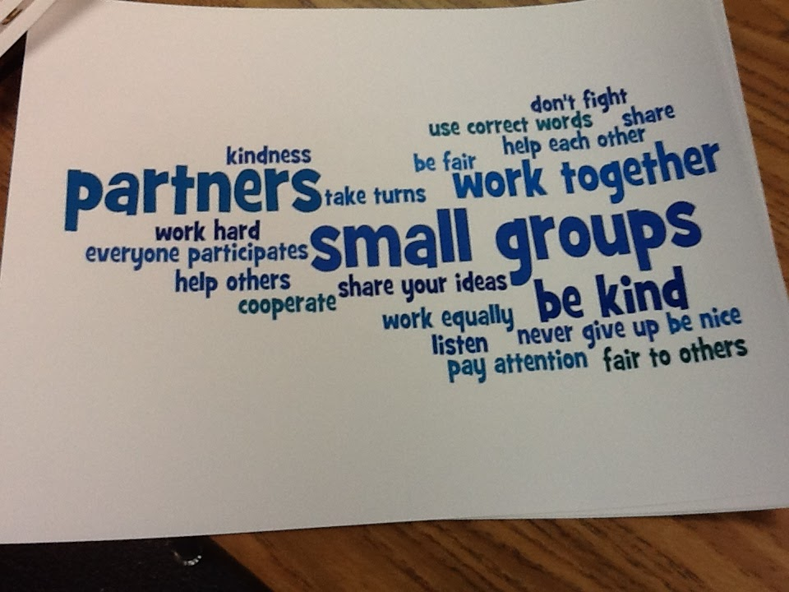
Group Norms

Slide 33
Norms
Norms encourage behaviors that will help a group do its work and discourage behaviors that interfere with a group’s effectiveness.
VATs cross the cultures of K-12 and higher education, which differ in their valuing of deliberation vs. efficiency and collaboration vs. individual achievement. Norms, along with good will, can help you work across cultures.

Slide 34
Functions of Norms
Standards or expectations by which individuals in a group have agreed to operate while working together
Maximize team productivity and effectiveness
Ensure individuals are respected
Place responsibility on individuals for expected behavior to build group community

Slide 35
Some Sample Norms
Begin and end the meeting on time.
Notify the leader if you must be late or absent.
Come prepared with assignments completed.
Assure that everyone has a change to speak without being interrupted. Set time limits if this is helpful.
As each meeting ends, plan for sharing with partnership leaders at your institution (Department chair, dean, provost, principal, counselor, as appropriate).
Notes:
Develop Norms in small groups – on large paper
Consolidate norms – put to a vote

Slide 36

Individual and Group
Responsibilities

Slide 37
What Is My Role as an AVATAR Partner or Team Member?
What knowledge can you contribute?
What skills can you bring to the group?

Slide 38
VATS draw on multiple knowledge bases. Which of these do you know well?
Knowledge of content and pedagogy in your discipline
Pedagogical content knowledge
Knowledge of resources and technology in your discipline
Knowledge of high school learners
Knowledge of college learners
Knowledge of instruction
Knowledge of state standards, the TEKS and/or the CCRS
Knowledge of state assessments, STAAR/EOC and/or the TSI
Knowledge of the state curriculum
Knowledge of college readiness
Knowledge of vertical alignment processes
Notes:
We talked about the role of each entity but what about you as an individual…
We all bring something different to the table- Think about the following knowledge bases… Which do you know well?

Slide 39
VATS draw on varied skills of members. Which are your strengths?
Facilitator
Deliberator
Inquirer
Summarizer
Connector
Organizer
Visualizer
Critic
Encourager
Do you focus on the big picture?
Do you see the relevance of details?
Do you have a good imagination?
Are you committed to social justice?
Can you imagine a future where all students teach their educational potentials?
Notes:
What skills do you have? Be mindful of these and step in when you are needed.

Slide 40
Items Your Group May Want to Think About:
Begin with the end in mind
  What do you want to achieve at each meeting?
Participate actively
  Ask questions
  Share experiences and insights
  Make connections
  Help each other
Tame the technology (Limit cell phone use, refrain from answering e-mails and surfing the web on laptops, iPad's, etc.)
Notes:
Before we break into groups for a few minutes…. A few things you may want to think about as a group….
Begin with the end in mind – what is our goal?
Be active in your participation – and be open and honest with each other
Be easy with the TECHNOLOGY! There is a time for it and I realize that we are all very busy but please respect the time of your group members.

Slide 41
Group by Subject
Answer the following questions:
  What is your knowledge base?
  What are your strengths?
  What barriers do you anticipate in this process? How might we overcome them?
Notes:
In addition to the other questions answered today….
Answer these questions…. On a large post it… list the barriers and methods to overcome – 20 minutes

Slide 42
Next Steps
Put the VAT meeting times on your calendar.
Complete any assignments given. (Slide 43)
Do you need any more team members to make this process more successful?
  Who can you recruit or appoint to be a part of this team?
Do you need partners who may be part of your feeder pattern but are missing from the table?

Slide 43
Assignments
Data needed to complete this process for your district or IHE
Familiarize yourself and your team with the text of TEC Section 28.014 and College Readiness Standards
Explore the Avatar Website – www.untavatar.org
  Select Files
  College Prep Courses
Gather any courses you would like to present to the group for consideration (ELA/MATH College Prep courses already developed)
Complete the College Prep Course Considerations form

Slide 44

Steps toward AVATAR Outcomes
Facilitator Meeting 1
  Identify key leaders and educators who make up a regional “pipeline” needed for students to be college and career ready and successful
  Establish Understanding of the AVATAR Process
Facilitator Meeting 2
  Use regional data to guide decision-making
  Establish shared regional college and career readiness foundation and understanding of HB 5 College Prep Course Guidelines
  Design and implement a vertical alignment action plan which will include critical conversations around specific courses needed for students to make academic progress
VAT Meetings…Creating, Evaluating, Processing, Collaborating
Facilitator Meeting 3
  Design and implement a sustainability plan
http://untavatar.org

