Slide 1
Rethinking Core
Mathematics through
Vertical Curriculum Alignment
Cisco College Core Curriculum Conference (C⁵)
May 15 – 17, 2013 Abilene, Texas
PRESENTERS:
Robin Adkins, ESC Region 16
Mary Harris, University of North Texas
Paul Johnson, Del Mar College
Jean Keller, University of North Texas
Gregg Lawler, West Texas A&M University
Ravae Shaeffer, ESC Region 20

Slide 2
Session Outcomes:
Gain awareness of vertical alignment guided by the Texas College and Career Readiness Standards as an important strategy to advance the success of students in learning mathematics.
Learn strategies used by teams of educators and stakeholders in assessing and improving the vertical alignment of courses and practices that affect students as they learn mathematics in secondary and postsecondary education.
Experience mathematics teaching strategies used by vertical alignment team members who are aligning mathematics courses in various regions of Texas.

Slide 3
  What, Why
  and How?
Jean Keller, AVATAR Co –Director
University of North Texas

Slide 4
What Is ?
AVATAR is a statewide network of regional partnerships, focused on secondary and postsecondary vertical alignment, to support students’ college and career readiness and success.
AVATAR is a Texas Higher Education Coordinating Board (THECB) funded project that is implemented by the North Texas Regional P-16 Council and the University of North Texas.

Slide 5
  Why is Needed?
Too many secondary and postsecondary leaders and educators lack shared and accurate information and understanding of what a student must know and do to be successful in postsecondary education and careers;
Too many students enter postsecondary education but do not complete in a timely fashion; and
Too many students take developmental education at the postsecondary level.

Slide 6




Graduation Rates
8th Grade Cohort
2001 - 2012
Received a Higher Education Degree or Certificate.
Graduated from High School…
69
19
2001
100
52
2012
Of 8th Graders Enrolled…
Enrolled in Higher Education…
Source: 2013 Texas Public Higher Education Almanac

Slide 7
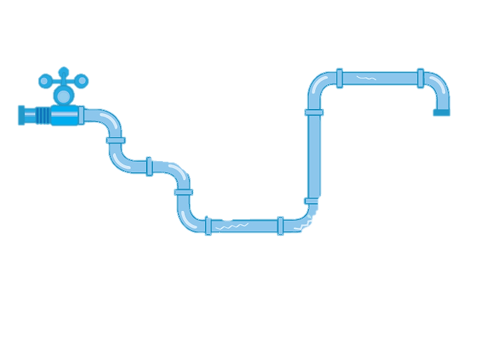
Texas Public 4 Year University Pipeline:
Fall 2005 Cohort
In 2011, No Longer Enrolled:
28 Full-Time
2 Part-Time
4 YEARS
Graduated by 2009:
27 Full-Time
0 Part-Time
In 2005, 100 Enroll:
96 Full-Time
4 Part-Time
6 YEARS
57
Graduated by 2011:
29 Full-Time
1 Part-Time
Out of every 100 students earn a degree
within 6 years
In 2011, Still
Enrolled:
12 Full-Time
1 Part-Time
PUBLIC UNIVERSITIES ENROLLMENT – 61,879
Data Retrieved from: 2013 Texas Public Higher Education Almanac

Slide 8
Texas Public 2 Year College Pipeline:
Fall 2005 Cohort
In 2011, No Longer Enrolled:
29 Full-Time
30 Part-Time
3 YEARS
Earned an Associate’s or Certificate by 2008:
6 Full-Time
3 Part-Time
4 - 6 YEARS
In 2005, 100 Enroll:
51 Full-Time
49 Part-Time
Earned an Associate’s or Certificate 2009-2011:
9 Full-Time
9 Part-Time
27
Out of every 100 students earn a degree
or certificate
within 6 years
In 2011, Still
Enrolled:
7 Full-Time
7 Part-Time
PUBLIC COLLEGE ENROLLMENT – 106,660
Data Retrieved from: 2013 Texas Public Higher Education Almanac

Slide 9
Educational Attainment
2013 Texas Public Higher Education Almanac
Texas
22.6%
6.5%
State Ranking
21st
44th
25th
17.7%
Some college, No degree
Associate’s Degree
Bachelor’s Degree
Source: 2013 Texas Public Higher Education Almanac

Slide 10
Students Needing Remediation
TWO-YEAR COLLEGE
FOUR-YEAR COLLEGE
51.0 %
Entering enrolled in remediation
22.5 %
Entering enrolled in remediation
Ethnicity | Two-Year Colleges
African-American | 67%
Latino | 59%
White | 43%
Other | 47%
Ethnicity | Four-Year Colleges
African-American | 45%
Latino | 34%
White | 13%
Other | 13%
Age | Two-Year Colleges
17-19 | 52%
20-24 | 51%
25+ | 48%
Age | Four-Year Colleges
17-19 | 22%
20-24 | 39%
25+ | 49%
Income | Two-Year Colleges
Low Income | 64%
Income | Four-Year Colleges
Low Income | 35%
Source: Remediation: Higher Education’s Bridge to Nowhere - Texas State Profile, Complete College America 2012

Slide 11
  How Does
Work?

Slide 12
Partnerships & Teams:
High Schools
2 Year IHEs
4 Year IHEs
Scaffolding
Student
Success
Regional ESCs
Regional P-16
Councils

Slide 13
Regional
Goals:
Establish a shared regional college and career readiness foundation and understandings.
Use regional data to guide decision-making.
Design and implement a vertical alignment action plan which includes critical conversations.
Design and implement a sustainability plan.

Slide 14

Partnerships & Teams:
Ravae Shaeffer

Slide 15
Project
Outcomes:
Enhance the success of students graduating college-ready from high schools and prepared for smooth transitions to postsecondary education with a significant decrease in the need for developmental education.
Ensure course descriptions, content learning outcomes, instructional strategies, and student and instructor expectations are aligned and communicated so that secondary students are prepared to enroll and succeed in postsecondary education at all levels.
Deliver secondary and postsecondary courses aligned to the Texas Essential Knowledge and Skills (TEKS), State of Texas Assessments of Academic Readiness (STAAR), End-of-Course (EOC) Assessments, and Texas College and Career Readiness Standards (CCRS) in Chemistry, English Language Arts, and Mathematics.
Develop materials and resources for faculty, administrators, Education Service Center personnel, and P-16 leaders to replicate the vertical alignment processes and activities statewide. http://www.ntp16.notlb.com/avatar

Slide 16
  Processes & Resources
Mary Harris, AVATAR Associate Director
University of North Texas

Slide 17
The Statewide Network
Mathematics
ESC 2, Citizens for Educational Excellence, TAMU-Corpus Christi, Del Mar College, & Calallen ISD.
ESC 9, Midwestern State University, Vernon College, Burkburnett ISD, Wichita Falls ISD, Iowa Park CISD, and Vernon ISD.
ESC 10, Dallas CCCD, Brookhaven College, & Dallas ISD.
ESC 14, Abilene Regional P-16 Council, Cisco College, Ranger College, Western Texas College, Abilene Christian University, McMurry University, Roscoe Collegiate ECHS, Albany ISD, Anson ISD, Clyde-Green Springs ISD, Cooper ISD, Merkel ISD, Wylie ISD, & Roscoe ISD.
ESC 16, Panhandle P-16 Council, West Texas A&M University, Amarillo College, Clarendon College, Frank Phillips College, Amarillo ISD, Borger ISD, & Canyon ISD.
Region 20, P16 Plus Council of Greater Bexar County, UT-San Antonio, San Antonio College, Palo Alto College, & Harlandale ISD.
English Language Arts
ESC 6, Sam Houston State University, Lone Star College System, Buffalo ISD, Magnolia ISD & Huntsville ISD.
ESC 9, Midwestern State University, Vernon College, Burkburnett ISD, Vernon ISD, Iowa Park CISD, & Wichita Falls ISD.
ESC 11, Hill College, & Burleson ISD.
ESC 12, McLennan Community College, Texas State Technical College, Waco ISD, La Vega ISD, Midway ISD, Robinson ISD, Reicher Catholic School, & Baylor University.
ESC 13, Austin Community College, Austin ISD, & St. Edwards University.
ESC 15, San Angelo P-16+ Partnership, Howard College, Angelo State University, Eden CISD, Wall ISD & San Angelo ISD.
Science
ESC 1, Upper Rio Grande Valley P-16, UT-Pan Am, South Texas College, & Pharr San Juan Alamo ISD.
ESC 10, UNT, Dallas CCCD, Brookhaven College, & Dallas ISD.
ESC 11, UNT, TCCD, & Fort Worth ISD.
Awareness
ESC 7, Stephen F. Austin University, Kilgore College, & Kilgore ISD.
Notes:
46

Slide 18
ROLES: AVATAR Partners and Teams
Are committed to higher education access and success for all students
Understand content course knowledge and skills
Utilize research-based instructional strategies
Demonstrate strong communication and leadership skills
Are effective team players
Are flexible – able to deal with ambiguity

Slide 19
AVATAR Partners
Roles and Responsibilities
Postsecondary Education: Two- and Four-Year Institutions of Higher Education
General/Core Education Leaders and Faculty
  Identify campus, system, or district level leaders who are responsible for core or general education courses to participate and support the vertical alignment partnership and team
  Identify and support discipline specific faculty and leaders to participate in the vertical alignment process
  Review course syllabi and explore shared reference course profiles based on the VAT’s work
  Expand and/or develop a campus or district vertical alignment plan for 2013 - 2014

Slide 20
Module 2
AVATAR Common Foundations: Understanding College and Career Readiness and Success
http://www.ntp16.notlb.com/avatar

Slide 21



Creating a College Ready Student
College and Career Ready: Helping all Students
Succeed Beyond High School
by David T. Conley, 2010
Participants will:
        Read the abstract
        Discuss the seven principles, utilizing the STEPS project discussion document
Discussion Document Available on AVATAR site: http://www.ntp16.notlb.com/avatar/files/resources and the seven principles are discussed in more detail in PowerPoint of Conley’s at https://epiconline.org/files/pdf/20110228_ASU.pdf

Slide 22
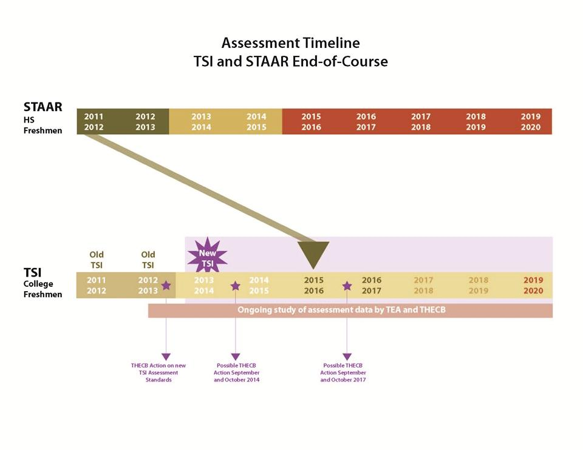
The Connection:
STAAR and TSI Implementation

Slide 23
As You Examine the Data, Please Consider:
To what extent do local students progress from high school to college?
Are there differences by discipline in college readiness?
How does student readiness for college vary by ethnicity? What factors contribute to the gaps?
What colleges do local students attend?
To what extent do local students take advantage of college readiness programs (AP/IB, dual credit, core completion)?
How does developmental education influence college readiness and success locally?
How do local students fare when they transfer to other institutions?

Slide 24
Module 3
AVATAR Teams:
Aligning Courses Through
Critical Conversations
http://www.ntp16.notlb.com/avatar

Slide 25
This Module Discusses…
College and Career Readiness Standards:
Content and Cross-Disciplinary Standards
Texas University Common Core Curriculum
Texas Academic Course Guide Manual (ACGM)
Reference Course Profiles:
Definition, Examples, Purpose, and Process
Assessments at Secondary and Postsecondary Levels

Slide 26
Mapping Texas Core Curriculum Objectives to Component Areas
Foundational Component Area | Critical Thinking | Communication Skills | Empirical & Quantitative Skills | Teamwork | Social Responsibility | Personal Responsibility
Communication 6 SCH | X | X | OPTIONAL | X | OPTIONAL | X
Mathematics 3 SCH | X | X | X | OPTIONAL | OPTIONAL | OPTIONAL
Life & Physical Sciences 6 SCH | X | X | X | X | OPTIONAL | OPTIONAL
Language, Philosophy, & Culture 3 SCH | X | X | OPTIONAL | OPTIONAL | X | X
Creative Arts 3 SCH | X | X | OPTIONAL | X | X | OPTIONAL
Source: Texas Higher Education Coordinating Board (2011) Revising the State Core Curriculum: A Focus on 21st Century Competencies. Retrieved from: www.thecb.state.tx.us/index.cfm?objectid=6EA8957A-D7E2-C369-67F42EC166BC88FC

Slide 27
Texas Academic Course Guide Manual
(ACGM)
What is it?
  official list of Texas approved courses for general academic transfer
  http://www.thecb.state.tx.us/acgm
How is it organized?
  alphabetic and with number by Texas Common Course Numbering System (TCCNS)
  Title, common course prefix, course number, description, approval number, CIP area, maximum semester credit hours per student, maximum course contact hours, and learning outcomes
Source: Lower Division Academic course Guide Manual (2012)
Retrieved from: http://www.thecb.state.tx.us/acgm

Slide 28
ACGM: Example Entry
MATH 1314 College Algebra (3 SCH version)
MATH 1314 College Algebra (4 SCH version)
In-depth study and applications of polynomial, rational, radical, exponential and logarithmic functions, and systems of equations using matrices. Additional topics such as sequences, series, probability, and conics may be included
Approval Number ...................................................................................... 27.0101.54 19
CIP Area ...................................................................................................... Mathematics
maximum SCH per student ............................................................................................. 4
maximum SCH per course ................................................................................................4
maximum contact hours per course ............................................................................. 64
Learning Outcomes
Upon successful completion of this course, students will:
1. Demonstrate and apply knowledge of properties of functions, including domain and range, operations, compositions, and inverses.
2. Recognize and apply polynomial, rational, radical, exponential and logarithmic functions and solve related equations.
3. Apply graphing techniques.
4. Evaluate all roots of higher degree polynomial and rational functions.
5. Recognize, solve and apply systems of linear equations using matrices.
Source: Lower Division Academic Course Guide Manual (2012)
Retrieved from: www.thecb.state.tx.us/AAR/UndergraduateEd/WorkforceEd/acgm.htm - 4k - 2012-02-14

Slide 29


AVATAR Course Profiles:
What to Include?
ACGM* and Institution’s Course Description
Hours of Credit
Prerequisites & Co-requisites
Prior Knowledge & Expectations Related CCRS
Student Learning Outcomes
Course Policies, Expectations, & Practices
Course Assignments & Assessments Descriptions
Grading Practices (grading rubrics)
Course Texts & Required Materials
Methods of Instruction
Class Schedule
Student, Class, & Campus Learning Resources
Sample Exams, Assignments, & Schedules
Instructor Information
*ACGM: Academic Course Guide Manual

Slide 30
  From a Regional Perspective
Robin Adkins, Facilitator/Coordinator
P-16 Specialist, ESC Region 16

Slide 31
AVATAR from a Regional Perspective
Robin Adkins, Facilitator Coordinator Region 16 Amarillo
Notes:
--I’ll share with you:
-How Region 16’s team was selected
-Resources we have utilized
-Our current and future plans

Slide 32
ESC Region 16

Slide 33
Selecting a Vertical Alignment Team
Original Team Consisted of:
    Two Higher Education Math Faculty
    One High School Math Teacher
    One ESC Instructional Services Director
    One ESC/P-16 Specialist
Notes:
--The project looked like it would line up with our P16 Council’s current vertical alignment efforts.
--The Executive Committee of the Texas Panhandle P16 Council OK’ed and directed that our project focus on math as our region’s greatest need.
--Original team members were recruited based upon established relationships from P16 work.

Slide 34
Selecting a Vertical Alignment Team (cont)
One team member represented the second-largest high school in the region
HOWEVER…
The student demographics and academic performance of that high school would not be representative of high schools in the region
SO…
We planned to include data from all high schools in the region in an effort to promote buy-in for the project from regional schools

Slide 35
Selecting a Vertical Alignment Team (cont)
BUT…
We realized very quickly that the data
would be overwhelming
ALSO…
While the HS represented on the team fed the four-year IHE represented, no students from that HS went to the two-year IHE represented

Slide 36
Selecting a Vertical Alignment Team (cont)
There are 4 IHEs in the region:
    West Texas A&M University (4-year)
    Amarillo College (2-year)
    Clarendon College (2-year)
    Frank Phillips College (2-year)
Notes:
--The other two IHEs were very willing to participate because of previously established relationships through our P16 work.

Slide 37
Selecting a Vertical Alignment Team (cont)
Three of the region’s larger high schools feeding the IHEs chose to participate:
            Amarillo HS
            Borger HS
            Canyon HS
Notes:
--These high schools were asked to participate because of the feeder patterns from them to IHEs: both two-year and four-year.
--ESC-established relationships helped bring these HSs into the project.

Slide 38
Selecting a Vertical Alignment Team (cont)
Team now consists of:
      Four Higher Education Math Faculty
      Three HS Math Teachers
      One ESC Instructional Services Director
      One ESC/P-16 Specialist
Notes:
Summarizing selection of team:
--The composition of our team “evolved.”
--If you are starting a team from scratch, I suggest:
1. Base the project’s focus on academic need from your data.
2. Build upon existing relationships.
3. Recruit IHE’s and HS’s based upon feeder patterns. [For us, this provided relevance and the data was manageable.]

Slide 39
Resources
--Regional Academic Performance
--AVATAR Training Modules
--Data was “Eye-opening”
Notes:
--Use regional academic performance to establish your project’s focus (public schools’ and higher educations’).
--Use AVATAR Training Modules to reinforce the need for curriculum alignment and provide existing research RE college readiness.
--Gregg Lawler will go into greater detail RE other resources our team reviewed and discussed:
-Our IHE partners provided data on HS partners’ graduates:
Numbers of students who enroll in developmental math classes and their outcomes: drops, completers, grades earned.
Numbers of students who enroll in College Algebra classes and their outcomes: drops, completers, grades earned.
A high school teacher said this data was “eye-opening” to her and her colleagues.
-College Syllabi
-College and High School textbooks
-College test review materials
-High School six weeks and semester tests

Slide 40
Current & Future Plans
--Use of Math Journals in “Demo Projects” this spring
--Refine the model and share in summer professional development
--Expand the team and possibly, its focus
Notes:
--Gregg Lawler will discuss these plans in greater detail.
--We’ll look at collaborating with our existing P16 Content Coordinators to possibly apply lessons learned in math work to science, ELA, and social studies.

Slide 41
SELECTING A VERTICAL ALIGNMENT TEAM
Amarillo, Canyon, & Borger ISDs
Amarillo, Clarendon, & Frank Phillips Colleges
West Texas A&M University
Region 16:
Scaffolding
Student
Success
Region 16 ESC
Panhandle P-16
Council
Please Note:
Amarillo High School is in Potter County
Amarillo College is in Potter County
Borger High School is in Hutchinson County
Frank Phillips College is in Hutchinson County
Canyon High School is in Randall County
West Texas A&M University is in Randall County
Clarendon College is in Gray County

Slide 42
  Mathematical Practices
  from AVATAR Partners
Paul Johnson, Del Mar College

Slide 43
  Mathematical Practices
  from AVATAR Partners
Gregg Lawler, West Texas A&M University

Slide 44
Mathematics Practices from Region 16
Mathematics Journal for Algebra II Students
Faculty Exchanges

Slide 45
Math Journals for Algebra II
Evolution of the Math Journal
Topics for Journal
Journal Design
Initial Trials
Future Plans

Slide 46
Evolution of Math Journal
Team narrowed focus of high school mathematics courses to Algebra II and Pre-Calculus
Focused on College Algebra and Pre-Calculus for higher-education
Reviewed textbooks and syllabi of college algebra courses offered at the regional colleges and university

Slide 47
Evolution of Math Journal
Also reviewed exams from College Algebra and Pre-Calculus courses
Wanted something that Algebra II teachers could use at the end of the semester

Slide 48
Topics for Math Journals
Region 16 AVATAR team created list of topics from Algebra II that students need to know to be successful in College Algebra
Also incorporating a set of “soft” skills needed to succeed in college courses

Slide 49
Journal Design
Customizable cover
Modular design
Page layout
  Example problems with room to work
  Space for notes

Slide 50
First Trials
Tammy Nash
  Amarillo High School
  Algebra II/Pre-calculus classroom
Beth Summers
  Frank Phillips College
  Intermediate algebra section

Slide 51
Future Plans for Math Journals
Continued revision of journal
Possible panel sessions with Algebra II/College Algebra teachers during summer
Rollout of full draft during fall semester
  Algebra II courses
  Developmental math courses at IHE

Slide 52
Future Plans for Math Journals
Tracking student use of journals
  During year
  Longitudinal study
Sharing final product with other regions/school districts

Slide 53
Faculty Exchanges
Goal: implement exchanges during Fall 2013 semester
Exchanges with Algebra II and College Algebra faculty and with Pre-calculus faculty

Slide 54
  Mathematical Practices
  from AVATAR Partners
Ravae Shaeffer, ESC Region 20

Slide 55
Harlandale
ISD
San Antonio &
Palo Alto Colleges
University of Texas at
San Antonio
Region 20:
Scaffolding
Student
Success
Region 20 ESC
P-16+ of Greater
Bexar County

Slide 56
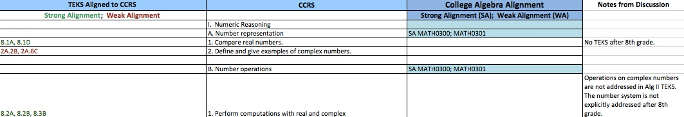
College and Career Readiness Standards
College Algebra
Grade 8-Algebra II TEKS
CCRS Alignment
Notes:
Process of alignment with CCRS led to critical conversations about instruction, grading practices, individual teacher expectations vs. professors’ expectations, student reading deficiencies, testing, test makeup, etc.

Slide 57
Critical Conversations
Secondary
Post-Secondary
Graduate College/Career Ready
Graduate Career Ready
Student Success Assessments
Dual Credit, Early College High Schools
Student Support Services
Educational Policies and Practices
Classroom Instruction, Textbooks,
Grading, etc.
Discipline Specific Course
Curriculum
Texas Essential Knowledge
and Skills
Impact of Developmental Education and
Texas Success Initiative
Dual Credit, Early College High Schools
Student Support Services
Educational Policies and Practices
Classroom Instruction, Textbooks
Grading, etc.
Discipline Reference Course
Profiles
College & Career Readiness
Standards

Slide 58
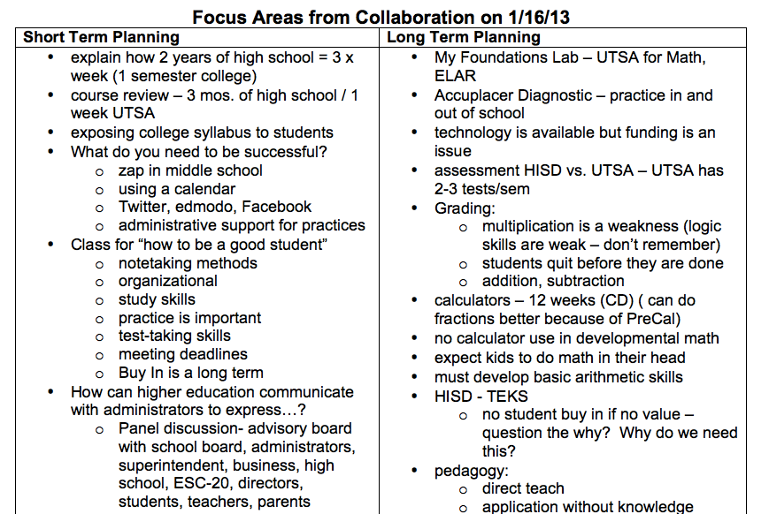
Notes:
Brainstorming about College Readiness in the district vs college readiness at ACCD & UTSA
Explain some of the long term and short term ideas on the page
Transition to next slide = focus areas based on district strategy discussion

Slide 59
Vertical Alignment Team
Year 1 Critical Conversations = Year 2 Product Outcomes
Secondary Math teachers & district specialist
Secondary English Language Arts & Reading teachers & specialist
Postsecondary Math Professors – UTSA & ACCD
P16+ of Bexar County
UTSA P-20 Initiatives
ESC-20 Coordinator
College Readiness Survey
Literacy Support Guide for Math Teachers
Professional Development Training for AVATAR in Region 20
Notes:
During discussions about CCRS alignment, professors and teachers realized that in order to change the culture of expectation for students in their district, they would need to make parents more aware of changes to grading policies, grading practices, and student work/expectations. The VAT determined that a survey of college readiness would give them more information about all stakeholders’ understanding of CCRS and the potential for change in the district. It would also allow the VAT to make recommendations to the C&I department, the Board, and the K-12 system for real change in the district.
Our ELAR teachers and specialist supported the math teachers and professors during critical conversations – leading to discussion about the true nature of the difficulties for students. As math teachers explained student difficulties, ELAR team identified decoding issues, vocabulary deficiencies, and writing/speaking deficiencies. ELAR team focused on a literacy support guide for math teachers.
In sharing AVATAR practices around the region – by P-16+, UTSA P-20 Initiatives, and ESC-20 – more districts inquired about setting up the VAT structures for their own teachers. Coordinators determined that a professional development sharing to support other structures in the region could support the P-16 pipeline in the region.

Slide 60
Discussion & Questions
http://www.ntp16.notlb.com/avatar

