Slide 1
Module 3
AVATAR Teams:
Aligning Courses Through
Critical Conversations
http://www.ntp16.notlb.com/avatar

Slide 2
RGV Pathways
What Are the RGV Pathways Project Goals?
To improve access to, analysis of, and use of data to inform decision-making at secondary and postsecondary levels
To create sustainable collaboration between secondary and postsecondary educators and institutions through face-to-face, subject-specific, vertical teams
To expedite successful student transitions from secondary institutions to and through postsecondary institutions.

Slide 3
Let’s Review Why Vertical Alignment is Needed.

Slide 4

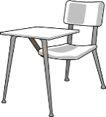
Reducing the Need for
Developmental Education
Through Course Vertical Alignment
51% of those entering a
2-year college enrolled in remediation.
Of those students…
30% completed the remediation
14.3% completed the remediation and associated college-level courses in 2 years
5.8% graduated within three years
22.5% of those entering a 4-year college enrolled in remediation.
Of those students…
49.2% completed the remediation
32.1% completed the remediation and associated college-level courses in 2 years
29.6% graduated within six years
Source: Complete College America/Alliance of the States 2011 Texas State Remediation Report
Retrieved from: http://www.completecollege.org/state_data/

Slide 5
Improving Retention Rates
Through Course Vertical Alignment
Source: Complete College America/Alliance of the States 2011 Texas Report
Retrieved from: http://www.completecollege.org/state_data/

Slide 6
What is the Impact of
Vertical Alignment?
Students are better prepared for their postsecondary courses.
Students will spend less time taking developmental education.
More students will graduate in a shorter period of time.

Slide 7
Student Achievement Is a Product of
Rigor and Relevance.
Student Achievement
Rigorous and Relevant
Standards
Rigorous and Relevant Curriculum
Rigorous and Relevant
Assessment
Rigorous and Relevant Instruction
Source: Daggett, W. R. (2005) Achieving Academic Excellence through Rigor and Relevance. International Center for Leadership Education. Retrieved from: http://www.leadered.com/pdf/academic_excellence.pdf

Slide 8
This Module Discusses…
TEKS – Texas Essential Knowledge and Skills
College and Career Readiness Standards:
Content and Cross-Disciplinary Standards
THECB Common Core Curriculum
Texas Academic Course Guide Manual (ACGM)
Reference Course Profiles:
Definition, Examples, Purpose, and Process
Assessments at Secondary and Postsecondary Levels

Slide 9
The AVATAR Process is built on Critical Conversations between secondary and postsecondary leaders and educators. The conversation is structured and facilitated in order to achieve course vertical alignment in content and cross-disciplinary skills.

Slide 10
Critical Conversations
Secondary
Post-Secondary
Graduate College/Career Ready
Graduate Career Ready
Student Success Assessments
Dual Credit, Early College High Schools
Student Support Services
Educational Policies and Practices
Classroom Instruction, Textbooks,
Grading, etc.
Discipline Specific Course
Curriculum
Texas Essential Knowledge
and Skills
Impact of Developmental Education and
Texas Success Initiative
Dual Credit, Early College High Schools
Student Support Services
Educational Policies and Practices
Classroom Instruction, Textbooks
Grading, etc.
Discipline Reference Course
Profiles
College & Career Readiness
Standards

Slide 11
Critical Conversations
Vertical team Critical Conversations may begin at any place on the pyramid.
Each region may move along the pyramid in different ways.
A good place to start is building foundational knowledge of the College and Career Readiness Standards and understanding their alignment with the TEKS.
Sdfsdfsdfsdfs
sdfsdfsdfsdf
CCRS

Slide 12
Texas Essential Knowledge and Skills
Sec. 28.001.
PURPOSE. It is the intent of the legislature that the essential knowledge and skills developed by the State Board of Education under this subchapter shall require all students to demonstrate the knowledge and skills necessary to read, write, compute, problem solve, think critically, apply technology, and communicate across all subject areas. The essential knowledge and skills shall also prepare and enable all students to continue to learn in postsecondary educational, training, or employment settings.
74th Legislative Session (1995)

Slide 13
What are the TEKS?
They are state-mandated learning standards for students from elementary through high school in the state of Texas; what students should and be able to do in each subject area.
Why were the TEKS created?
Prior to the creation of the TEKS, Essential Elements were used. More specific and clear guidelines were needed so teachers are knowledgeable about what to teach and assess.
Who developed the TEKS?
Groups of teachers, administrators, parents, business people, and members of the general public made up the subject-specific TEKS writing teams.
Source: Mathematics & Science TEKS Toolkit, Charles A. Dana Center at University of Texas
http://www.utdanacenter.org/

Slide 14
What is College and Career Readiness?
College and career readiness can be defined as the level of preparation necessary for students to:
  enroll and succeed, without remediation, in entry-level, college credit bearing, general education courses.
  apply basic knowledge and skills, such as critical thinking and problem solving, to concrete situations in order to function in the postsecondary setting and/or workplace.
Source: Association for Career and Technical Education & David Conley “Redefining College Readiness”, as cited in Texas College & Career Readiness Center, 2012)

Slide 15

Let’s Review Together:
College and Career Readiness Standards
Link:
http://www.thecb.state.tx.us/index.cfm?objectid=EADF962E-0E3E-DA80-BAAD2496062F3CD8

Slide 16
TEXAS CCRS
College and Career Readiness Standards
CCRS mandated by House Bill 1 (HB1)
Texas Education Agency (TEA) and Texas Higher Education Coordinating Board (THECB) convened vertical teams to develop the standards
There is strong alignment between the Texas Essential Knowledge and Skills and the CCRS
Sponsored by both Texas Education Agency (TEA) and the Texas Higher Education Coordinating Board (THECB)
TIMELINE
2008-2011
Validation study by EPIC to compare CCRS to general education and technical education courses
May 2014
Review of STAAR performance
standards
October 2007
Presented to THECB
January 2008
Adopted by THECB
May 2006
HB1 mandating development of standards
October to December 2007
Public Comment Period
April 2008
Sent to Commissioner of Education and State Board of Education for incorporation to the TEKS
February-May 2012
Convening of committees to establish, approve, and implement STAAR performance standards
Source: Texas College & Career Readiness Center, 2012

Slide 17
TEXAS CCRS
College and Career Readiness Standards
Represent a full range of knowledge and skills that students need to succeed in college and careers.
Emphasize the content of courses.
Introduce disciplinary structures to familiarize students with key concepts and content in each of the core academic areas.
Include a set of cross-disciplinary standards that apply to specific and all content courses.
Source: Texas College & Career Readiness Center, 2012

Slide 18
TEXAS CCRS
College and Career Readiness Standards
The CCRS differ from high school graduation standards by emphasizing content and cross-disciplinary standards to determine readiness instead of mastery of skills and knowledge.
The content standards stimulate students’ deeper levels of thinking and concentrate on foundational skills in reading, writing, research, data use, and technology.
The cross-disciplinary standards focus on intellectual curiosity, problem solving, academic behaviors, work habits, and academic integrity.
Source: Texas College & Career Readiness Standards, Introduction

Slide 19
TEXAS CCRS
College and Career Readiness Standards
Source: Conley, D. T. (2007). Redefining college readiness. Eugene, OR: Educational Policy Improvement Center.
epiconline.org

Slide 20
TEXAS CCRS
College and Career Readiness Standards
Cross-Disciplinary Standards
Skills Required
Key Cognitive Skills Foundational Skills
Intellectual Curiosity Reading Across the Curriculum Reasoning Writing Across the Curriculum
Problem Solving Research Across the Curriculum
Academic Behaviors Use of Data
Work Habits Technology
Academic Integrity
Source: Texas College & Career Readiness Center, 2012

Slide 21
Texas University Common
Core Curriculum
Why Change It?
  The curriculum needs to reflect current and future demands of students at the college level and in the workplace.
  It represents a change from the belief of core as “basics” or just needed courses to a set of essential college level skills and knowledge to be learned in a variety of disciplines.
Purpose:
  “Through the core curriculum, students will gain a foundation of knowledge of human cultures and the physical and natural worlds; develop principles of personal and social responsibility for living in a diverse world, and advance intellectual and practical skills that are essential for all learning” (THECB, 2011)
Source: The Core Curriculum: A Focus on 21st Competencies Webinar (04/11/2012) and Report to UEAC
Available at: http://www.thecb.state.tx.us/index.cfm?objectid=6AB82E4B-C31F-E344-C78E3688524B44FB
and www.thecb.state.tx.us/index.cfm?objectid=6EA8957A-D7E2-C369-67F42EC166BC88FC

Slide 22
What will the Texas Common
Core Curriculum Achieve?
Six Core Objectives
Critical Thinking Skills: to include creative thinking, innovation, inquiry, and analysis, evaluation, and synthesis of information
Communication Skills: to include effective development, interpretation and expression of ideas through written, oral, and visual communication
Empirical & Quantitative Skills: to include the manipulation and analysis of numerical data or observable facts resulting in informed conclusions
Teamwork: to include the ability to consider different points of view and to work effectively with others to support a shared purpose or goal
Personal Responsibility: to include the ability to connect choices, actions, and consequences to ethical decision-making
Social Responsibility: to include intercultural competence, knowledge of civic responsibility, and the ability to engage effectively in regional, national , and global communities
Source: The Core Curriculum: A Focus on 21st Competencies Webinar (04/11/2012)
Available at: http://www.thecb.state.tx.us/index.cfm?objectid=6AB82E4B-C31F-E344-C78E3688524B44FB

Slide 23
Connections:
New Common Core Curriculum &
Cross-Disciplinary CCRS
Texas Common Core Objectives
Critical Thinking Skills
Communication Skills
Empirical & Quantitative Skills
Teamwork
Personal Responsibility
Social Responsibility
Cross-Disciplinary CCRS Skills
Key Cognitive Skills: intellectual curiosity, reasoning, problem solving, academic behaviors, work habits, academic integrity
Foundational Skills: reading across the curriculum, writing across the curriculum, research across the curriculum, use of data, technology
What do you notice in the two lists?

Slide 24
How Is the University Common
Core Curriculum Structured?
Eight Foundational Component Areas
  Communication
  Mathematics
  Life and Physical Sciences
  Language, Philosophy, & Culture
  Creative Arts
  American History
  Government/Political Science
  Social/Behavioral Science
Source: The Core Curriculum: A Focus on 21st Competencies Webinar (04/11/2012)
Available at: http://www.thecb.state.tx.us/index.cfm?objectid=6AB82E4B-C31F-E344-C78E3688524B44FB

Slide 25
Connections:
Texas Common Core Component &
Cross-Disciplinary CCRS Content Areas
University Core Component Areas
Communication
Mathematics
Life & Physical Sciences
Language, Philosophy, & Culture
Creative Arts
American History
Government/Political Science
Social & Behavioral Sciences
CCRS Content Areas
English/Language Arts
Social Sciences
Mathematics
Science
What do you notice in the two lists?

Slide 26
Mapping Texas Core Curriculum Objectives to Component Areas
Foundational Component Area | Critical Thinking | Communication Skills | Empirical & Quantitative Skills | Teamwork | Social Responsibility | Personal Responsibility
Communication 6 SCH | X | X | OPTIONAL | X | OPTIONAL | X
Mathematics 3 SCH | X | X | X | OPTIONAL | OPTIONAL | OPTIONAL
Life & Physical Sciences 6 SCH | X | X | X | X | OPTIONAL | OPTIONAL
Language, Philosophy, & Culture 3 SCH | X | X | OPTIONAL | OPTIONAL | X | X
Creative Arts 3 SCH | X | X | OPTIONAL | X | X | OPTIONAL
Source: Texas Higher Education Coordinating Board (2011) Revising the State Core Curriculum: A Focus on 21st Century Competencies. Retrieved from: www.thecb.state.tx.us/index.cfm?objectid=6EA8957A-D7E2-C369-67F42EC166BC88FC

Slide 27
Mapping Texas Core Curriculum Objectives to Component Areas
Foundational Component Area | Critical Thinking | Communication Skills | Empirical & Quantitative Skills | Teamwork | Social Responsibility | Personal Responsibility
American History 6 SCH | X | X | OPTIONAL | OPTIONAL | X | X
Government/ Political Science 6 SCH | X | X | OPTIONAL | OPTIONAL | X | X
Social/Behavioral Science 3 SCH | X | X | X | OPTIONAL | X | OPTIONAL
Component Area Option 6 SCH | OPTIONAL | OPTIONAL | OPTIONAL | OPTIONAL | OPTIONAL | OPTIONAL
Source: Texas Higher Education Coordinating Board (2011) Revising the State Core Curriculum: A Focus on 21st Century Competencies. Retrieved from: www.thecb.state.tx.us/index.cfm?objectid=6EA8957A-D7E2-C369-67F42EC166BC88FC

Slide 28
Texas Academic Course Guide Manual
(ACGM)
What is it?
  official list of Texas approved courses for general academic transfer
  http://www.thecb.state.tx.us/acgm
How is it organized?
  alphabetic and with number by Texas Common Course Numbering System (TCCNS)
  Title, common course prefix, course number, description, approval number, CIP area, maximum semester credit hours per student, maximum course contact hours, and learning outcomes
Source: Lower Division Academic course Guide Manual (2012)
Retrieved from: http://www.thecb.state.tx.us/acgm

Slide 29
ACGM: Example Entry
CHEM 1112 General Chemistry II (Lab)
Basic laboratory experiments supporting theoretical principles presented in CHEM 1312; introduction of the scientific method, experimental design, chemical instrumentation, data collection and analysis, and preparation of laboratory reports.
Co-requisite: CHEM 1312—General Chemistry II
Approval Number ...................................................................................... 40.0501.56 03
CIP Area .............................................................................................. Physical Sciences
maximum SCH per student ........................................................................................... 1
maximum SCH per course ............................................................................................ 1
maximum contact hours per course ............................................................................. 48
Learning Outcomes
Upon successful completion of this course, students will:
1. Use basic apparatus and apply experimental methodologies used in the chemistry laboratory.
2. Demonstrate safe and proper handling of laboratory equipment and chemicals.
3. Conduct basic laboratory experiments with proper laboratory techniques.
4. Make careful and accurate experimental observations.
5. Relate physical observations and measurements to theoretical principles.
6. Interpret laboratory results and experimental data, and reach logical conclusions.
7. Record experimental work completely and accurately in laboratory notebooks and communicate experimental results clearly in written reports.
8. Design fundamental experiments involving principles of chemistry and chemical instrumentation.
9. Identify appropriate sources of information for conducting laboratory experiments involving principles of chemistry.
Source: Lower Division Academic Course Guide Manual (2012)
Retrieved from: www.thecb.state.tx.us/AAR/UndergraduateEd/WorkforceEd/acgm.htm - 4k - 2012-02-14

Slide 30


Reference Course Profiles
Why are they needed?
What is their purpose?
What are they?
How do we create them?

Slide 31
Reference Course Profile: What is it?
According to the THECB, a reference course profile is a composite course document that includes:
  a comprehensive syllabus
  a list of prerequisite knowledge and relevant CCR Standards
  a list of learning outcomes
  a schedule of lessons with attached sample assignments and assessments
Reference course profiles should share student and faculty expectations and serve as a resource for alignment.
http://www.thecb.state.tx.us/index.cfm?objectid=EF10502B-0887-897E-C10685432675A18C
THECB PowerPoint: College and Career Readiness Regional Round-up (2009)
Retrieved from: www.uh.edu/wtsc_apps/thecb-reg/docs/Reference-Course-Profiles-09.14.09.ppt
THECB 09/2009

Slide 32
Reference Course Profiles
Three Examples:
AVATAR Pilot Project Examples
THECB & Educational Policy Improvement Center Collaboration Examples
C.O.R.E Program Examples

Slide 33
Reference Course Profiles
The Educational Policy Improvement Center Validation Study I
Link to the Study:
http://www.thecb.state.tx.us/files/dmfile/TXValidationStudy1.pdf
Link to Reference Course Profiles:
www.thecb.state.tx.us/index.cfm?objectid=F6192F5F-E60E-6222-9866CF650412C31A
dfsdfsdfsdfsdfsdfsdfsdfsdfsdfsdfsdfsdfsdfsdfsdfsdfsdfsdfsdfs

Slide 34


AVATAR Course Profiles:
What to Include?
ACGM* and Institution’s Course Description
Hours of Credit
Prerequisites & Co-requisites
Prior Knowledge & Expectations Related CCRS
Student Learning Outcomes
Course Policies, Expectations, & Practices
Course Assignments & Assessments Descriptions
Grading Practices (grading rubrics)
Course Texts & Required Materials
Methods of Instruction
Class Schedule
Student, Class, & Campus Learning Resources
Sample Exams, Assignments, & Schedules
Instructor Information
*ACGM: Academic Course Guide Manual

Slide 35

Work Groups:
In subject specific groups, discuss your course outcomes, expectations, policies, assignments, grading practices, assessments, etc.
Explore in groups:
  similarities and differences,
  alignment to TEKS and CCRS (content
  and cross-disciplinary standards),
  various learning activities to teach
  similar or connected concepts, and
  expectations of students

Slide 36
Let’s Review Relevant Assessments and Their Role in Course Alignment.

Slide 37
What are the Key Assessments?
Texas Assessment of Knowledge and Skills (TAKS)
State of Texas Assessment of Academic Readiness (STAAR)
  Grades 3-8
  End of Course (EOC)
Texas Success Initiative (TSI)

Slide 38
STAAR High School
STAAR End-of-Course Beginning with Freshman Class of 2011
  Algebra I
  Algebra II
  Geometry
  Biology
  Chemistry
  Physics
  English I
  English II
  English III
  World Geography
  World History
  United States History
Notes:
The high school assessment program has changed Significantly from TAKS. The assessment a student will take depends on the course in which he or she is enrolled.
There are STAAR End-Of-Course Exams for the following courses:
Algebra I
Algebra II
Geometry
Biology
Chemistry
Physics
English I
English II
English III
World Geography
World History
United States History
This change begins with freshman in the 2011-2012 school year.

Slide 39
State of Texas Assessment of Academic Readiness
STAAR
  Graduation Requirements
Minimum High
School Program:
Must meet the minimum cumulative score requirement
in each of the four core content areas.
Recommended High
School Program:
In addition to the previous,
must achieve level 2 for
Algebra II and English III.
Distinguished Achievement
High School Program:
In addition to the minimum, must achieve level 3 for Algebra II and English III.
Level 1:
Unsatisfactory
Academic
Performance
Level 2:
Satisfactory
Academic
Performance
Level 3:
Advanced
Academic
Performance
Minimum Score
Source: http://www.tea.state.tx.us/WorkArea/linkit.aspx?LinkIdentifier=id&ItemID=2147497744&libID=2147497741

Slide 40
What is the TSI?
Texas Success Initiative (TSI) requires all students enrolling in public colleges and universities to take an approved test to demonstrate readiness for college-level work, unless otherwise exempt.
Currently approved tests include: ACCUPLACER, ASSET, COMPASS, AND THEA
  Minimum state standards are set for each test, yet institutions may set higher standards and/or require additional departmental placement tests
Source: The Tipping Point in Developmental Education (McCoy & Mejia)
retrieved from: http://www.mheducation.com/uar/Developmental_Ed_White_Paper.pdf

Slide 41
Upcoming TSI Changes
Texas Education Code
Chapter 4, Subchapter C, Section 453.3
Assessment--the use of a Board-approved instrument to determine the academic skills of each entering undergraduate student and the student's readiness to enroll in freshman-level academic coursework.
What does this mean?
The Commissioner will recommend a uniform performance standard for college readiness, placement in Developmental Education or Adult Basic Education.
With the one test, there will be one cutoff score that determines college readiness to be in place by Fall 2013.
Institutions may not set a higher standard.

Slide 42
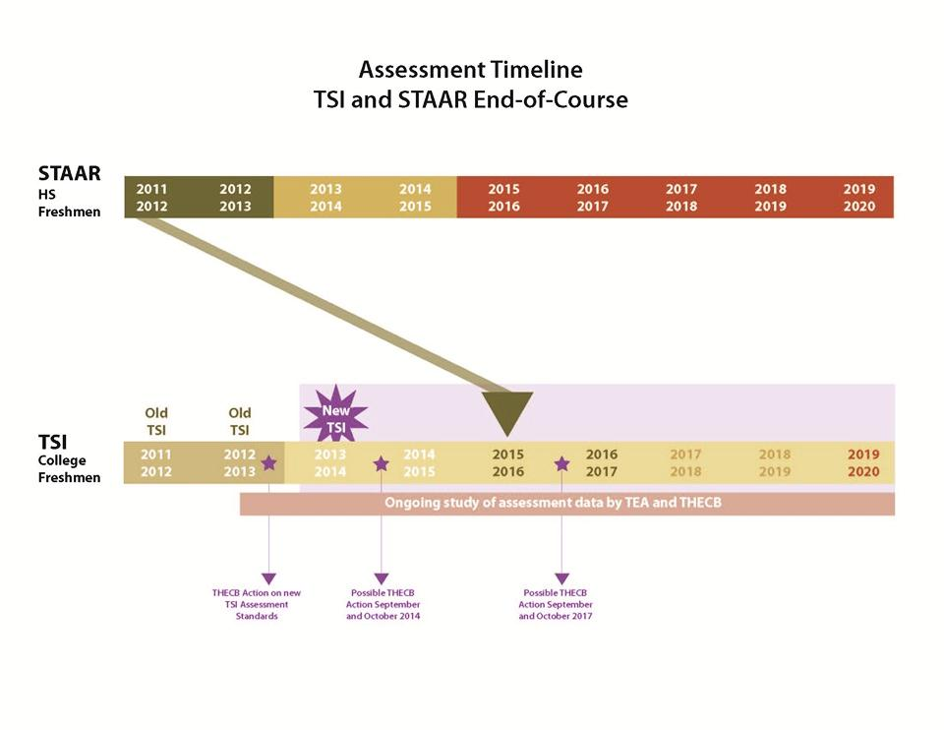
The Connection:
STAAR and TSI Implementation

Slide 43
Other Considerations in College and Career Readiness…
Advanced Placement (AP) & International
Baccalaureate (IB) programs
  Many more participating in courses
  Performance still trailing number of attempts
Dual Credit
  High rates of participation
  Quality and rigor difficult to monitor
Early College High Schools
  Proficiency and graduation rates higher than local high schools
  Stronger student performance linked to ECHSs located on college campuses
  Not all college credits earned transfer to college by institution upon graduation from a ECHS
Source: Six Years and Counting: The ECHSI Mature, 2009
http://www.earlycolleges.org/publications.html#earlycollege:researchandevaluations

Slide 44
Critical Questions
How does one change teachers’ beliefs about the teaching-learning-assessment process?
How can we help teachers deal with change regarding their pedagogical values and beliefs and the development of new methodological skills?
What are the ways that we can help educators at all levels understand the standards and the implications for their teaching?

