Slide 1
Region 9 Education Service Center AVATAR Update
ELA Focus: The Heart of English
Feb. 13, 2014. This event will allow for conversations and learning between secondary and postsecondary ELA teachers. Presenters include Vernon College and Midwestern State University instructors, secondary ELA teachers and ELA education specialists. Participants are K-12 teachers and teachers-in-training at Vernon College and Midwestern State University.

Slide 2
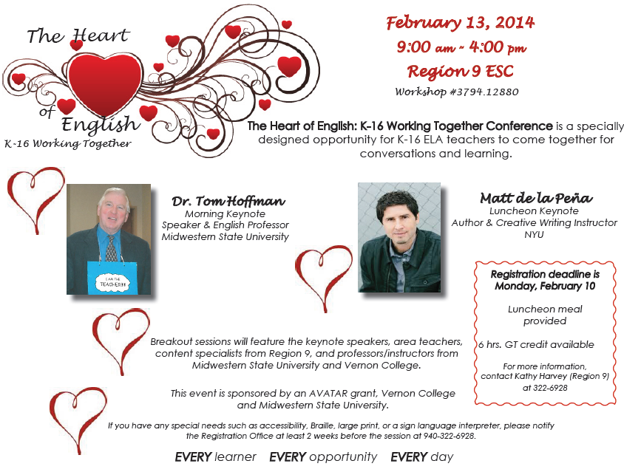

Slide 3
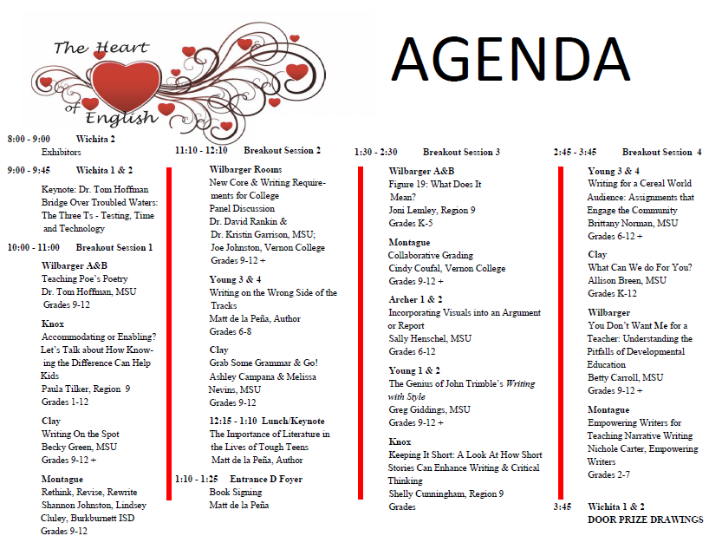

Slide 4
Region 9 Education Service Center
AVATAR Update
Math Focus: Lesson Study
Spring Semester, 2014. This process will allow Vernon College math instructors and Region 9 secondary math teachers to collaborate to research, design, teach, and revise a lesson over college Contemporary Mathematics and high school AQR and Statistics courses. The group will utilize the text Lesson Study: Step by Step by Lewis & Hurd as a guide to the process.

Slide 5
Region 9 Education Service Center AVATAR Update
Math Into the Class
Spring Semester, 2014. This project will utilize instructors who previously participated in the AVATAR Math Project for Spring 2013. These college math instructors will film their presentation about the necessity of math in the everyday world. The presentation will be available to all schools in the R9 distance learning cohort.

Slide 6
Region 9 Education Service Center AVATAR Update
Summer Bridge Program- The 3 R’s: Reading, Writing and Arithmetic
July 28-31, 2014. This collaboration between the AVATAR ELA and Math teams will provide training for teachers and students. Students and teachers will participate in one day workshops with a focus on reading, writing, math, and test- taking skills. Presenters are still being secured for this event.

