Slide 1
Region 7
P-16 Data Analysis
2013-14

Slide 2
Looking at Region 7’s College Readiness Data

Slide 3
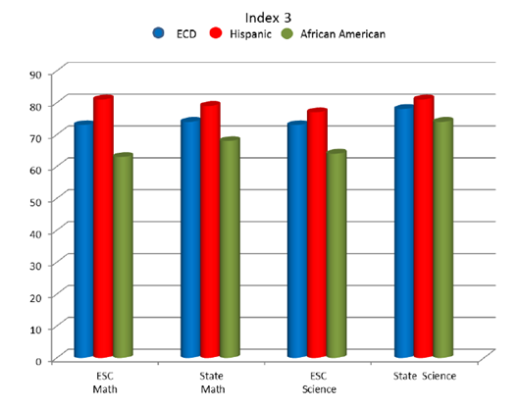
Region 7
2013 Index 3 Closing Performance Gaps

Slide 4
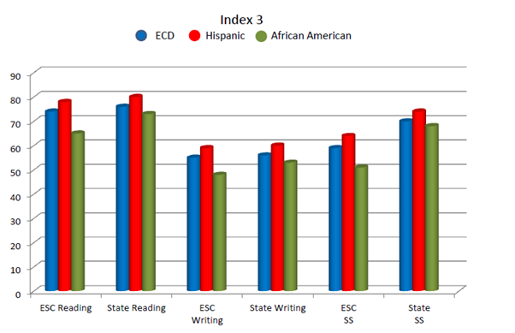
Region 7
2013 Index 3 Closing Performance Gaps

Slide 5
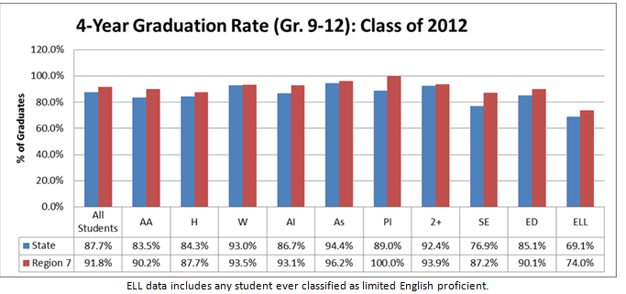
Region 7 2013
Index 4 Post Secondary Readiness

Slide 6
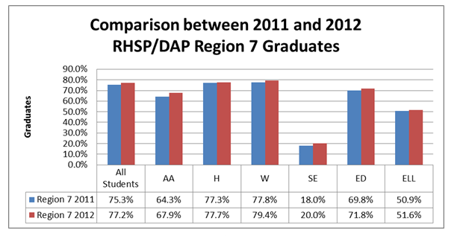
Region 7 2013
Index 4 Post Secondary Readiness

Slide 7
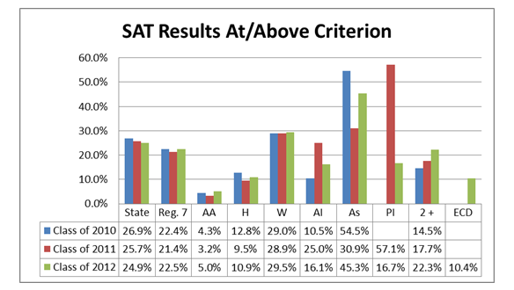
Region 7 2013
Index 4 Post Secondary Readiness

Slide 8
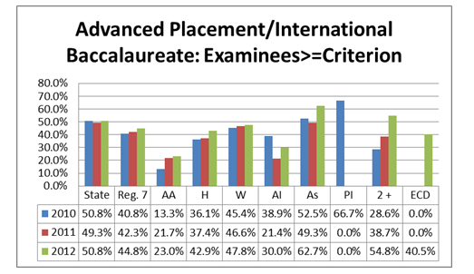
Region 7 2013
Index 4 Post Secondary Readiness

Slide 9
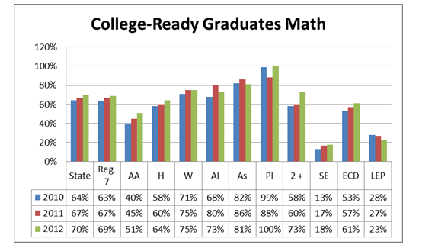
Region 7 2013
Index 4 Post Secondary Readiness

Slide 10
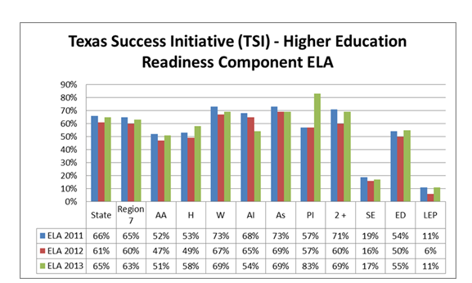
Region 7 2013
Index 4 Post Secondary Readiness

Slide 11
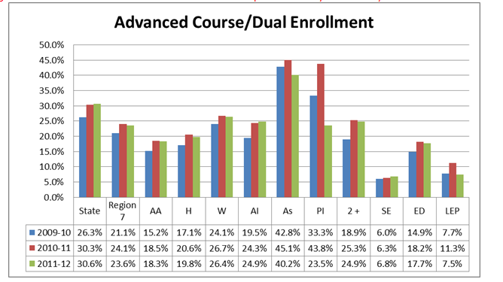
Region 7 2013
Index 4 Post Secondary Readiness

