Slide 1

Accountability System
Jane Silvey & Lisa Mullins

Slide 2
Level III
Advanced Academic Performance
Accomplished Academic Performance*
Level II
Satisfactory Academic Performance
Level I
Unsatisfactory Academic Performance
Developing Academic Performance*
*For STAAR Alternate assessments
What are the STAAR Performance Standards?

Slide 3
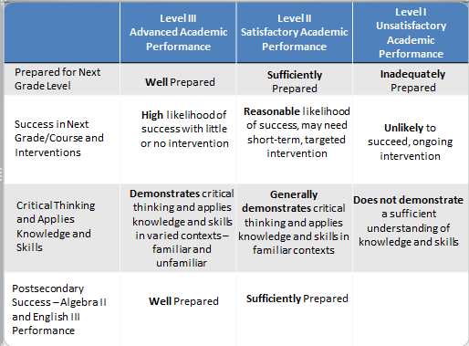

Slide 4
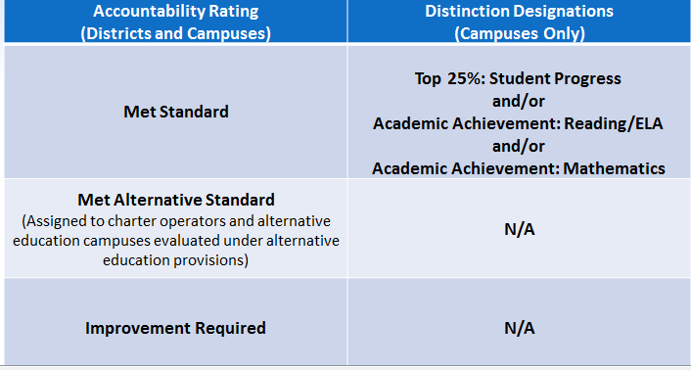
2013 Rating Labels

Slide 5
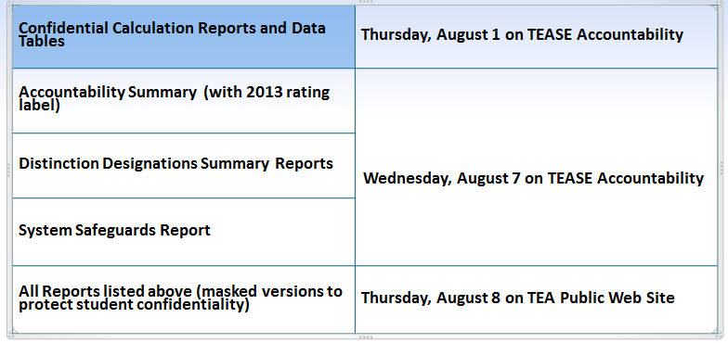
Notification of Ratings

Slide 6
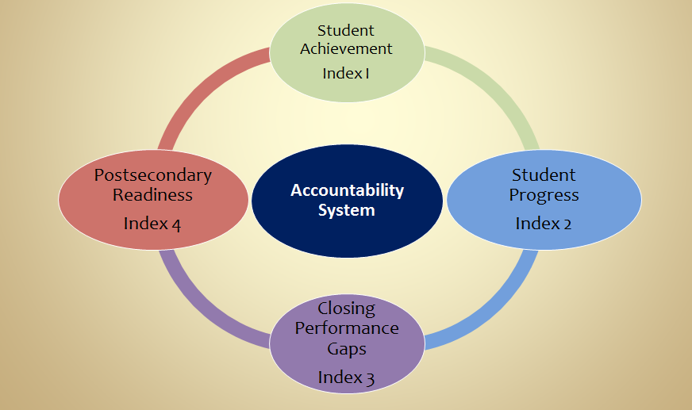
For 2013 and beyond
a framework of FOUR
Performance Indexes
Notes:
For 2013 and beyond the accountability system is a framework of 4 performance indexes.
Index 1 – Student Achievement
Index 2 – Student Progress
Index 3 – Closing Performance Gaps
Index 4 – Postsecondary Readiness
We will be looking at each index separately.

Slide 7
Performance Index 1:
Student Achievement
Provides a snapshot of performance
across subjects at
Level II – Satisfactory Academic Performance
Notes:
Index 1 is Student Achievement. It provides a snapshot of performance across subjects at Level II – Satisfactory Academic Performance.
For 2013 it will look at performance at Phase-in 1, Level II.

Slide 8

Performance Index 1: Student Achievement
Measures: % Met Level II Standard All Students – Reading All Students – Writing All Students – Math All Students – Science All students – Social Studies Participation by race/ethnicity
Notes:
Index 1 measures the % of students that met Level II performance – for 2013 Phase in 1 Level II. In this index we are measuring “All Students” group. In all content areas – listed on slide.
Also, this index will measure participation by race/ethnicity.

Slide 9

Performance Index 1: Student Achievement
Includes: STAAR STAAR-Modified, STAAR Alternate STAAR-L Grades 3-8 and EOC English and Spanish Grade 11 TAKS performance (2013 only)
Notes:
The assessment that Index 1 includes: STAAR, STAAR-Modified, STAAR-Alternate, STAAR-L in grades 3-8 & EOC English & Spanish grades 3-5.
For 2013 only, Index 1 will include grade 11 TAKS performance.

Slide 10
Performance Index 1: Student Achievement
Minimum Size: None Small Group analysis is applied if there are fewer than 10 tests

Slide 11
Performance Index 1: Student Achievement
Grades 3-8 Districts and Campuses Spring results – Snapshot Date Grades 5 and 8 Highest score 1st & 2nd administration EOC Districts and Campuses Students enrolled on Fall Snapshot Summer 2012 results…. Fall 2012 results… Spring 2013 results…
Notes:
The assessment results that will be included for 2013 for districts and campuses includes grades 3-8 spring results for students enrolled on the fall enrollment snapshot.
Grades 5/8 math/reading highest score for 1st & 2nd administration
EOC best result for – Summer 2012 results for students enrolled on the prior year fall enrollment snapshot of 2011, December 2012 results for students enrolled on the fall enrollment snapshot (October 2012) and spring 2013 results for students enrolled on the fall enrollment snapshot (October 2012).

Slide 12
Performance Index 1: Student Achievement
ENGLISH LANGUAGE LEARNER RESULTS: Students in US schools 1- 3 years excluded Students in US schools 4 years and beyond included at phase-in Level II Asylees/refugees in US school 1-5 years excluded
Notes:
The assessment results that will be included for 2013 for districts and campuses includes grades 3-8 spring results for students enrolled on the fall enrollment snapshot.
Grades 5/8 math/reading highest score for 1st & 2nd administration
EOC best result for – Summer 2012 results for students enrolled on the prior year fall enrollment snapshot of 2011, December 2012 results for students enrolled on the fall enrollment snapshot (October 2012) and spring 2013 results for students enrolled on the fall enrollment snapshot (October 2012).

Slide 13
Performance Index 1: Student Achievement
District/Campus
Index 1 Met Standard Rating
Index Target: 50
 | Reading |  | Mathematics |  | Writing |  | Science |  | Social Studies |  | Total | % Met Level II
Students Met Level II | 50 | + | 38 | + | 19 | + | 10 | + | 19 | = | 136 | 45% | 45
Students Tested | 100 | + | 100 | + | 42 | + | 40 | + | 23 | = | 305
Index Score |  |  |  |  |  |  |  |  |  |  |  |  | 45
Notes:
Index 1 is the simplest computation of all the indexes. It is the number of tests with Level II scores divided by total number of tests taken on a campus. a target of 50 for this index. Notice the table totals the number of students that met level II across the first row and divided by the total of the students tested. This campus had an index core of 45 and that doesn’t meet the state’s target score of 50.
ELL for 2013:
Students in US schools 1-3 years excluded
Students in US schools 4 and beyond included at Level II
Asylees/refugees in US schools year 1-5 excluded

Slide 14
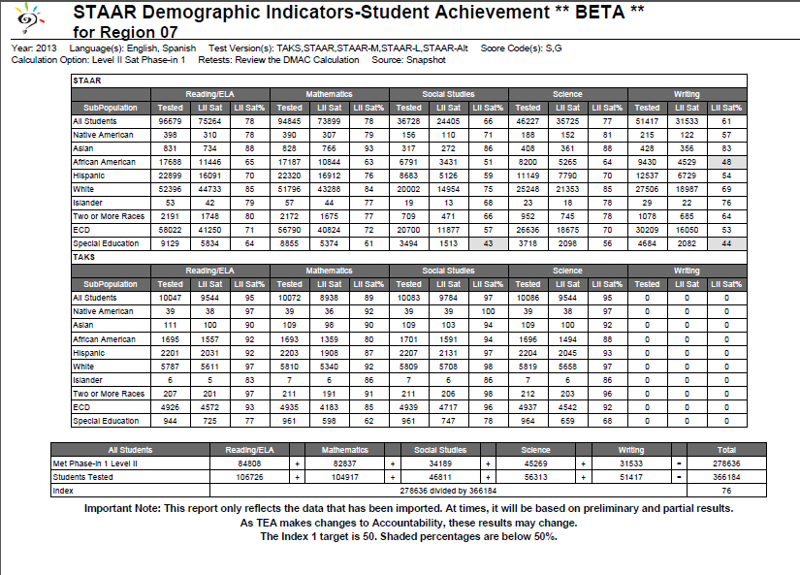
Notes:
State data for Index 1 – indicates 76 score which is above target of 50

Slide 15
PERFORMANCE INDEX 2
STUDENT PROGRESS
Measures student progress
by
subject and student group
Notes:
The purpose of Index 2 is to provide a measure of student progress by subject and student group.

Slide 16
PERFORMANCE INDEX 2 STUDENT PROGRESS
Subjects:
Reading Math Writing
Student Groups:
All Students
SPED
ELL
Seven Racial/Ethnic Groups
Notes:
Index 2 measures student progress in reading, math & writing in 10 student groups – all students, SP Ed, ELL & 7 race/ethnicity groups.
The minimum size for all students is 10 and all other student groups is 25.
ELL – Progress Measure not available for 2013 for students test on English test versions – asylees/refugees excluded.
Spanish test version – Growth measure calculated in 2013; students in US Schools 1-3 years excluded; 4 & beyond included; asylees/refugees 1-5 years excluded.

Slide 17
PERFORMANCE INDEX 2 STUDENT PROGRESS
Index Targets:
District 21
High School 17
Middle School 29
Elementary 30
Notes:
Index 2 measures student progress in reading, math & writing in 10 student groups – all students, SP Ed, ELL & 7 race/ethnicity groups.
The minimum size for all students is 10 and all other student groups is 25.
ELL – Progress Measure not available for 2013 for students test on English test versions – asylees/refugees excluded.
Spanish test version – Growth measure calculated in 2013; students in US Schools 1-3 years excluded; 4 & beyond included; asylees/refugees 1-5 years excluded.

Slide 18
PERFORMANCE INDEX 2 STUDENT PROGRESS
ELL Results:
English Test Version:
  STAAR ELL Progress Measure NOT available for 2013 on STAAR English.
  Asylee/refugees excluded
Spanish Test Version:
  STAAR Growth Measure calculated
  Students in US schools 1-3 years excluded
  Students in US schools 4 years and beyond included in growth measure
  Asylees/refugees year 1-5 excluded
Notes:
Index 2 measures student progress in reading, math & writing in 10 student groups – all students, SP Ed, ELL & 7 race/ethnicity groups.
The minimum size for all students is 10 and all other student groups is 25.
ELL – Progress Measure not available for 2013 for students test on English test versions – asylees/refugees excluded.
Spanish test version – Growth measure calculated in 2013; students in US Schools 1-3 years excluded; 4 & beyond included; asylees/refugees 1-5 years excluded.

Slide 19
PERFORMANCE INDEX 2 STUDENT PROGRESS
Minimum Size:
All Students – at least 10 test results
Student Groups – 25 test results for the group
Small Group Analysis – cannot be calculated for 2013
Notes:
Index 2 measures student progress in reading, math & writing in 10 student groups – all students, SP Ed, ELL & 7 race/ethnicity groups.
The minimum size for all students is 10 and all other student groups is 25.
ELL – Progress Measure not available for 2013 for students test on English test versions – asylees/refugees excluded.
Spanish test version – Growth measure calculated in 2013; students in US Schools 1-3 years excluded; 4 & beyond included; asylees/refugees 1-5 years excluded.

Slide 20
PERFORMANCE INDEX 2 STUDENT PROGRESS
STAAR Percent Met Growth Standard
Students are assigned to one of three growth categories based on change in scale score in relation to growth expectations:
Did Not Meet Expectation,
Met Expectation,
Exceeded Expectation

Slide 21
PERFORMANCE INDEX 2 STUDENT PROGRESS
Important Points about Index 2
Gain Score = Current-year scale score – Prior-year scale score
Grounded in STAAR performance standards & goal of having all students achieve at or above Level II
All students scoring at the 3 highest raw scores, in the current year will be classified as having Exceeded the progress target.
Students who maintained Level III performance from the prior year to the current year will be classified as having Met or Exceeded the progress target.
A student can move to a higher performance level without having Met progress.

Slide 22
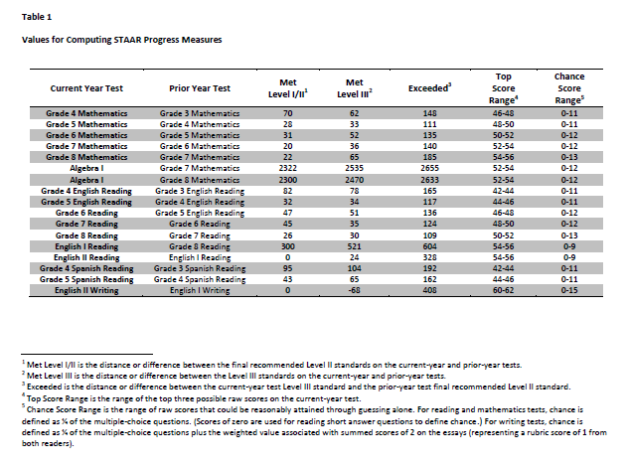

Slide 23
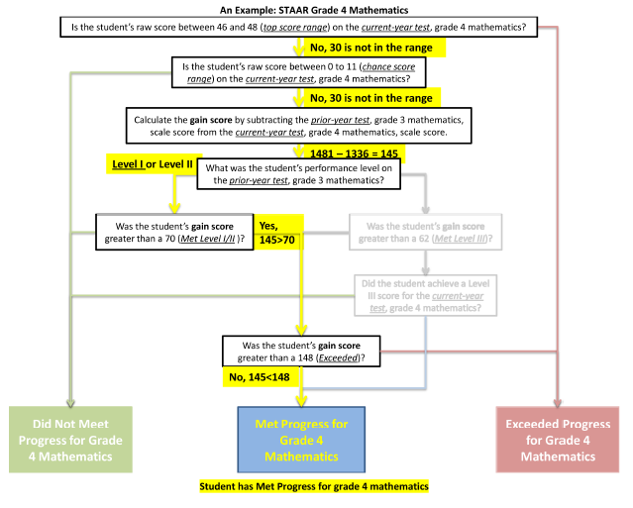

Slide 24
PERFORMANCE INDEX 2 Student Progress
Index Target will be set at about fifth percentile by campus type One Point for percentage of students who Met Expectation or Exceeded Expectation in each race/ethnicity for Reading grades 4-8; English I & II Reading; English II Writing Math grades 4-8 and Algebra I (2014) Writing

Slide 25
PERFORMANCE INDEX 2 Student Progress
Index Target will be set at about fifth percentile One Point for percentage of students who Met Expectation or Exceeded Expectation in each race/ethnicity for Reading grades 4-8; English I & II Reading; English II Writing Math grades 4-8 and Algebra I (2014) Writing Another Point for Percentage of all students who Exceeded Expectations Reading grades 4-8; English I & II Reading; English II Writing Math grades 3-8 and Algebra I (2014) Writing

Slide 26
Index construction for Index 2: Student Progress
STAAR Weighted Growth for Reading | All | AA | Amer. Indian | Asian | Hisp. | Pacific Island | White | Two or More | ELL | Sp. Ed. | Total Points | Max. Points
# TESTS | 931 | 64 |  |  | 828 |  |  |  | 819 | 75
Did Not Meet Expectation
Met Expectation
Exceeded Expectation
% of TESTS: Met or Exceeded Exp.
Exceeded Expectation
Reading Weighted Growth Rate
Notes:
The computation for index 2 is not difficult math, but it can look confusing at first glance. This example is for reading. It is called a weighted measurement because the scores that exceed expectations are given more weighted or points. Notice the grid contains all 7 racial/ethnic groups plus ELL and Special Ed. The first step is to enter all the tests taken by each group.

Slide 27
Index construction for Index 2: Student Progress
STAAR Weighted Growth for Reading | All | AA | Amer. Indian | Asian | Hisp. | Pacific Island | White | Two or More | ELL | Sp. Ed. | Total Points | Max. Points
# TESTS | 931 | 64 |  |  | 828 |  |  |  | 819 | 75
Did Not Meet Expectation | 326 | 13 |  |  | 207 |  |  |  | 205 | 26
Met Expectation | 605 | 51 |  |  | 621 |  |  |  | 614 | 49
Exceeded Expectation | 186 | 16 |  |  | 124 |  |  |  | 164 | 4
% of TESTS: Met or Exceeded Exp.
Exceeded Expectation
Reading Weighted Growth Rate
Notes:
Next you record the number for each criteria, Did not meet expectation, met expectation and exceeded expectation. Remember this has nothing to do with “passing”. Each child is evaluated individually on their growth

Slide 28
Index construction for Index 2: Student Progress
STAAR Weighted Growth for Reading | All | AA | Amer. Indian | Asian | Hisp. | Pacific Island | White | Two or More | ELL | Sp. Ed. | Total Points | Max. Points
# TESTS | 931 | 64 |  |  | 828 |  |  |  | 819 | 75
Did Not Meet Expectation | 326 | 13 |  |  | 207 |  |  |  | 205 | 26
Met Expectation | 605 | 51 |  |  | 621 |  |  |  | 614 | 49
Exceeded Expectation | 186 | 16 |  |  | 124 |  |  |  | 164 | 4
% of TESTS: Met or Exceeded Exp. | 65% | 80% |  |  | 75% |  |  |  | 75% | 65%
Exceeded Expectation | 20% | 25% |  |  | 15% |  |  |  | 20% | 5%
Reading Weighted Growth Rate
Notes:
the % that met expectation and % of those that exceeded expectations are entered in the table. Notice how those exceeding expectation are weighted. For example, look at the AA column. 64 students took reading tests. 13 did not meet expectations and 51 met expectations. That is all 64 students but of the 51 that met expectations 16 of them not only met the expectation they exceeded expectations so they are counted twice.

Slide 29
Index construction for Index 2: Student Progress
STAAR Weighted Growth for Reading | All | AA | Amer. Indian | Asian | Hisp. | Pacific Island | White | Two or More | ELL | Sp. Ed. | Total Points | Max. Points
# TESTS | 931 | 64 |  |  | 828 |  |  |  | 819 | 75
Did Not Meet Expectation | 326 | 13 |  |  | 207 |  |  |  | 205 | 26
Met Expectation | 605 | 51 |  |  | 621 |  |  |  | 614 | 49
Exceeded Expectation | 186 | 16 |  |  | 124 |  |  |  | 164 | 4
% of TESTS: Met or Exceeded Exp. | 65% | 80% |  |  | 75% |  |  |  | 75% | 65%
Exceeded Expectation | 20% | 25% |  |  | 15% |  |  |  | 20% | 5%
Reading Weighted Growth Rate | 85 | 105 |  |  | 90 |  |  |  | 95 | 70 | 445 | 1000
Notes:
The % of met and exceeded are totaled to determine the number of points for each column and then those points are combined to get the total points. In this example there are 5 categories of students and if every student exceeded expectations each category would show 100% in met expectations and 100% in exceeded expectations for a total of 200 points in each category and a total of 1000 points for the 5 columns. These totals are then transferred to a table including the weighted growth rate for reading, writing and math.

Slide 30
Index construction for Index 2: Student Progress
Indicator | All | AA | Amer. Indian | Asian | Hisp. | Pacific Island | White | Two or More | ELL | Sp. Ed. | Total Points | Max. Points
STAAR Reading Weighted Growth Rate | 85 | 105 |  |  | 90 |  |  |  | 95 | 70 | 445 | 1000
STAAR Mathematics Weighted Growth Rate | 85 | 105 |  |  | 90 |  |  |  | 95 | 70 | 445 | 1000
2014 STAAR Writing Weighted Growth Rate | 85 | 95 |  |  | 90 |  |  |  | 95 | 70 | 435 | 1000
TOTAL |  |  |  |  |  |  |  |  |  |  | 1325 | 3000
INDEX SCORE |  |  |  |  |  |  |  |  |  |  |  | 44
Notes:
This table shows the WGR or Weighted growth rate for reading, math and writing. Again the index score is determined by dividing the total points by the max. points. At the time of the taping the state had not set a target for this index.

Slide 31
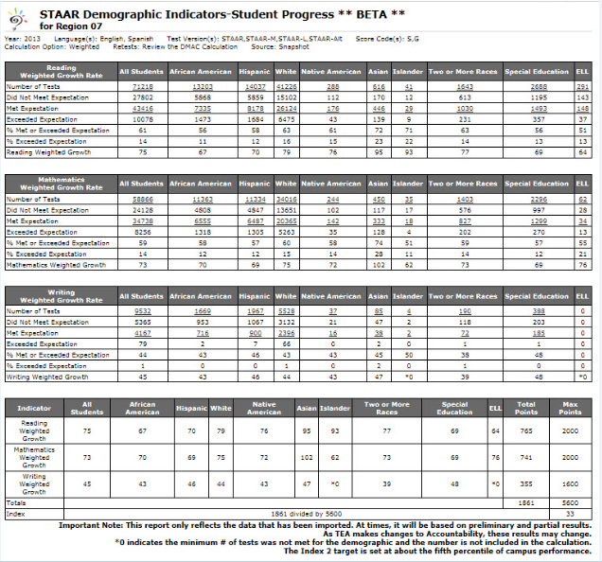

Slide 32
PERFORMANCE INDEX 3:
CLOSING PERFORMANCE GAPS
Emphasize advanced academic achievement of the ECD and lowest race/ethnicity preforming groups
Notes:
Let’s take a look at Index 3 – Closing Performance Gaps. This index emphasizes advanced academic achievement of the Economically Disadvantated student group and the lowest performing race/ethnicity group at each campus or district.

Slide 33
PERFORMANCE INDEX 3: CLOSING PERFORMANCE GAPS
Subjects:
Reading Math Writing Social Studies Science
Student Groups:
ECD
Two lowest Preforming Race/Ethic Groups
(page 26)
Notes:
2013 and beyond. The STAAR weighted performance rate calculation must be modified for 2013 because STAAR Level III performance cannot be included in the indicator until 2014
STAAR Grades 3-8 English and Spanish at phase-in Level II and final Level III performance standards for assessments administered in the spring
EOC at phase-in Level II and final Level III performance standards for assessments administered in the spring and the previous fall and summer
STAAR Grades 3-8 and EOC Modified and Alternate at phase-in Level II and final Level III performance standards
Retest results: Grades 5 and 8, best result from primary administration and first retest; EOC retest results included

Slide 34
PERFORMANCE INDEX 3: CLOSING PERFORMANCE GAPS
Index Target 55
One Point
  Each % of students: ECD or one of two lowest race/ethnic groups meeting Level II
Notes:
Di. stricts and campuses will receive one point for each % of students who meet Level II

Slide 35
Notes:
2 Lowest performing racial/ethnic groups determined by comparing performance of racial/ethnic groups on the Index 1 student achievement indicator from spring 2012. The disaggregated student group rates will be calculated for reporting – not used (Index 1 is all students). This is the DMAC report for Index 1 that shows all student groups so we can determine the lowest race/ethnic groups in each content area.

Slide 36

STAAR Weighted Performance Rate for Reading | ECD | Lowest Performing Racial/Ethnic Group1 | Lowest Performing Racial/Ethnic Group2 | Total Points | Maximum Points
# of Tests | 873 | 878 | 2601
Performance Results Phase in 1: Level II or above Number Percent | 428 49% | 490 56% | 390 15%
Reading WPR | 49 | 56 | 15 | 120 | 300
Notes:
The table shows the computation required to determine the WPR (weighted performance rate) for reading. For each student category, Economically disadvantaged, Lowest performing Racial/ethnic group 1 and group 2, the weighted performance rate is determined comparing the number of students who scored Level II or above to the total number of students test.

Slide 37
Indicator | Economically Disadvantaged | Lowest Performing Race/Ethnic Group 1 | Lowest Performing Race/Ethnic Group 2 | Total Points | Maximum Points
STAAR Reading WPR | 49 | 56 | 15 | 120 | 300
STAAR Mathematics WPR | 60 | 50 | 22 | 132 | 300
STAAR Writing WPR | 40 | 45 | 18 | 103 | 300
STAAR Science WPR | 60 | 20 | 29 | 109 | 300
STAAR Social Studies WPR | 25 | 20 | 25 | 70 | 300
TOTAL |  |  |  | 534 | 1,500
Index Score (total points divided by maximum points) |  |  |  | 36
Notes:
The weighted performance rate is calculated and entered for each subject tested on the campus. The total points for each subject is entered and totaled then divided by the maximum number of points possible. Notice the maximum is 300 for each subject. If all students in the Economically disadvantaged group, Lowest performing Racial/ethnic group 1 and group 2 met the level II standard, each category would have a score of 100% and a maximum of 300 for the subject The state has set the target for Index 3 at 55.

Slide 38
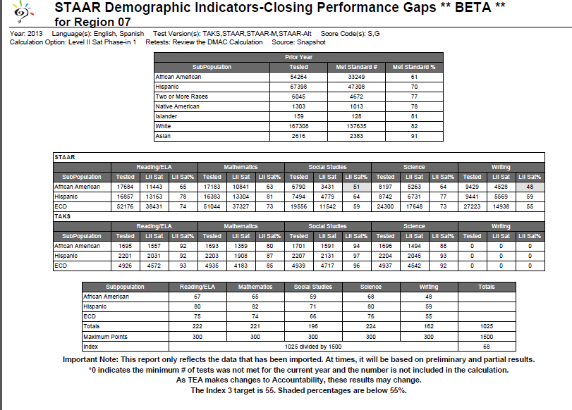

Slide 39
Index 4: Postsecondary Readiness
Importance of high school diploma and CCRS
Notes:
HB 5 will have little changes in Index 4.
The purpose of this index is to emphasize the importance for students to receive a high school diploma that provides them with the foundation necessary for success in college, the workforce, job training programs or the military.

Slide 40
Index 4: Postsecondary Readiness
STAAR Percent Met final Level II on One or More Tests
2014 and beyond (Final Level II performance is not included in accountability in 2013)
Assessment results include all assessments evaluated in Index I
Combined over All Subjects: Reading, Writing, Mathematics, Science, and Social Studies

Slide 41
Index 4: Postsecondary Readiness
Index Target 75
Graduation Score:
Grade 9-12 Four-Year 2012 Graduation Rate for All
Students and all student groups
OR
Grade 9-12 Five-Year 2011 Graduation Rate for All
Students and all student groups,
and
RHSP/DAP Graduates for All Students and
race/ethnicity student groups
Notes:
To receive a met standard rating, all campuses & districts must meet accountability targets on all indexes for which they have performance data in 2013. For Index 4, districts and campuses must have a score of 75 or higher.
HS graduation rates include the 4 year or 5 year graduation rates, whichever year calculation is the highest.
Index 4 looks at the % of students graduating with Recommended HS program or the Distinguished Achievement HS program.
Total number of students in the graduating class contains graduates, continuing students, GED recipients & dropouts.
Student Groups: All, SE, ELL, 7 race/ethnicity

Slide 42
Index 4: Postsecondary Readiness
Indicator | All | AA | Hispanic | White | Asian | Pacific Island | Amer. Indian | Two or More | ELL | Sp. Ed. | Total Points | Max. Points
4-year graduation rate 2012 | 82.8% | 74.5% | 70.2% | 75.4% |  |  |  |  | 82.4% |  | 385.3 | 500
RHSP/DAP | 75% | 66.1% | 51.4% | 67.6% |  |  |  |  |  |  | 260.1 | 400
4-Year Graduation Total |  |  |  |  |  |  |  |  |  |  | 645.4 | 900
TOTAL INDEX POINTS |  |  |  |  |  |  |  |  |  |  | 72
Notes:
This table shows an example of a 4 hear graduation rate. An important thing to notice is that 50% of Index 4 is the % of each race/ethnic graduating Recommended or distinguished. The post-secondary readiness rewards schools ensuring students are ready for college or career of their choice.

Slide 43
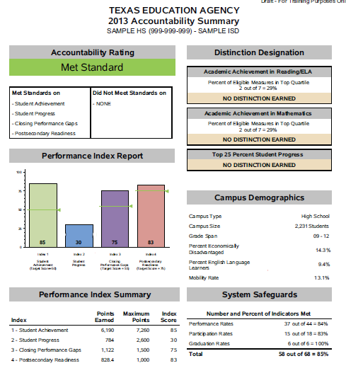
Notes:
This is a look at a possible report that schools will receive from TEA indicate the results on each of the 4 indexes.

Slide 44
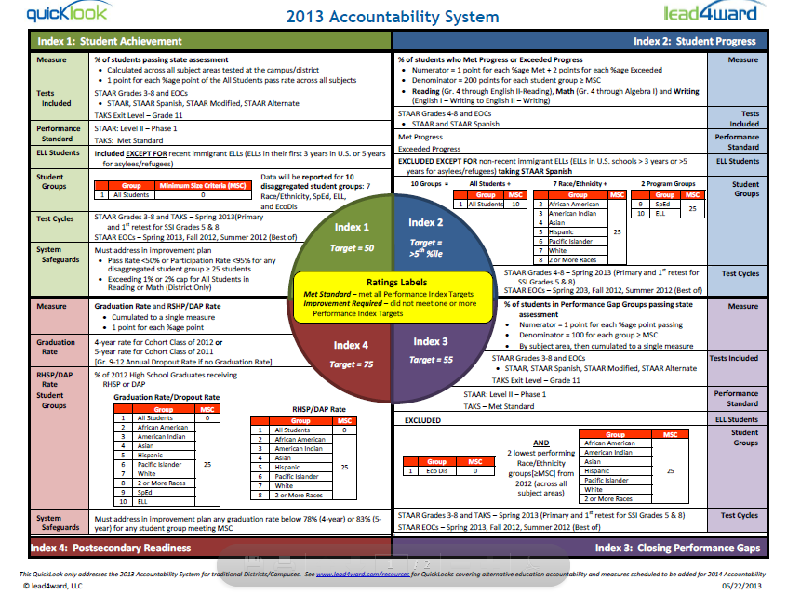

Slide 45
Some Distinction Designations
Top 25% Distinction
Campus Academic Achievement Distinction
Grade 3-9 and Algebra – Level III
AP/IB Performance ELA and Math
SAT/ACT Participation
SAT Performance in ELA or Math
ACT Performances in ELA or Math
Notes:
Campuses that receive an accountability rating of met standard are eligible for the distinction designations for 2013 listed on the slide.
The top 25% distinction will be based on performance on index 2 – student progress – in relation to campuses in the comparison group (found in TEASE or TEAL).
The campus Academic Achievement Distinction Designation (AADD) recognizes outstanding academic achievement in reading/ELA and math on a variety of indicators including completion of advanced dual enrollment courses and SAT & ACT performance & participation; based on comparison of similar campuses.
AADD indicators are evaluated for campuses whose grade span is with in grades 3-12 that achieved a met standard rating. AADD indicators are evaluated for all students.
The Grade 3 – 8 looks at the number of students achieving Level III in math, reading or writing. It also looks at participation of 8th graders taking Algebra I and the # of 8th grade students who scored Level II on Algebra I.

