Slide 1
All AVATAR artifacts :
http://www.ntp16.notlb.com/avatar
Notes:
Notes are added.

Slide 2

ESC Region 14

Slide 3
Albany High School Roscoe High School
Cisco College
Western Texas College
Ranger College
Scaffolding
Student
Success
Abilene Christian University
Hardin-Simmons University
McMurry University
Region 14 ESC
Abilene Regional
P-16
Council

Slide 4
AVATAR Team Members
Christy Barnett Region 14 ESC
Jay Baccus Anson ISD
Edward Morales Roscoe ISD
Dan Boren Roscoe ISD
Rick Davis Albany ISD
Julie McQueen Abilene Christian University
Joe Butler Cisco College

Slide 5
Partner College and Universities
Community Colleges
Partner Universities
Cisco College
Western Texas College
Ranger College
Abilene Christian University
Hardin-Simmons University
McMurry University
*Note: All partner universities are private, and do not report data to the THECB. We will add data as it becomes available from each institution’s office of institutional research. The data has been requested, but has not been received.

Slide 6
AEIS Data from TEA
Albany High School, 2010-11
  Student Body:
Student Group | Number
TOTAL | 228
Grade 7 | 36
Grade 8 | 28
Grade 9 | 38
Grade 10 | 50
Grade 11 | 37
Grade 12 | 39
Graduating class | 51
% Minimum curriculum | 7.8*
% Recommended curriculum | 92.2*
*State Comparison:
Minimum 17.2%
Recommended 82.8%

Slide 7
AEIS Data from TEA
Albany High School, 2010-11
  Ethnicity of Student Body in Percentages:
Ethnic Group | Percentage
African American | 1.8
Hispanic | 19.7
White | 76.8
American Indian | 0.4
Asian | 0
Pacific Islander | 0
2 or more races | 1.3

Slide 8
AEIS Data from TEA
Albany High School, 2010-11
  Other Descriptors of Student Body in Percentages:
Demographic groups | Percentage
Economically disadvantaged | 25.9
Limited English Proficient (LEP) | 3.1
With disciplinary placements | 1.1
At risk* | 35.5
Mobility (2009-10) | 13.0
*At risk of dropping out of school based on performance and status indicators listed in the AEIS Glossary.

Slide 9
AEIS Data from TEA
Albany High School, 2010-11
  Percent Enrolled in Advanced Course/Dual Enrollment:
Year | All | African- American | Hispanic | White | Amer. Indian | Asian | Pacific Island | Two/ More
2009-10 | 20.1 | * | 15.8 | 19.9 | * | * | - | *
2008-09 | 24.6 | 28.6 | 12.5 | 24.0 | * | n/a | n/a | n/a

Slide 10
AEIS Data from TEA
Albany High School, 2010-11
  AP/IB Percentage Tested
  IP PercenAP/IP Percentage Tested
  tage TestedAP/IP Percentage Tested
  AP/IP Percentage Tested
  AP/IB Percent Examinees Met or Exceeded Criteria
Year | All | African- American | Hispanic | White | Amer. Indian | Asian | Pacific Island | Two/ More
2009-10 | 9.3 | * | 12.5 | 6.2 | - | * | - | *
2008-09 | 13.3 | * | 11.1 | 13.1 | - | n/a | n/a | n/a
Year | All | African- American | Hispanic | White | Amer. Indian | Asian | Pacific Island | Two/ More
2009-10 | 0 | * | * | * | - | - | - | *
2008-09 | 10 | * | * | 12.5 | - | n/a | n/a | n/a

Slide 11
AEIS Data from TEA
Albany High School, 2010-11
  Texas Success Initiative, English Lang Arts, Percent Passing
  IP PercenAP/IP Percentage Tested
  tage TestedAP/IP Percentage Tested
  AP/IP Percentage Tested
  Texas Success Initiative, Math, Percent Passing
Year | All | African- American | Hispanic | White | Amer. Indian | Asian | Pacific Island | Two/ More
2010-11 | 62 | * | 36 | 73 | * | * | * | *
2009-10 | 75 | * | 75 | 77 | * | * | * | *
Year | All | African- American | Hispanic | White | Amer. Indian | Asian | Pacific Island | Two/ More
2010-11 | 58 | * | 67 | 58 | * | * | * | *
2009-10 | 75 | * | 75 | 74 | * | * | * | *
Notes:
Percentage of students who met TSI exemption criteria. Current year 11th graders.

Slide 12
AEIS Data from TEA
Albany High School, 2010-11
  Percentage College Ready Graduates, Class of 2010
Subject | All | African- American | Hispanic | White | Amer. Indian | Asian | Pacific Island | Two/ More
English | 70 | * | 60 | 72 | * | * | * | *
Math | 58 | * | 80 | 53 | * | * | * | *
Both | 53 | * | 60 | 50 | * | * | * | *
Notes:
Percentage of students meeting TSI requirements: TAKS 2200 + 3 for ELA; TAKS 2200 for math.
For STAAR, students who meet advanced level on the Algebra II and English III Reading and Writing will be considered TSI exempt.
This indicator differs from the TSI slide because it includes the SAT and ACT performance and it is based prior year graduates instead of current year 11th graders.

Slide 13
P-16 Data from THECB
Albany High School, 2011
Institution of Enrollment, Class of 2011 | Students
Cisco College | 11
Other Public/Ind 4-year (15) | 12
Other Public/Ind 2-year (9) | 5
Not trackable | 1
Not found | 13
Notes:
No data reported on individual schools where fewer than 5 students attended.

Slide 14
P-16 Data from THECB
Albany High School, 2011
  Public Higher Education First Year Grades of High School Graduates in FY 2010
IHE type | N | <2.0 | 2.0-2.49 | 2.5-2.99 | 3.0-3.49 | >3.5 | Unk
4-year | 10 | 2 | 1 | 1 | 2 | 4 | 0
2-year | 13 | 2 | 1 | 2 | 3 | 1 | 4

Slide 15
AEIS Data from TEA
Roscoe High School, 2010-11
  Student Body:
Student Group | Number
TOTAL | 172
Grade 7 | 22
Grade 8 | 23
Grade 9 | 18
Grade 10 | 33
Grade 11 | 22
Grade 12 | 22
Graduating class | 32
% Minimum curriculum | 40.6*
% Recommended curriculum | 59.4*
*State Comparison:
Minimum 17.2%
Recommended 82.8%

Slide 16
AEIS Data from TEA
Roscoe High School, 2010-11
  Ethnicity of Student Body in Percentages:
Ethnic Group | Percentage
African American | 1.4
Hispanic | 57.1
White | 40.7
American Indian | 0.7
Asian | 0
Pacific Islander | 0
2 or more races | 0

Slide 17
AEIS Data from TEA
Roscoe High School, 2010-11
  Other Descriptors of Student Body in Percentages:
Demographic groups | Percentage
Economically disadvantaged | 56.4
Limited English Proficient (LEP) | 4.3
With disciplinary placements | 0
At risk* | 32.1
Mobility (2009-10) | 13.7
*At risk of dropping out of school based on performance and status indicators listed in the AEIS Glossary.

Slide 18
AEIS Data from TEA
Roscoe High School, 2010-11
  Percent Enrolled in Advanced Course/Dual Enrollment:
Year | All | African- American | Hispanic | White | Amer. Indian | Asian | Pacific Island | Two/ More
2009-10 | 53.9 | * | 54.4 | 54.7 | - | - | - | *
2008-09 | 55.3 | - | 58.6 | 52.7 | * | n/a | n/a | n/a

Slide 19
AEIS Data from TEA
Roscoe High School, 2010-11
  AP/IB Percentage Tested
  IP PercenAP/IP Percentage Tested
  tage TestedAP/IP Percentage Tested
  AP/IP Percentage Tested
  AP/IB Percent Examinees Met or Exceeded Criteria
Year | All | African- American | Hispanic | White | Amer. Indian | Asian | Pacific Island | Two/ More
2009-10 | 0 | - | 0 | 0 | - | - | - | -
2008-09 | 0 | - | 0 | 0 | - | n/a | n/a | n/a
Year | All | African- American | Hispanic | White | Amer. Indian | Asian | Pacific Island | Two/ More
2009-10 | - | - | - | - | - | - | - | -
2008-09 | - | - | - | - | - | n/a | n/a | n/a

Slide 20
AEIS Data from TEA
Roscoe High School, 2010-11
  Texas Success Initiative, English Lang Arts, Percent Passing
  IP PercenAP/IP Percentage Tested
  tage TestedAP/IP Percentage Tested
  AP/IP Percentage Tested
  Texas Success Initiative, Math, Percent Passing
Year | All | African- American | Hispanic | White | Amer. Indian | Asian | Pacific Island | Two/ More
2010-11 | 67 | * | 78 | 56 | * | * | * | *
2009-10 | 57 | * | 54 | 60 | * | * | * | *
Year | All | African- American | Hispanic | White | Amer. Indian | Asian | Pacific Island | Two/ More
2010-11 | 83 | * | 67 | >99 | * | * | * | *
2009-10 | 67 | * | 55 | 80 | * | * | * | *

Slide 21
AEIS Data from TEA
Roscoe High School, 2010-11
  Percentage College Ready Graduates, Class of 2010
Subject | All | African- American | Hispanic | White | Amer. Indian | Asian | Pacific Island | Two/ More
English | 62 | * | 53 | 73 | * | * | * | *
Math | 56 | * | 53 | 60 | * | * | * | *
Both | 44 | * | 40 | 50 | * | * | * | *

Slide 22
P-16 Data from National Clearinghouse
Roscoe High School, 2011
Institution of Enrollment, Class of 2011 | Students
Angelo State University | 4
West Texas A&M University | 3
Texas A&M | 1
University of Houston | 1
Texas Tech | 1
Tarleton State University | 1
Midwestern State University | 1
South Plains College | 1
Western Texas College | 1

Slide 23
P-16 Data from THECB
Roscoe High School, 2011
  Public Higher Education First Year Grades of High School Graduates in FY 2010
IHE type | N | <2.0 | 2.0-2.49 | 2.5-2.99 | 3.0-3.49 | >3.5 | Unk
4-year | 7 | 0 | 3 | 0 | 1 | 3 | 0
2-year | 13 | 4 | 5 | 0 | 0 | 3 | 1

Slide 24
Participation Data from THECB
Cisco College, 2011
Western Texas College, 2011
Ranger College, 2011
  Enrollment by Year; 2011 by Ethnicity Percentage
Institution | 2010 | 2011
Cisco College | 4745 | 4363
Western Texas College | 2307 | 2286
Ranger College | 1588 | 1736
Institution | White | Hispanic | African American | Multi-Racial | Asian/Pacific | Inter’l | Other/Unk
Cisco College | 54.7 | 22.0 | 6.3 | 0.9 | 0.9 | 2.5 | 12.7
WTC | 58.8 | 27.1 | 6.9 | 1.1 | 0.3 | 3.6 | 2.1
Ranger College | 67.9 | 21.8 | 4.7 | 0 | 0.3 | 0.3 | 5.0

Slide 25
P-16 Data from THECB
Cisco College, 2011
Western Texas College, 2011
Ranger College, 2011
  Dual Credit Enrollment
Dual Credit Enrollment | 2011
Cisco College | 704
Western Texas College | 606
Ranger College | 321

Slide 26
Online Institutional Resumes: THECB
Cisco College, 2011
  Graduation/Completion Numbers
Degrees and Certificates Awarded | 2011
Cisco College Associate’s Degree | 225
Certificate 1 | 203
Certificate 2 | 21
Core Completer | 138

Slide 27
Participation Data from THECB
Cisco College, 2011
Developmental Education, Fall 2008 Cohort Tracked for 2 years
FTIC Students Not Needing Dev. Ed. | N | % Attempting College Courses | % Attempting and Completing
Cisco College | 1030
Math |  | 55.3 | 51.2
Reading |  | 86.6 | 69.4
Writing |  | 76.2 | 65.8
FTIC Students Requiring Dev. Ed. | N | % Attempting College Courses | % Attempting and Completing
Math | 283 | 24 | 67.6
Reading | 137 | 67.2 | 65.2
Writing | 63 | 69.8 | 70.5

Slide 28
Student Migration Data from THECB
Cisco College, 2011
Fall 2010 to Fall 2011
Graduates by program | N | % at Same | % at Other 2-yr | % at 4-yr | % not found
Academic | 103 | 7.8 | 1.0 | 56.3 | 35
Technical | 239 | 16.3 | 1.7 | 4.2 | 77.8
Tech-Prep | 33 | 54.5 | 0 | 0 | 45.5
Non-graduates | N | % at Same | % at Other 2-yr | % at 4-yr | % not found
Academic | 2,853 | 35.7 | 8.0 | 15.9 | 40.4
Technical | 1,417 | 43.6 | 4.6 | 4.5 | 47.3
Tech-prep | 50 | 28.0 | 2.0 | 2.0 | 68.0

Slide 29
Academic Performance of Transfer Students from
Cisco College, 2010
Developmental Education vs. No Developmental Education, Fall 2009
Developmental Education prior to Transfer | Total | N | <2.0 | 2.0-2.49 | 2.5-2.99 | 3.0-3.49 | >3.5 | Unk | Enroll Fall ‘11
Angelo State | 15 | 9 | 2 | 1 | 2 | 2 | 2 | 0 | 6
Tarleton State | 45 | 19 | 8 | 2 | 4 | 2 | 3 | 0 | 12
Texas Tech | 20 | 8 | 4 | 1 | 1 | 1 | 1 | 0 | 5
Other public 4-yr | 42 | 28 | 9 | 4 | 7 | 4 | 3 | 1 | 53
No Developmental Education |  | N | <2.0 | 2.0-2.49 | 2.5-2.99 | 3.0-3.49 | >3.5 | Unk | Enroll Fall ‘11
Angelo State | 15 | 6 | 0 | 1 | 1 | 2 | 2 | 0 | 5
Tarleton State | 45 | 26 | 6 | 5 | 5 | 7 | 1 | 2 | 20
Texas Tech | 20 | 12 | 4 | 1 | 5 | 1 | 1 | 0 | 11
Other public 4-yr | 42 | 14 | 2 | 2 | 5 | 3 | 1 | 1 | 11

Slide 30
Academic Performance of Transfer Students from
Cisco College, 2010
Academic or Technical Associate Degrees, Fall 2009
Associate of Arts Degree | Total | N | <2.0 | 2.0-2.49 | 2.5-2.99 | 3.0-3.49 | >3.5 | Unk | Enroll Fall ‘11
Angelo State | 15 | 3 | 1 | 0 | 0 | 1 | 1 | 0 | 3
Tarleton State | 45 | 16 | 2 | 0 | 4 | 6 | 3 | 1 | 10
Texas Tech | 20 | 2 | 0 | 1 | 0 | 0 | 1 | 0 | 2
Other public 4-yr | 42 | 8 | 1 | 2 | 2 | 3 | 0 | 0 | 5
Technical Associate Degree | Total | N | <2.0 | 2.0-2.49 | 2.5-2.99 | 3.0-3.49 | >3.5 | Unk | Enroll Fall ‘11
Angelo State | 15 | 0 | 0 | 0 | 0 | 0 | 0 | 0 | 0
Tarleton State | 45 | 0 | 0 | 0 | 0 | 0 | 0 | 0 | 0
Texas Tech | 20 | 0 | 0 | 0 | 0 | 0 | 0 | 0 | 0
Other public 4-yr | 42 | 3 | 1 | 0 | 1 | 0 | 0 | 1 | 1

Slide 31
Success Data from THECB
Cisco College, 2011
Percent of Students Transferred or Employed with Peer Comparison
Student Transfer and Completer Percentages
 | Transferred with < 30 SCH | Transferred with > 30 SCH | Employed | Still Enrolled | Enrolled & Employed
Cisco College
FY 2010 | 17% | 14.6% | 66.8% | 9.2% | 9.2%
FY 2011 | 21.4% | 13.8% | n/a | n/a | n/a
Peers (2010) | 13.8% | 15.5% | 63.1% | 8.9% | 10.9%
Peers (2011) | 14.4% | 15.6% | n/a | n/a | n/a

Slide 32
Online Institutional Resumes: THECB
Western Texas College, 2011
  Graduation/Completion Numbers
Degrees and Certificates Awarded | 2011
Western Texas College Associate’s Degree | 168
Certificate 1 | 206
Certificate 2 | 0
Core Completer | 28

Slide 33
Participation Data from THECB
Western Texas College, 2011
Developmental Education, Fall 2008 Cohort Tracked for 2 years
FTIC Students Not Needing Dev. Ed. | N | % Attempting College Courses | % Attempting and Completing
Western Texas College | 580
Math |  | 52.6 | 53.9
Reading |  | 64.3 | 59.1
Writing |  | 59.4 | 75.9
FTIC Students Requiring Dev. Ed. | N | % Attempting College Courses | % Attempting and Completing
Math | 100 | 20 | 80
Reading | 59 | 54.2 | 65.6
Writing | 32 | 50 | 81.3

Slide 34
Student Migration Data from THECB
Western Texas College, 2011
Fall 2010 to Fall 2011
Graduates by program | N | % at Same | % at Other 2-yr | % at 4-yr | % not found
Academic | 117 | 13.7 | 1.7 | 34.2 | 50.4
Technical | 157 | 21.7 | 1.3 | 1.3 | 75.8
Tech-Prep | 4 | 75 | 0 | 0 | 25
Non-graduates | N | % at Same | % at Other 2-yr | % at 4-yr | % not found
Academic | 1,845 | 33.9 | 10.2 | 20.3 | 35.6
Technical | 163 | 32.5 | 6.2 | 1.8 | 59.5
Tech-prep | 14 | 14.3 | 0 | 21.4 | 64.3

Slide 35
Academic Performance of Transfer Students from
Western Texas College, 2010
Developmental Education vs. No Developmental Education, Fall 2009
Developmental Education prior to Transfer | Total | N | <2.0 | 2.0-2.49 | 2.5-2.99 | 3.0-3.49 | >3.5 | Unk | Enroll Fall ‘11
Angelo State | 8 | 3 | 3 | 0 | 0 | 0 | 0 | 0 | 1
Tarleton State | 10 | 4 | 1 | 1 | 1 | 1 | 0 | 0 | 3
Texas Tech | 27 | 3 | 1 | 0 | 0 | 2 | 0 | 0 | 3
Other public 4-yr | 30 | 4 | 0 | 1 | 2 | 0 | 1 | 0 | 3
No Developmental Education |  | N | <2.0 | 2.0-2.49 | 2.5-2.99 | 3.0-3.49 | >3.5 | Unk | Enroll Fall ‘11
Angelo State | 8 | 5 | 1 | 0 | 3 | 1 | 0 | 0 | 3
Tarleton State | 10 | 6 | 2 | 2 | 0 | 2 | 0 | 0 | 4
Texas Tech | 27 | 24 | 7 | 2 | 3 | 7 | 5 | 0 | 14
Other public 4-yr | 30 | 26 | 6 | 4 | 6 | 5 | 3 | 2 | 17

Slide 36
Academic Performance of Transfer Students from
Western Texas College, 2010
Academic or Technical Associate Degrees, Fall 2009
Associate of Arts Degree | Total | N | <2.0 | 2.0-2.49 | 2.5-2.99 | 3.0-3.49 | >3.5 | Unk | Enroll Fall ‘11
Angelo State | 8 | 0 | 0 | 0 | 0 | 0 | 0 | 0 | 0
Tarleton State | 10 | 3 | 1 | 0 | 0 | 2 | 0 | 0 | 2
Texas Tech | 27 | 10 | 2 | 1 | 2 | 2 | 3 | 0 | 7
Other public 4-yr | 30 | 9 | 0 | 0 | 5 | 2 | 1 | 1 | 5
Technical Associate Degree | Total | N | <2.0 | 2.0-2.49 | 2.5-2.99 | 3.0-3.49 | >3.5 | Unk | Enroll Fall ‘11
Angelo State | 8 | 0 | 0 | 0 | 0 | 0 | 0 | 0 | 0
Tarleton State | 10 | 1 | 0 | 0 | 0 | 1 | 0 | 0 | 0
Texas Tech | 27 | 1 | 0 | 0 | 0 | 1 | 0 | 0 | 0
Other public 4-yr | 30 | 1 | 0 | 0 | 1 | 0 | 0 | 0 | 1

Slide 37
Success Data from THECB
Western Texas College, 2011
Percent of Students Transferred or Employed with Peer Comparison
Student Transfer and Completer Percentages
 | Transferred with < 30 SCH | Transferred with > 30 SCH | Employed | Still Enrolled | Enrolled & Employed
Western Texas College
FY 2010 | 40.4% | 10.5% | 55.1% | 15.3% | 8.2%
FY 2011 | 32.5% | 12% | n/a | n/a | n/a
Peers (2010) | 20.9% | 12.9% | 64.7% | 9.7% | 9.9%
Peers (2011) | 21.8% | 13.4% | n/a | n/a | n/a

Slide 38
Online Institutional Resumes: THECB
Ranger College, 2011
  Graduation/Completion Numbers
Degrees and Certificates Awarded | 2011
Ranger College Associate’s Degree | 35
Certificate 1 | 117
Certificate 2 | 0
Core Completer | 23

Slide 39
Participation Data from THECB
Ranger College, 2011
Developmental Education, Fall 2008 Cohort Tracked for 2 years
FTIC Students Not Needing Dev. Ed. | N | % Attempting College Courses | % Attempting and Completing
Ranger College | 310
Math |  | 72.2 | 57.8
Reading |  | 88.7 | 87.3
Writing |  | 87 | 69
FTIC Students Requiring Dev. Ed. | N | % Attempting College Courses | % Attempting and Completing
Math | 64 | 25 | 62.5
Reading | 49 | 67.3 | 75.8
Writing | 29 | 51.7 | 53.3

Slide 40
Student Migration Data from THECB
Ranger College, 2011
Fall 2010 to Fall 2011
Graduates by program | N | % at Same | % at Other 2-yr | % at 4-yr | % not found
Academic | 29 | 10.3 | 6.9 | 58.6 | 24.1
Technical | 108 | 9.3 | 2.8 | 0.9 | 87
Tech-Prep | N/A | N/A | N/A | N/A | N/A
Non-graduates | N | % at Same | % at Other 2-yr | % at 4-yr | % not found
Academic | 1,271 | 27.9 | 14.6 | 22 | 35.5
Technical | 179 | 28.5 | 12.3 | 3.4 | 55.9
Tech-prep | N/A | N/A | N/A | N/A | N/A

Slide 41
Academic Performance of Transfer Students from
Ranger College, 2010
Developmental Education vs. No Developmental Education, Fall 2009
Developmental Education prior to Transfer | Total | N | <2.0 | 2.0-2.49 | 2.5-2.99 | 3.0-3.49 | >3.5 | Unk | Enroll Fall ‘11
Tarleton State | 16 | 3 | 1 | 0 | 1 | 1 | 0 | 0 | 3
UT Arlington | 7 | 3 | 1 | 1 | 0 | 1 | 0 | 0 | 1
Other public 4-yr | 34 | 13 | 8 | 0 | 5 | 0 | 0 | 0 | 5
No Developmental Education |  | N | <2.0 | 2.0-2.49 | 2.5-2.99 | 3.0-3.49 | >3.5 | Unk | Enroll Fall ‘11
Tarleton State | 16 | 13 | 4 | 4 | 2 | 3 | 0 | 0 | 12
UT Arlington | 7 | 4 | 1 | 0 | 1 | 0 | 1 | 1 | 2
Other public 4-yr | 34 | 21 | 5 | 5 | 1 | 8 | 2 | 0 | 18

Slide 42
Academic Performance of Transfer Students from
Ranger College, 2010
Academic or Technical Associate Degrees, Fall 2009
Associate of Arts Degree | Total | N | <2.0 | 2.0-2.49 | 2.5-2.99 | 3.0-3.49 | >3.5 | Unk | Enroll Fall ‘11
Tarleton State | 16 | 4 | 0 | 0 | 2 | 2 | 0 | 0 | 4
UT Arlington | 7 | 4 | 0 | 1 | 0 | 1 | 1 | 1 | 2
Other public 4-yr | 34 | 6 | 2 | 1 | 0 | 1 | 2 | 0 | 6
Technical Associate Degree | Total | N | <2.0 | 2.0-2.49 | 2.5-2.99 | 3.0-3.49 | >3.5 | Unk | Enroll Fall ‘11
Tarleton State | 16 | 0 | 0 | 0 | 0 | 0 | 0 | 0 | 0
UT Arlington | 7 | 0 | 0 | 0 | 0 | 0 | 0 | 0 | 0
Other public 4-yr | 34 | 0 | 0 | 0 | 0 | 0 | 0 | 0 | 0

Slide 43
Success Data from THECB
Ranger College, 2011
Percent of Students Transferred or Employed with Peer Comparison
Student Transfer and Completer Percentages
 | Transferred with < 30 SCH | Transferred with > 30 SCH | Employed | Still Enrolled | Enrolled & Employed
RangerCollege
FY 2010 | 9.7% | 13.1 | 63.6% | 9.3% | 10.2%
FY 2011 | 11% | 12.3 | n/a | n/a | n/a
Peers (2010) | 20.9% | 12.9% | 64.7% | 9.7% | 9.9%
Peers (2011) | 21.8% | 13.4% | n/a | n/a | n/a

Slide 44
P-16 Data from THECB
Abilene Christian University, 2011
Hardin-Simmons University, 2011
McMurry University, 2011
  Dual Credit Enrollment
Dual Credit Enrollment | 2011
Abilene Christian University | ---
Hardin-Simmons University | ---
McMurry University | ---

Slide 45
Data Sources
Texas Education Agency – AEIS 2011 Report.
Texas Higher Education Coordinating Board - Data Resources and Tools.
Institutional Research Departments – ACU, HSU, and McMurry.
National Student Clearinghouse

Slide 46
Identifying and Supporting College-Ready Writing Skills:
A Vertical Alignment Model
The 18th Education Trust National Conference
November 8-10, 2007
Paul Carney, Project Coordinator
Minnesota State Community and Technical College - Fergus Falls, MN
Cyndy Crist, System Director for P-16 Collaboration , Minnesota State Colleges and Universities
This project is generously funded by the Office of the Chancellor, the Minnesota State Colleges and Universities, the Center for Teaching and Learning, and the Carl Perkins Vocational and Technical Education Act.

Slide 47
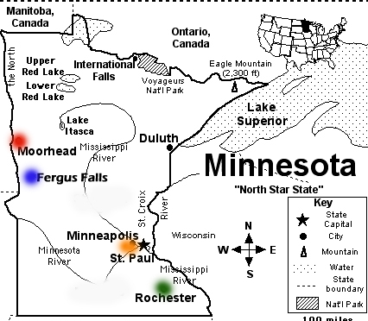
College-Readiness Alignment Sites
2004-2005 and 2005-2006
MSU-
Moorhead (3)
Moorhead HS (2)
Dilworth HS (1)
Normandale CC (3)
Eden Prairie HS (2)
Richfield HS (1)
MSCTC –
Fergus Falls (3)
Fergus Falls HS (2)
Underwood HS (1)
Rochester CC (3)
Rochester Mayo HS (2)
Rochester Century HS (1)

Slide 48


Alignment Site =
One college + two feeder high schools
- 2004-2005 2 sites (12 participants)
- 2005-2006 2 sites (12 participants)

Slide 49
The College-Ready Writing Standard:
“Scaling the Fence”
Each essay is read and rated by 12 readers (6 college faculty + 6 high school teachers)
Condition A. Reader Rating
For an essay to be rated college ready by a reader, it must meet
the fence rubric’s college-ready standard for Content, Organization,
and Conventions.
Condition B. Project Certified Rating
For an essay to meet the project’s college-ready standard, at least
8 of the 12 readers must give it a college-ready rating (Condition
A).
A + B = CR

Slide 50
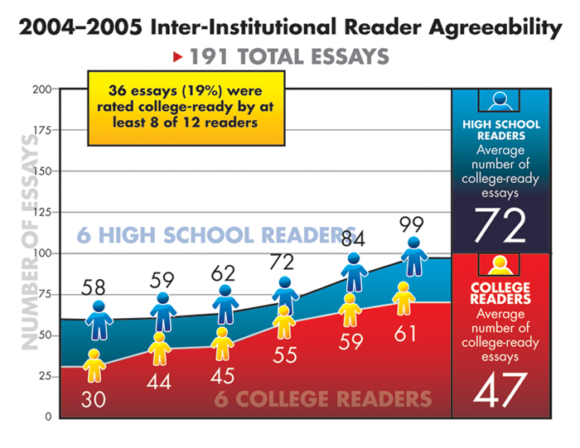

Slide 51
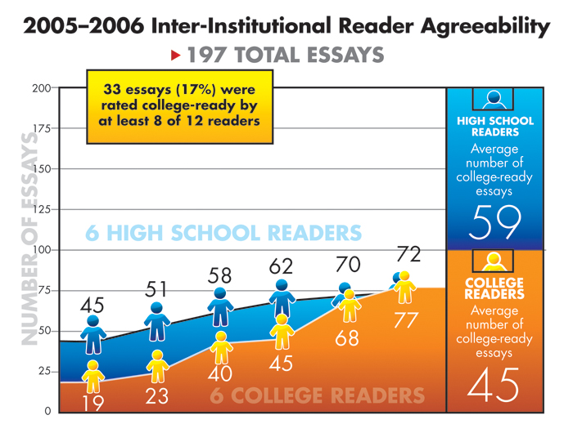

Slide 52
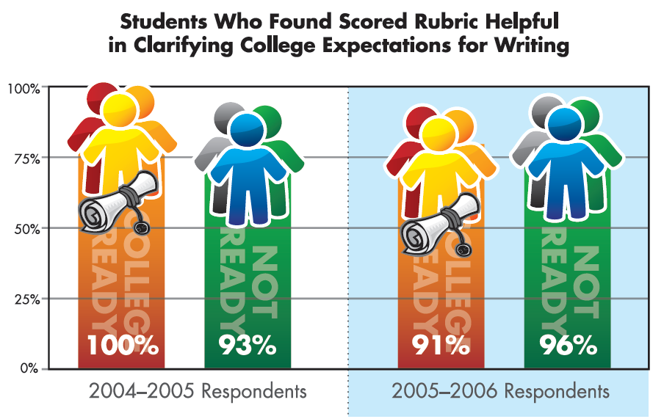

Slide 53
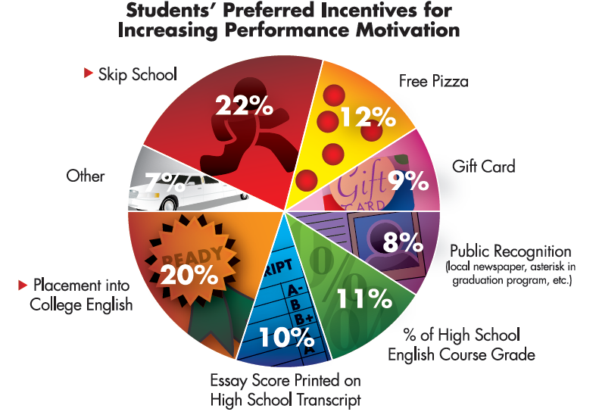

Slide 54
College Bound but Not College Ready
96% (306) of the students whose essays were rated not college ready (319) indicated they were planning to attend college.

Slide 55
AVATAR Data Follow-up
Paul Carney invites AVATAR participants to his website https://www.centerforcollegereadiness.org/
Mary Harris invites AVATAR data gatherers to consult at mary.harris@unt.edu or 940 565-4327.
Introduce yourself and your team to local Institutional Research officers.

