Slide 1
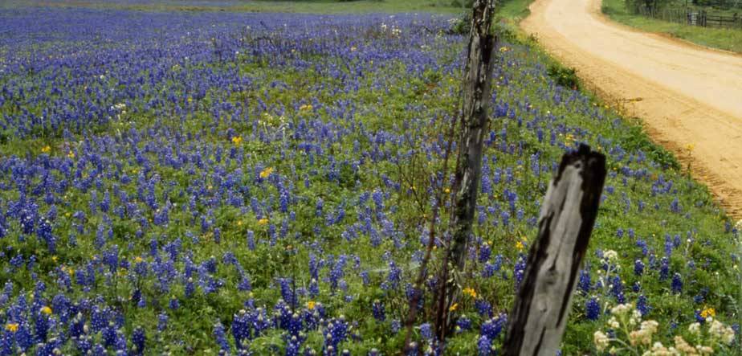
Heart of Texas
Area Profile
Heart of Texas P-20 Summit
April 19, 2016

Slide 2
Demographic Highlights
Population
Age
Ethnicity

Slide 3
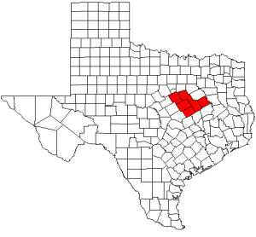
HOTCOG – Service Area and Total Population
Bosque – 17,891 ↓
Falls – 17,142 ↓
Freestone – 19,691 ↓
Hill – 34,855 ↓
Limestone – 23,320 ↓
McLennan – 245,671 ↑
Texas – 27,469,114 ↑↑
Source: U.S. Census Bureau – 2015 Estimates (% Change since 2010)
Notes:
Since 2014:
Bosque, Freestone, Hill slight recovery
Falls dropping
Limestone flat
McLennan continues growth
Texas added > 1M in last 18 months

Slide 4
Median Age
Source: U.S. Census Bureau – 2014 Estimates
Notes:
Counties in service area tend to be older than state
Median age
% over 18
Gap is growing over time

Slide 5
Ethnicity: Percent Hispanic or Latino
Source: U.S. Census Bureau – 2014 Estimates
Notes:
Main ethnicity change is Hispanic growth

Slide 6
Percent Home Language Other than English
Source: U.S. Census Bureau – 2014 Estimates
Notes:
% non-English speakers at home also growing
Primarily Spanish in central Texas
Houston has at least 145 different languages spoken…

Slide 7
Economic & Workforce Data
Labor force
Unemployment
Median Family Income
Poverty Rates

Slide 8
Labor Force & Unemployment Rate
 | Number in Labor Force | Percent Unemployed
Texas | 13,273,740 | 4.3% ↓
Bosque | 8,057 | 4.5% ↓
Falls | 6,454 | 4.3% ↓
Freestone | 7,452 ↓ | 5.4% ↔
Hill | 15,584 ↓ | 4.6% ↓
Limestone | 8,596 ↓ | 5.1% ↓
McLennan | 112,492 ↓ | 4.1% ↓
Source: U.S. Bureau of Labor Statistics – 2016 Local Area Unemployment Statistics
Notes:
16+, not in school
Almost 500K more employed in Texas than in 2013
Freestone, Hill, Limestone, McLennan had significant drops in the labor force
Contributed to drop in unemployment rate
Same data source, may reflect a change in models used at the Census Bureau

Slide 9
Unemployment Rate 2004-2016
Source: US Bureau of Labor Statistics http://www.bls.gov/eag/eag.us.htm
Notes:
Latest estimate for Waco MSA
– Feb 2016
– 3.8%

Slide 10
Median Household Income
Source: U.S. Census Bureau – 2014 Small Area Income and Poverty Estimates
Notes:
All increasing except Limestone

Slide 11
Percent of Persons Below Poverty Level
Source: U.S. Census Bureau – 2014 Small Area Income and Poverty Estimates

Slide 12
Education Data
Educational Attainment
Public School Outcomes
College Readiness and Performance

Slide 13
Percent with Bachelor's Degree or Higher
Source: U.S. Census Bureau – Texas Quickfacts
Notes:
Statewide goal of 60% (!)

Slide 14
2015 STAAR
All Grades, % Satisfactory or Above
Source: TEA Texas Academic Performance Report 2014-15 Region Performance

Slide 15
2015 STAAR
All Grades, % at Postsecondary Readiness
Source: TEA Texas Academic Performance Report 2014-15 Region Performance
Notes:
32% of local HS grads enrolled at MCC
43% of those enrolled in at least one developmental course

Slide 16
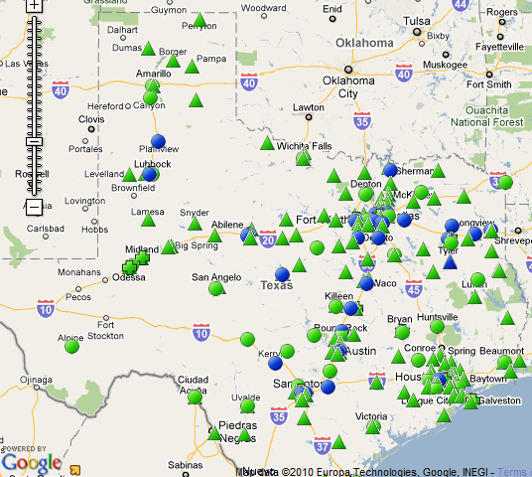
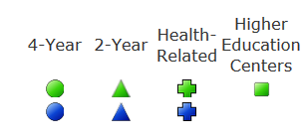
Texas Institutions of Higher Education
Baylor University (16,787)
McLennan Community College (8,305)
  University Center (1,155)
Hill College (4,089)
TSTC Waco (3,790)

Slide 17
Statewide Fall Enrollment 2009-2015
Source: txhighereddata.org, tacc.org

Slide 18
2013-14 HS Grads Enrolled in Texas Higher Education, Fall 2014
Source: THECB Report – 2013-14 High School Graduates Enrolled in Higher Education

Slide 19
Major Changes
Dual Credit Expansion
HB5 Endorsements & Higher Ed Pathways
Closing the Gaps → TX 60x30

Slide 20
Final Thoughts
Rural areas are losing population relative to state, getting older
  Entire area getting more diverse, mirroring state trends
Median Family Income lags behind state
  Higher levels of poverty in Falls, Limestone, McLennan counties
Economic recovery (in Texas) is finally complete
  Unemployment at or below 2007 levels
Notes:
We'll see what happens with the effect of oil prices

Slide 21
Conclusions
Low educational attainment relative to the State
Mismatch Between Standards and College Preparedness
  Only around 40% of college-bound graduates are prepared for college level work
  Under-prepared Students in Mathematics, Writing

Slide 22


