Slide 1
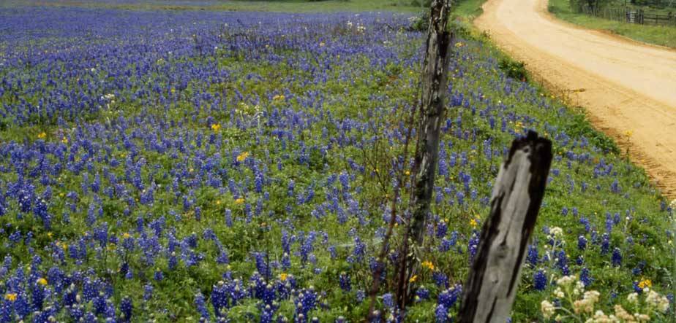
Heart of Texas
Area Profile
Heart of Texas P-20 Summit
December 1, 2014

Slide 2
Demographic Highlights
Population
Age
Ethnicity

Slide 3
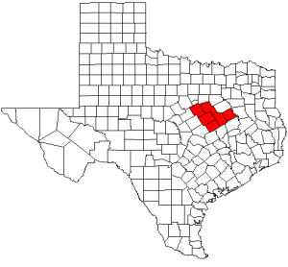
HOTCOG – Service Area and Total Population
Bosque – 17,855 (-2.0%)
Falls – 17,493 (-2.1%)
Freestone – 19,646 (-0.8%)
Hill – 34,823 (-0.8%)
Limestone – 23,326 (-0.3%)
McLennan – 241,481 (+2.8%)
Texas – 26,448,193 (+5.2%)
Source: U.S. Census Bureau – 2013 Estimates (% Change since 2010)

Slide 4
Median Age
Source: U.S. Census Bureau – 2013 Estimates
Notes:
Counties in service area tend to be older than state
Median age
% over 18
Gap is growing over time

Slide 5
Percent 18 Years and Over
Source: U.S. Census Bureau – 2013 Estimates
Notes:
Co

Slide 6
Ethnicity: Percent Hispanic or Latino
Source: U.S. Census Bureau – 2013 Estimates
Notes:
Main ethnicity change is Hispanic growth
- Large jump since 2009 due to new federal method for collecting/reporting R/E

Slide 7
Percent Home Language Other than English
Source: U.S. Census Bureau – 2013 Estimates
Notes:
% non-English speakers at home also growing
Primarily Spanish in central Texas
Houston has 250 different languages spoken…

Slide 8
Economic & Workforce Data
Labor force
Unemployment
Median Family Income
Poverty Rates

Slide 9
Labor Force & Unemployment Rate
 | Number in Labor Force | Percent Unemployed
Texas | 12,819,818 | 6.3%
Bosque | 8,118 | 6.6%
Falls | 6,509 | 8.3%
Freestone | 10,024 | 5.5%
Hill | 16,790 | 6.2%
Limestone | 11,278 | 6.0%
McLennan | 114,907 | 6.1%
Source: U.S. Bureau of Labor Statistics – 2013 Local Area Unemployment Statistics
Notes:
16+, not in school

Slide 10
Unemployment Rate 2004-2014
Source: US Bureau of Labor Statistics http://www.bls.gov/eag/eag.us.htm

Slide 11
Median Household Income
Source: U.S. Census Bureau – 2008-2012 Average

Slide 12
Percent of Persons Below Poverty Level
Source: U.S. Census Bureau – 2008-2012 Average

Slide 13
Education Data
Educational Attainment
Public School Outcomes
College Readiness and Performance

Slide 14
Percent with Bachelor's Degree or Higher
Source: U.S. Census Bureau – 2008-2012 Average
Notes:
Statewide goal of 60% (!)

Slide 15
2013 STAAR All Grades – % Level II & Above
Source: TEA Texas Academic Performance Report 2012-13 Region Performance

Slide 16
2013 STAAR EOC – % Level II & Above
Source: TEA Texas Academic Performance Report 2012-13 Region Performance
Notes:
EOC – End of Course

Slide 17
2013 TAKS Grade 11 – % Met Standard
Source: TEA Texas Academic Performance Report 2012-13 Region Performance

Slide 18
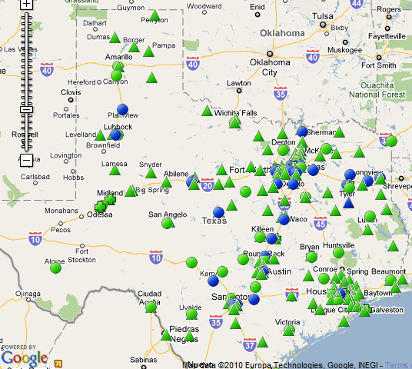
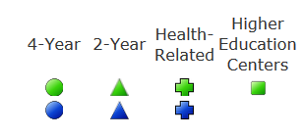
Texas Institutions of Higher Education
Baylor University (16,263)
McLennan Community College (8,329)
  University Center (1,100)
Hill College (4,026)
TSTC Waco (3,988)

Slide 19
Statewide Fall Enrollment 2009-2013
Source: txhighereddata.org, tacc.org
Notes:
Fall 2014 Preliminary data indicates
CCs down about 1% across the state
32 of 50 CCs reporting declines from Fall 2013
Next door, Central TX up 14% (largest in state)

Slide 20
2011-12 HS Grads Enrolled in Texas Higher Education, Fall 2012
Source: THECB Report – 2011-12 High School Graduates Enrolled in Higher Education

Slide 21
2013 High School Graduates Attending MCC Needing Developmental Coursework
32% of local HS grads enrolled at MCC
41% of those enrolled had at least one developmental need
Source: McLennan Community College Office of Institutional Research.
Notes:
32% of 2013 HS Grads from the local area attended MCC in Fall 2013
41% had at least one developmental need
Math is up 12% from 59% in 2011.

Slide 22
Final Thoughts
Rural areas are losing population relative to state, getting older
  Entire area getting more diverse, mirroring state trends
Median Family Income lags behind state
  Higher levels of poverty in Falls, Limestone, McLennan counties
Economic recovery is still incomplete
  Unemployment above 2007 levels

Slide 23
Conclusions
Low educational attainment relative to the State
Transition to final STAAR standards will prove a challenge
Mismatch Between Standards and College Preparedness
  Only around 60% of college-bound graduates are prepared for college level work
  Under-prepared Students in Mathematics

