Slide 1
Moving Beyond HB5 Mandates: Building Pathways to College Level Courses
Maria Esther Rodriguez, RGV FOCUS
Nicole Saenz, Region One ESC
Dr. Shirley Mills, UTRGV
Dr. Colin Charlton, UTRGV

Slide 2
RGV FOCUS Overview
RGV FOCUS Established in 2012
Engagement
Activation
Measurement and Communication

Slide 3
Vision and Goals
All RGV learners will achieve a degree or credential that leads to a meaningful career
All RGV students graduate high school college ready
All high school graduates transition to postsecondary within a year
All postsecondary students can achieve a degree or credential on time
All postsecondary graduates can be employed within 6 months
© RGV FOCUS 2016

Slide 4
Strategic Priorities
College & Career Readiness
Career Connections
College Supports
Excellent Teaching
Dropout Prevention & Recovery
Culture of Attending College
2013
2013
2015
2016
© RGV FOCUS 2016

Slide 5
House Bill 5 Mandate
Mandate for each school district to partner with at least one institution of higher education to develop two college prep courses (Math/English)
Courses are for 12th grade students who do not meet the college-readiness standards
© RGV FOCUS 2016

Slide 6







Regional Approach
© RGV FOCUS 2016

Slide 7
Why This Work Will Succeed
Student Focused
Collaborative
Community Centered
Evidence Driven
Transformational
© RGV FOCUS 2016

Slide 8
Math College Prep Course

Slide 9
College Prep Mathematics Course
The Course Design for the Region One – College Prep Mathematics Course emphasizes practice and mastery.
Students have seen the material before, but have not had time to master it.
The course design uses computer technology to deliver questions to students:
- Students get immediate feedback on their work.
    Instructors can intervene with students immediately.
    The course template is flexible and allows the instructor to adapt it to their class configuration.
The total cost of our course is $0 per student. The software and textbook are available free of charge.
© RGV FOCUS 2016

Slide 10
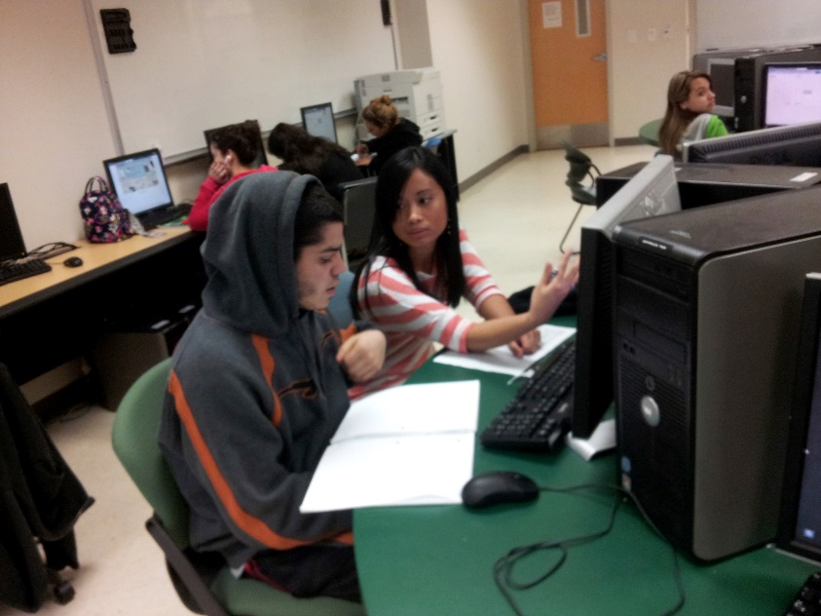
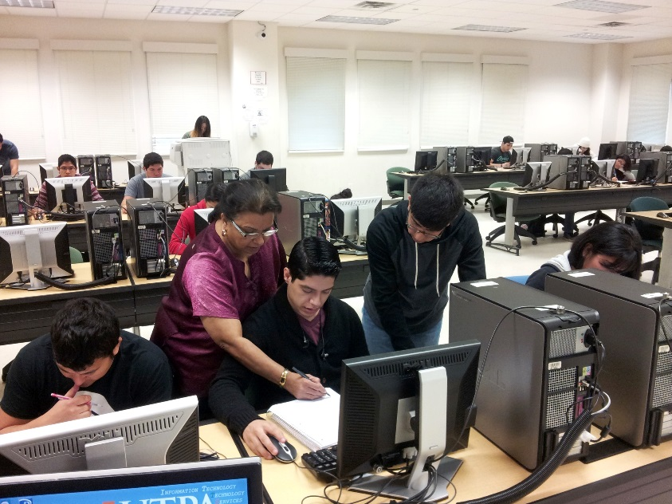
College Prep Mathematics Course
The Course Design for the Region One – College Prep Mathematics Course emphasizes practice and mastery.
This type of course design models the developmental mathematics courses at STC, TSC, TSTC, and the former UTPA.
© RGV FOCUS 2016

Slide 11




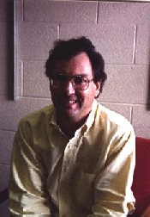
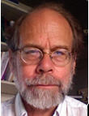
College Prep Mathematics Course
To achieve our low cost we are making using of an online software: WebWork.
WebWork is an online homework originally developed with a 1994 grant from the National Science Foundation at the University of Rochester (Pis Arnold Pizer and Michael Gage).
© RGV FOCUS 2016

Slide 12
College Prep Mathematics Course
It is currently supported by the MAA and the NSF: http://webwork.maa.org
It is available under a free license.
It is open: Work we do with it can be made freely available to any institution we share it with.
UTRGV (formerly UTPA) has been running a WebWork server since 2002. With Texas Tech (2000) these are two of the oldest continuously operating installations in the country.
© RGV FOCUS 2016

Slide 13
CPM – AY2014-2015 Results
The first iteration of the course featured a generic homework template not aligned to any particular textbook.
Many students successful in the first semester of the course passed the TSI Assessment.
In the first half of the course, students using WebWork extensively performed better on the final objective assessment than students whose course made little use of the software.
In the second half of the course this trend reversed.
© RGV FOCUS 2016

Slide 14
CPM – AY205-2016
For the second iteration of the course we made a significant change:
We have aligned our template with an online textbook: Beginning and Intermediate Algebra by Tyler Wallace (Big Bend Community College – Washington)
The textbook is available online
  http://www.wallace.ccfaculty.org/book/book.html
It is available under a creative commons license
Has worksheets and an answer key
Has videos by the author
This textbook is being used at UTSA and UTRGV for developmental mathematics interventions.
© RGV FOCUS 2016

Slide 15
CPM – AY205-2016
For the second iteration of the course we made a significant change:
Our course redesign also emphasized the success we have been having with the first semester preparing students for the TSI Assessment.
The first semester is now available to schools and non-profits as a stand-alone TSI Prep Workshop tool.
© RGV FOCUS 2016

Slide 16
Summary of CPM
Course cost is now $0 for partnering schools. This is unique in Texas.
Teachers have a well organized template.
Students are demonstrating success with the TSI Assessment.
Because we host the courses – We have access to the student data.
Because we host the courses – If a teacher has a problem we have the tools to solve it.
© RGV FOCUS 2016

Slide 17
Future of CPM and WebWork
Some plans for Texas College Prep Mathematics courses and WebWork:
A Texas specific version of the textbook.
Specific training for teachers running a TSI Prep Workshop on how to gauge student needs.
  An online version of the TSI Prep workshop that is self guided.
Adaptions of the course to other Regions, States, and Mexico.
Spanish language versions of the problems.
© RGV FOCUS 2016

Slide 18
English College Prep Course

Slide 19

College Transitions v1.0
Integrated reading, research, and writing curriculum
Rhetoric-based on development of purpose, audience, form, meaningful source integration, and language/style conventions
Scaffolded project sequence with multiple opportunities for theoretical application and revision
Extensive feedback guidelines for self-assessment, peer review, and instructor formative and summative evaluation
Designed for in-class work
Free as PDF or ebook through iTunes (Apple devices): tinyurl.com/rgvct
© RGV FOCUS 2016

Slide 20
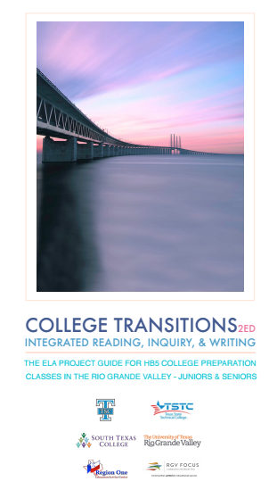
College Transitions v2.0
Integrated reading, research, and writing curriculum revised with high school teacher collaboration
Extensive in-text notes on teaching techniques and activities
Scaffolded 6-unit project sequence with 18 week project and 18 week self-defined project
Projects include literacy autobiography, audience analysis, audience-genre-purpose proposal, and finished project
Free as Chapter PDFs: tinyurl.com/rgvct
© RGV FOCUS 2016

Slide 21

College Transitions 2015-16 professional development & assessment
Workshops focused on feedback, revision, and portfolio preparation and assessment
Online discussion group at collegetransitions.freeforums.net
On site focus groups with College Transitions teachers and students
Portfolio assessment committee with IHE and HS partners
Random portfolio assessment from all high schools running CT
UTRGV teacher exchange program opportunity
© RGV FOCUS 2016

Slide 22
Advisory Committee & Professional Development

Slide 23
Advisory Council
Role:
  Provide feedback
  Act as central contact
  Other support
Feedback
  Reflections on 2014-2015
  Thoughts on 2015-2016
© RGV FOCUS 2016

Slide 24
HB5 College Prep Professional Development

Slide 25
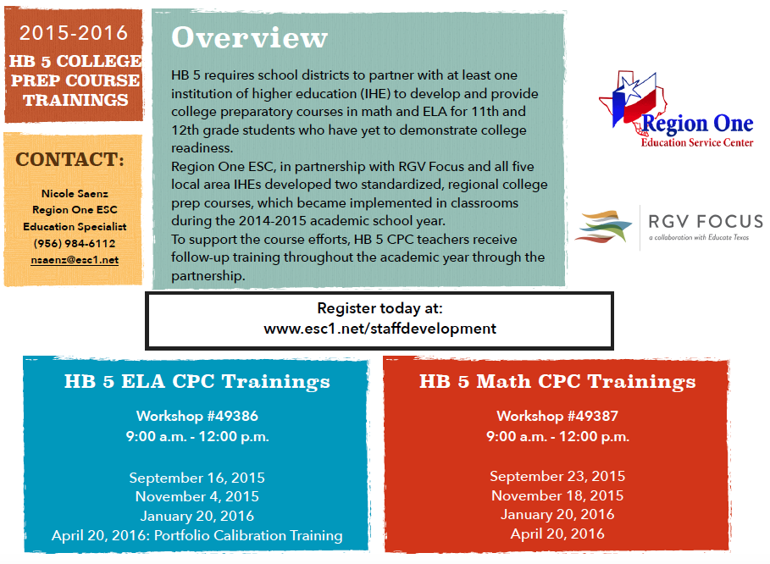

Slide 26
Scaling Beyond our Region
MOA Across Regions
Region 2
Coastal Bend
Del Mar College
TAMUCC
TAMUK
Region 1
UTRGV
STC
TSC
TSTC
LCC
TAMUI
Exploring Collaboration
Region 1
UTRGV
STC
TSC
TSTC
UTSA
Region 20
Alamo Colleges
© RGV FOCUS 2016

Slide 27
HB5 College Prep Course Materials
The following resources are available on the web via the RGV FOCUS website: http://rgvfocus.org/hb5-college-prep-courses/
College Prep Course Factsheet and Frequently Asked Questions
List of Partner School Districts
Sample Memo of Understanding
Memo of Agreement between Region One and Region Two
2015-2016 Professional Development Sessions for HS Teachers
Math College Prep Resources
English College Prep Resources
© RGV FOCUS 2016

Slide 28

Questions?

Slide 29
English Support Contacts
Colin Charlton, UTRGV
Colin.Charlton@utrgv.edu
Andrew Hollinger, UTRGV
Andrew.Hollinger@utrgv.edu
Howard Price, STC
hprice@southtexascollege.edu
Boye Sanchez, TSC
Boye.Sanchez@tsc.edu

Slide 30
Math Support Contacts
Virgil Pierce, UTRGV
virgil.pierce@utrgv.edu
Enrique Arredondo, STC
earredo@southtexascollege.edu
Abraham Jimenez, TSC
abraham.jimenez@tsc.edu

Slide 31
Region One & RGV FOCUS Contacts
Nicole A. Saenz, Region One
nsaenz@esc1.net
Tina Atkins, Region One
tatkins@esc1.net
Luzelma Canales, RGV FOCUS
lcanales@cftexas.org
Maria Esther Rodriguez, RGV FOCUS
erodriguez@cftexas.org

