Slide 1
Academic Vertical Alignment Training and Renewal (AVATAR) Project
Spring 2012 Pilot Project
Module Nine
A New Texas Core Curriculum

Slide 2

Focused on 21st Century Competencies Where do we start?
PERSONAL RESPONSIBILITY
Communication Skills
Empirical &
Quantitative Skills
Teamwork
CRITICAL THINKING SKILLS
Social Responsibility
Notes:
Opening Activity: Ask each team member to offer advice about which topic they would choose as their first priority with their students and where each of them would start addressing that priority.

Slide 3
Purpose of a Core Curriculum
Gain a foundation of knowledge of human cultures and the physical and natural world;
Develop principles of personal and social responsibility for living in a diverse world;
Advance intellectual and practical skills that essential for all learning.
Students will:
Does this sound familiar?

Slide 4
Six Core Objectives
Communication Skills – to include effective development, interpretation and expression of ideas through written, oral and visual communication.
Empirical & Quantitative Skills – to include the manipulation and analysis of numerical data or observable facts resulting in informed conclusions.
Teamwork – to include the ability to consider different points of view and to work effectively with others to support a shared purpose or goal.
Social Responsibility – to include intercultural competence, knowledge of civic responsibility, and the ability to engage effectively in regional, national, and global communities.
Personal Responsibility – to include the ability to connect choices, actions and consequences to ethical decision-making.
Critical Thinking Skills – to include creative thinking, innovation, inquiry, analysis, evaluation and synthesis of information.

Slide 5
Student Learning Outcomes (SLOs)
Social Responsibility – to include intercultural competence, knowledge of civic responsibility, and the ability to engage effectively in regional, national, and global communities.
  SLO: Students will demonstrate intercultural competence and civic knowledge by engaging effectively in local, regional, national, and global communities.
Personal Responsibility – to include the ability to connect choices, actions and consequences to ethical decision-making.
SLO: Students will demonstrate the ability to connect choices, actions and consequences to ethical decision-making.
Notes:
Let’s take a closer look at two of the core objectives that become Student Learning Outcomes

Slide 6
Foundational Components
Mathematics
Life & Physical Sciences
Communications
Language, Philosophy, & Culture
Creative Arts
American History
Government/Political Science
Social/Behavioral Science
Component Area Option
Notes:
College and University coursework foundation areas are embedding the SLOs into their course curriculums.

Slide 7
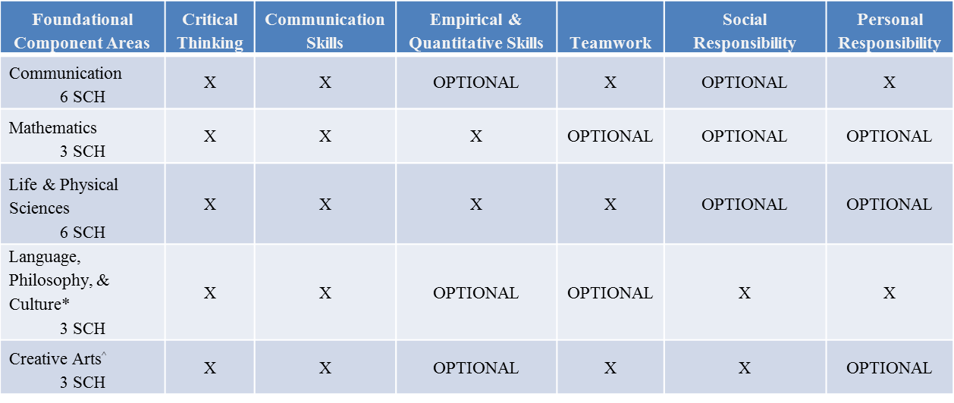
Mapping Core Objectives to Component Areas
Must contain a minimum of 3 Core Objectives selected by the institution

Slide 8
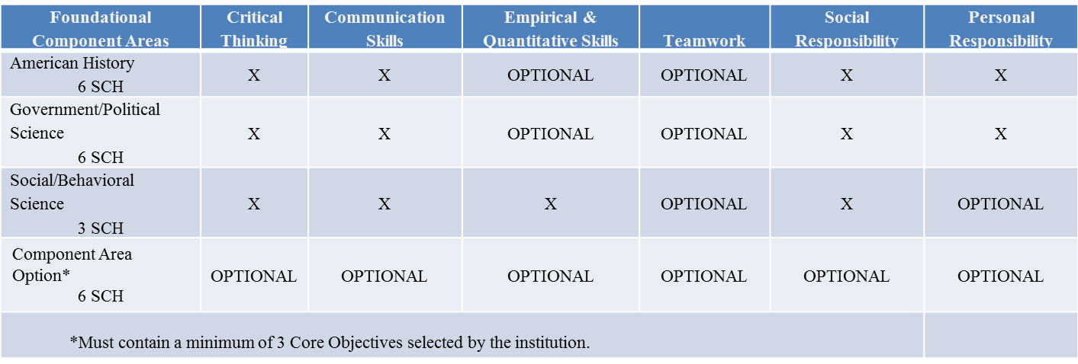
Mapping Core Objectives to Component Areas

Slide 9
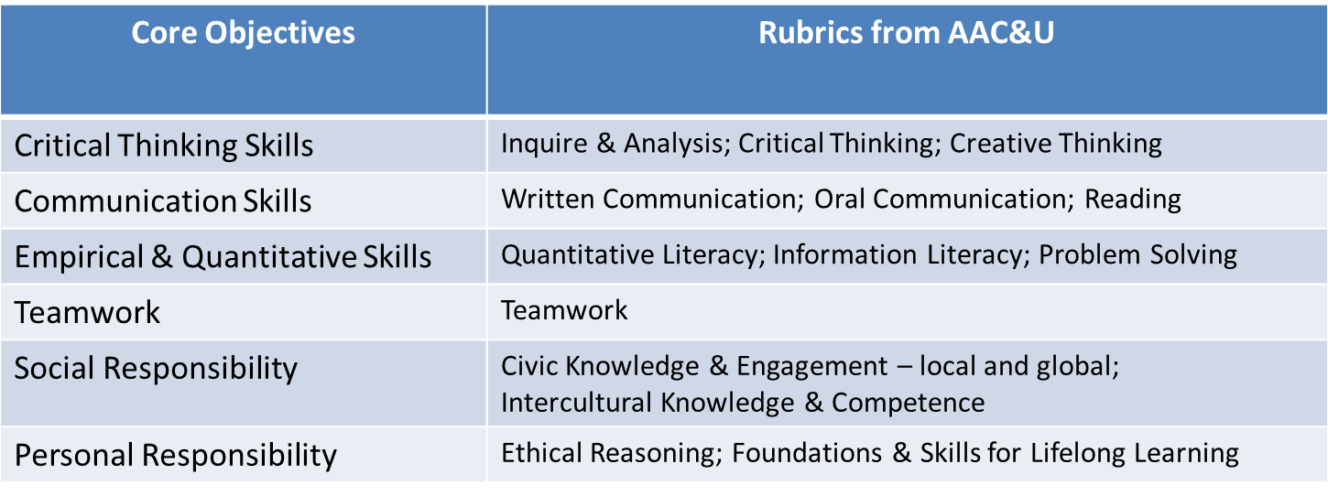
Assessment of the New Core
Association of American Colleges and Universities

Slide 10
VALUE Rubrics:
Valid Assessment of Learning in Undergraduate Education
As part of the VALUE project, teams of faculty and other academic and student affairs professionals engaged in an iterative process over eighteen months wherein they gathered, analyzed, synthesized, and then drafted institutional level rubrics (and related materials) for 15 of the AAC&U Essential Learning Outcomes.
The rubric development teams relied on existing campus rubrics when available, other organizational statements on outcomes, experts in the respective fields and faculty feedback from campuses throughout the process. Each VALUE rubric contains the most common and broadly shared criteria or core characteristics considered critical for judging the quality of student work in that outcome area.
The VALUE rubrics reflect faculty expectations for essential learning across the nation regardless of type of institution, mission, size or location. In several cases, outcomes that AAC&U paired in the Essential Learning Outcomes (e.g., written and oral communication) have been separated with the intent of developing individual VALUE rubrics for each.
Source: http://www.aacu.org/VALUE/rubrics/index_p.cfm
Notes:
As part of the VALUE project, teams of faculty and other academic and student affairs professionals engaged in an iterative process over eighteen months wherein they gathered, analyzed, synthesized, and then drafted institutional level rubrics (and related materials) for 15 of the AAC&U Essential Learning Outcomes, creating the set of VALUE rubrics that appears below. The rubric development teams relied on existing campus rubrics when available, other organizational statements on outcomes, experts in the respective fields and faculty feedback from campuses throughout the process. Each VALUE rubric contains the most common and broadly shared criteria or core characteristics considered critical for judging the quality of student work in that outcome area.
The VALUE rubrics reflect faculty expectations for essential learning across the nation regardless of type of institution, mission, size or location. In several cases, outcomes that AAC&U paired in the Essential Learning Outcomes (e.g., written and oral communication) have been separated with the intent of developing individual VALUE rubrics for each.

Slide 11



Look Closer at a Core Class
Examine Student Learning Outcomes (SLO) with an eye to curriculum alignment.
What are students expected to
know and be able to do at the end
of the course?
Write SLO statements that clearly represent the knowledge, skills, attitudes, competencies,
and habits of mind, that students are
expected to acquire.
Notes:
Give groups time to explore the SLOs and debrief: What did you discover?

Slide 12
Further Information
http://www.thecb.state.tx.us/corecurriculum2014
Full implementation in the fall of 2014

Slide 13
Group Inquiry
Secondary will bring course information that is considered a prerequisite to the college core course
Postsecondary (two and four-year) will bring a course syllabi for the content specific core course.
Secondary group members will share the CCRSs and related cross-disciplinary standards and goals built into the content specific- course(s).
Postsecondary group member will share the foundational component area and related core objectives for the course
Notes:
Kathy can they bring these????

Slide 14

An Even Closer Look
The three-level structure to shape SLOs –
  Outcomes = clearly identified
  Instruction = content vocabulary, instructional methods, assignments, sample class lessons, student resources
  Assessment = testing, rubrics, grading, evaluation methods
    Determine how to identify SLOs achieved prior to student passing the course
Examine your courses noting alignments and gaps
  Course prerequisites
  Course policies (extra credit, late assignments, etc.)
  Course practices
  Course expectations (technology, equipment use, textbook purchase, attendance, etc.)

Slide 15
A Closer Look at a Core Class
A BIG Question:
How do we link outcomes to assessments?
Notes:
Record a summary of the group’s answers.

Slide 16
Core Class Expectations
How will you know if the course was successful in terms of student learning outcomes expected
  College and Career Readiness Standards
  Cross disciplinary
  Core foundational components
  Core objectives
Notes:
Record a summary of the group’s answers.

Slide 17




Slide 18
Partners for Success
Counselors
Community
Campus Staff
Students
Parents
Administrators
Teachers
Notes:
Counselors
Teachers
Administrators, especially the principal
Other campus staff (specialists, school psychologists, nurses, special education staff)
Parents
Community and business leaders - recruit individuals who can influence and hold the confidence of the school decision makers
These partners can form a steering committee and sounding board to assist a district/campus in:
Guiding efforts to create a culture of college and career readiness
Reviewing results of needs assessments
Making recommendations for program development
Reviewing accountability data and outcomes research
Locating internal and external funding sources
Remember, it takes a village, a community to raise a child.

