Slide 1
Vertical Alignment for
Student Success Post HB 5
Texas ASCD, Austin
October 27, 2015

Slide 2
Presentation Overview
The AVATAR model
HB 5’s reshaping of vertical alignment collaborations
AVATAR in Region 12 (Waco)
AVATAR in Region 20 (San Antonio)
http://untavatar.org

Slide 3

The AVATAR
Model

Slide 4
Foundations of AVATAR
  Closing the Gaps
  Student Participation
  Student Success
Source: Closing the Gaps Progress Report, June 2012
Retrieved from: http://www.thecb.state.tx.us/index.cfm?objectid=858D2E7C-F5C8-97E9-0CDEB3037C1C2CA3

Slide 5
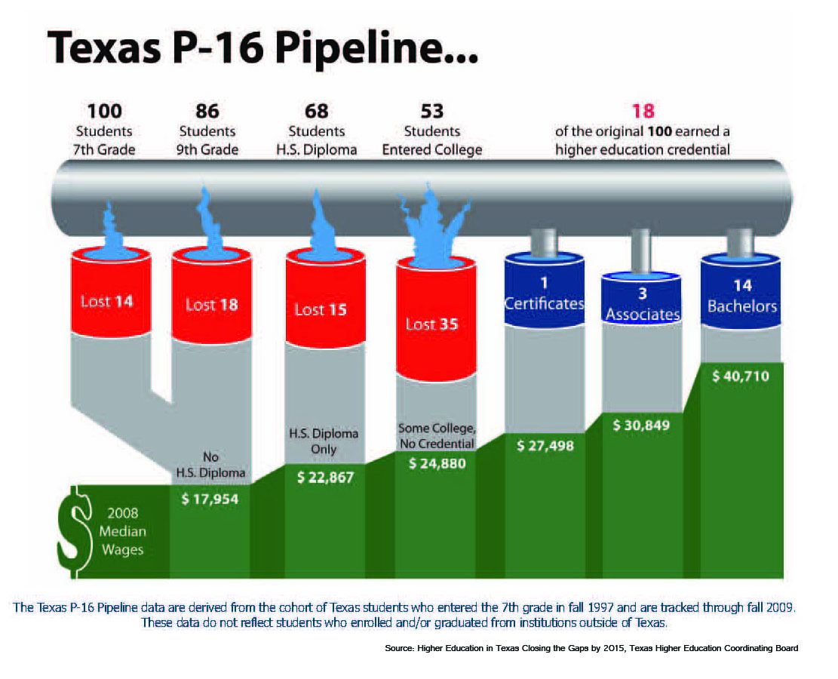
The Texas P-16 Pipeline, 2007

Slide 6
Success Measure 1:
Percent College Ready High School Graduates, 2013-2014
Public High School Graduates Class of 2013 N=301,418 | All | African American | Hispanic | White | Asian
ELA | 65 | 53 | 58 | 75 | 80
Mathematics | 74 | 60 | 69 | 83 | 90
Both subjects | 56 | 41 | 48 | 69 | 77
  Other Descriptors of Student Body in Percentages:
Source: State TAPR, TEA, 2014
http://untavatar.org

Slide 7
Success Measure 2: Percent Advanced Course Dual Credit Completion in 2013-14
  Other Descriptors of Student Body in Percentages:
Public High School Students, 2013-2014 | All | African American | Hispanic | White | Asian
2013 | 31.4 | 24.2 | 28.5 | 35.6 | 57
2012 | 30.5 | 24.0 | 26.2 | 34.9 | 55.7
Source: State TAPR, TEA, 2014
http://untavatar.org

Slide 8
Success Measure 3: Percent AP/IB Enrollees Tested and Meeting Criteria in 2013-14
  Other Descriptors of Student Body in Percentages:
Public High School Students | All | African American | Hispanic | White | Asian
Tested | 22.1 | 13.7 | 19.5 | 24.9 | 53.6
Met Criteria | 50.9 | 27.3 | 37.5 | 64.3 | 72.5
Source: State TAPR, TEA, 2014
http://untavatar.org

Slide 9
Success Measure 4: Percent 2012 Graduates Completing One Year in Higher Education without Remediation
  Other Descriptors of Student Body in Percentages:
Public High School Graduates Class of 2012 | All | African American | Hispanic | White | Asian
Enrolled | 57.3 | na | na | na | na
Completed One Year no Remediation | 69.0 | na | na | na | na
Source: State TAPR, TEA, 2014
http://untavatar.org

Slide 10
What is Alignment?
  Alignment assumes a standards-based system of curriculum and assessment. Vertical alignment attends to articulation of curriculum across levels of education and requires willingness to focus instruction, assessment, staff development, and management so that students succeed. Horizontal alignment attends to student learning in every section of the same grade or class.
  Reference: Squires, D. A. (2009). Curriculum Alignment: Research-Based Strategies for Increasing Student Achievement. Thousand Oaks, CA, Corwin,

Slide 11
Alignment Research
  Squires (2009) reviewed research and concluded:
  Alignment improves student outcomes.
  Alignment is a powerful tool for assuring the written, taught and tested curriculum are the focus of instruction, assessment, and professional development.
  Smith (2014) focused on Algebra 1 and concluded:
    Alignment of high school instruction around frameworks and vertical progressions enhances student success and is facilitated by collaborative planning and professional development.
  References: Squires, D. A. (2009). Curriculum Alignment: Research-Based Strategies for Increasing Student Achievement. Thousand Oaks, CA, Corwin,
  Smith, T.M. (2014). Curricular Alignment to Support Student Success in Algebra. American Institute for Research. Retrived from https://www2.ed.gov/programs/dropout/curricularalignment092414.pdf

Slide 12
High Schools
2 Year IHEs
Scaffolding
Student
Success
4 Year IHEs
Regional ESCs
Regional P-16
Councils
AVATAR is a Partnership of Regional Leaders from these institutions

Slide 13
AVATAR Partnerships Form
Vertical Alignment Teams
Vertical Alignment Teams (VATs): Educators and leaders representing AVATAR partners who are committed to addressing discipline specific course needs to create environments where students can make successful transitions between and among regional educational systems.
http://untavatar.org

Slide 14
The AVATAR Process
Creates and builds relationships through ongoing critical conversations
Uses regional data to make alignment decisions
Develops shared understanding of college and career readiness and success for students
Identifies and implements intentional actions
Evaluates, sustains, and shares vertical alignment work
http://untavatar.org

Slide 15
AVATAR enables Critical Conversations
Secondary
Post-Secondary
Graduate College/Career Ready
Graduate Career Ready
Impact of Developmental Education and
Texas Success Initiative
Dual Credit, Early College High Schools
Student Support Services
Educational Policies & Practices
Classroom Instruction, Textbooks
Grading, etc.
Discipline Reference Course
Profiles
College & Career Readiness
Standards
Student Success Assessments
Dual Credit, Early College High Schools
Student Support Services
Educational Policies & Practices
Classroom Instruction, Textbooks
Grading, etc.
Discipline Specific Course Curriculum
Texas Essential Knowledge and Skills

Slide 16
The Statewide Network
Mathematics
ESC 2, Citizens for Educational Excellence, Education to Employment Partners P-16 Council, TAMU-Corpus Christi, TAMU-Kingsville, Del Mar College, Coastal Bend College, Robstown ISD, Odem-Edroy ISD, Corpus Christi ISD, & Calallen ISD.
ESC 9, Region 9 P-16 Council, Midwestern State University, Vernon College, Burkburnett ISD, Wichita Falls ISD, Iowa Park CISD, and Vernon ISD.
ESC 10, North Texas Regional P-16 Council, University of North Texas , Dallas CCCD, Brookhaven College, Carrolton Farmers Branch ISD& Dallas ISD.
ESC 12, Heart of TX P-20 Council, McLennan Community College, Texas State Technical College, Waco ISD, La Vega ISD, Midway ISD, Robinson ISD, Rapoport Academy, Reicher Catholic School, & Baylor University.
ESC 15. San Angelo P-16+ Partnership, Howard College, Angelo State University, San Angelo ISD & TLC Charter School.
ESC 16, Panhandle P-16 Council, West Texas A&M University, Amarillo College, Clarendon College, Frank Phillips College, Amarillo ISD, Borger ISD, & Canyon ISD.
Region 20, P16 Plus Council of Greater Bexar County, UT-San Antonio, Alamo Colleges, Palo Alto College, & Harlandale ISD.
2013-2014
English Language Arts
ESC 6, Sam Houston State University P-16 Council , Sam Houston State University, Lone Star College System, Huntsville ISD, & Sam Houston State University Regional P-16 Council (Huntsville).
ESC 9, Region 9 P-16 Council, Midwestern State University, Vernon College, Burkburnett ISD, Vernon ISD, Iowa Park CISD, Windthorst ISD, & Wichita Falls ISD.
ESC 11, North Texas Regional P-16 Council, Tarleton State University, Hill College, Burleson ISD, Cleburne ISD, Godley ISD, & Joshua ISD.
ESC 12, Heart of TX P-20 Council, McLennan Community College, Texas State Technical College, Waco ISD, La Vega ISD, Midway ISD, Robinson ISD, Rapoport Academy, Reicher Catholic School, West Midway & Baylor University.
ESC 15, San Angelo P-16+ Partnership, Howard College, Angelo State University, Eden CISD, Wall ISD & San Angelo ISD.
Region 20, P16 Plus Council of Greater Bexar County, UT-San Antonio, Alamo Colleges, Palo Alto College, & Harlandale ISD.
Science
ESC 1, Upper Rio Grande Valley P-16, UT-Pan Am, South Texas College, South Texas ISD, Missions ISD, Weslaco ISD, McAllen ISD, & Pharr San Juan Alamo ISD.
ESC 10, North Texas Regional P-16 Council, University of North Texas , Dallas CCCD, Brookhaven College, Carrolton Farmers Branch & Dallas ISD.
College Awareness
ESC 7, Deep East Texas P-16 Council/Stephen F. Austin University, Kilgore College, Kilgore ISD, Panola Charter, & Tyler Junior College.
Notes:
46

Slide 17
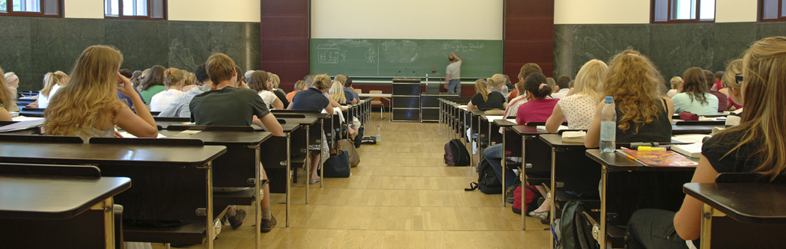
House Bill 5:
Provisions with Implications for Vertical Alignment

Slide 18
Provision 1: College Preparatory Courses (CPCs)
Districts must partner with at least one IHE to develop college prep courses in math and ELA for 12th grade students who do not meet college readiness standards or whose performance indicates they are not ready for entry-level college coursework.
Effective 2013-2014 (with courses to be provided no later than 2014-2015)
High school and IHE faculty keep meeting regularly as necessary to ensure courses are aligned with college readiness expectations.
Notes:
HB 5, Section 10 (TEC 28.014); LBB p. 115
Notes:
This is specific to mathematics and ELA courses.
Not meeting college readiness standards is automatically indicated if the student fails an EOC exam.

Slide 19
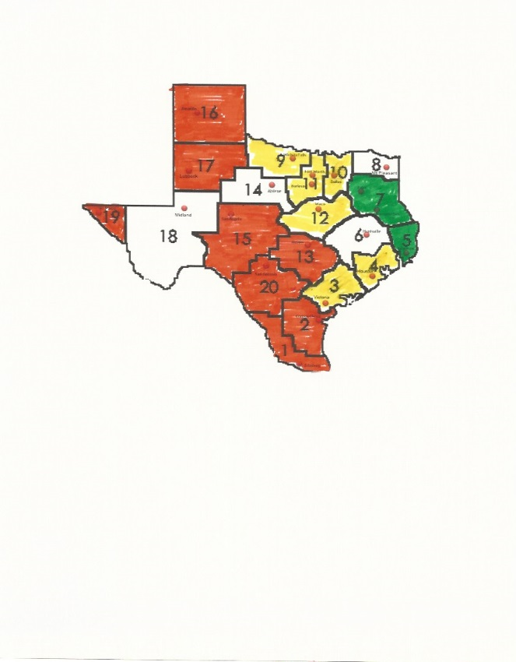
What was accomplished by ESC regions in 2014-15?

Slide 20
How CPC’s link to a national interest in transitions for high risk students
NUMBERS OF REGIONAL ACTIVITIES AND PARTICIPANTS, 2014-2015
By providing for College Preparatory Courses, Texas joins 37 other states that are exploring high school transitional courses as an alternative to developmental education (Barnett et al, 2013).
College Preparatory Courses support imperatives to to address student need for remediation at the lowest possible level, using fast-track models, and support brush-up before placement testing (Center for Community College Student Engagement, 2014; Office of President, 2014).
Center for Community College Student Engagement (2014). A Matter of Degree: Practices to Pathways. Austin TX: University of Texas at Austin, Higher Education Leadership.
Executive Office of the President (2014). Increasing College Opportunity for Low-Income Students. Washington D.C. : White House.
Barnett, E. A., Frey, M. P., Trimble, M. J., & Pheatt, L(2013). Reshaping the College Transition. Teachers College, Columbia University: Community College Research Center.

Slide 21
Provision 2: Endorsement Options
Endorsements
STEM (Science, Technology, Engineering, and Mathematics)
Business and Industry
Public Services
Arts and Humanities
Multidisciplinary Studies
Notes:
Notes:
HB 5 requires that the endorsement will be placed on the diploma and transcript.
SBOE can choose to include specific course requirements in each of the endorsement areas but we do not know yet if they will do this. They have the authority to do so.
HB 5 requires that students must have multiple options for earning each endorsement, including, to the greatest extent possible, coherent sequences of courses. Additionally, the statute requires that student must be permitted to enroll in courses under more than one endorsement curriculum before the student’s junior year.
STEM – least complicated endorsement in statute. TEA has talked with SBOE about possible CTE courses for this area.
Business and Industry – aligns a lot to the current career clusters in CTE. TEA has visited with SBOE about possibly aligning these to the current coherent sequences in clusters.
Public Services – Per TEA’s conversation with SBOE, Culinary Arts & Hospitality may be moved from this endorsement to the Business and Industry endorsement.
Arts and Humanities – Per TEA’s conversation with SBOE, Political Science may be moving to Public Services – as that is more closely aligned with where courses reside within current course clusters.

Slide 22
Endorsement Requirements
Endorsements
A student shall specify in writing the endorsement the student intends to earn on entering Grade 9.
A district shall permit a student to enroll in courses under more than one endorsement before the student’s junior year and to choose, at any time, to earn an endorsement other than the endorsement previously specified.
A student must earn at least 26 hours to earn an endorsement.
A school district must make available to high school students courses that allow the student to complete at least one endorsement.
A school district that offers only one endorsement must offer the Multidisciplinary endorsement.
A school district may define advanced courses and determine a coherent sequence of courses for an endorsement area provided that prerequisites in Chapters 110-118, 126-127, and 130 are met.
Notes:
Notes:
HB 5 requires that the endorsement will be placed on the diploma and transcript.
SBOE can choose to include specific course requirements in each of the endorsement areas but we do not know yet if they will do this. They have the authority to do so.
HB 5 requires that students must have multiple options for earning each endorsement, including, to the greatest extent possible, coherent sequences of courses. Additionally, the statute requires that student must be permitted to enroll in courses under more than one endorsement curriculum before the student’s junior year.
STEM – least complicated endorsement in statute. TEA has talked with SBOE about possible CTE courses for this area.
Business and Industry – aligns a lot to the current career clusters in CTE. TEA has visited with SBOE about possibly aligning these to the current coherent sequences in clusters.
Public Services – Per TEA’s conversation with SBOE, Culinary Arts & Hospitality may be moved from this endorsement to the Business and Industry endorsement.
Arts and Humanities – Per TEA’s conversation with SBOE, Political Science may be moving to Public Services – as that is more closely aligned with where courses reside within current course clusters.

Slide 23
Provision 3: Locally Developed CTE Courses/Activities
Districts may offer courses or other activities, including apprenticeships, needed for industry-recognized credentials or certificates
Notes:
Section 8, 28.002(g-1); LBB p. 54
Conditions required:
The district develops a program under which the district partners with a public or private institution of higher education and local business, labor, and community leaders to develop and provide the course; and
The course or other activity allows the student to enter:
A CTE training program in the district’s region of the state;
An IHE without remediation;
An apprenticeship training program; or
An internship required as part of the accreditation toward an industry-recognized credential or certificate for course credit.
28.002 (g-2) Reporting
District must annually report to TEA names of the courses, programs, IHE, and internships in which the students have enrolled under (g-1) and TEA must make this information available to other districts

Slide 24
Provision 4: TEC 39.0545
To evaluate community and student engagement
Districts and campuses can showcase where they are excelling and where there is room for improvement
  Not all should be exemplary…..
To tell the story of what is happening in districts and on campuses when it’s not a test day
An opportunity to highlight community values, which are varied across the state and sometimes within a district
  Reference: TATA (2015). TASA House Bill 5 Community Engagement Background Overview and Requirements of the New Statute. Located at http://www.tasanet.org/domain/175

Slide 25

AVATAR in Region 12

Slide 26

Avatar in Region 20
http://untavatar.org

Slide 27
Presenters
Mary Harris
Christine Holecek
Ravae Schaeffer
Professor Emerita
Co-director, AVATAR
University of North Texas
Denton, TX
Mary_harris@unt.edu
940 367-3026
Education Specialist II
Education Service Center Region 12
Waco, TX
cholecek@esc12.net
254 297-1284

