Slide 1



College Preparatory Courses – Region 8
Thursday, June 2, 2016 2-4 p.m.

Slide 2
Introductions
Texarkana College
Lisa Jones, Coordinator for Developmental Education
Texas A&M – Texarkana
Brittany Barnett, Coordinator of TRIO Student Support Services
DeKalb ISD
Stephanie Sparks, Assistant Superintendent
Lea Dooley, High School Counselor
Lori Shelton, High School English Teacher
Pam Montgomery, High School Math Teacher

Slide 3
Academic Vertical Alignment Training and Renewal
AVATAR
Development
Explanation
AVATAR is a statewide network, comprised of regional efforts, focused on vertical alignment to support students’ college and career readiness and success.
AVATAR is a Texas Higher Education Coordinating Board (THECB) project which is implemented by the North Texas Regional P-16 Council and the University of North Texas.
Notes:
2011 North Texas Regional P-16 Council, UNT, THECB
2014-15 CP Courses
Summer 2015 Region 8 ESC
January 2016 TC

Slide 4
Region 8 Goals
Develop ISD, post-secondary, and workforce/P-16 partnerships appropriate to local endorsement options
Facilitate offering and documentation of College Preparatory Courses (CPCs) of the partnership
Deepen vertical alignment of the ELA and Math offerings of local ISDs and post-secondary partners

Slide 5
region 8 objectives SUPPORTING THE GOALS
:
Increase knowledge and understanding of College Preparatory Courses among local ISDs through the ISD, post-secondary, and workforce partnership
Develop common documentation system for notation of College Preparatory Course completion on high school transcripts and reporting system for course data
Develop vertical alignment documents, teacher resources, and a share point for College Preparatory ELA and Math partners

Slide 6
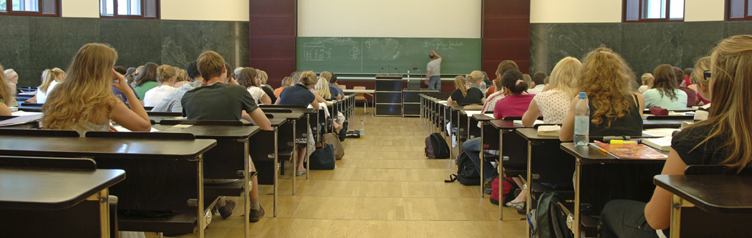
Are we really responsible for getting all students college and career ready?

Slide 7
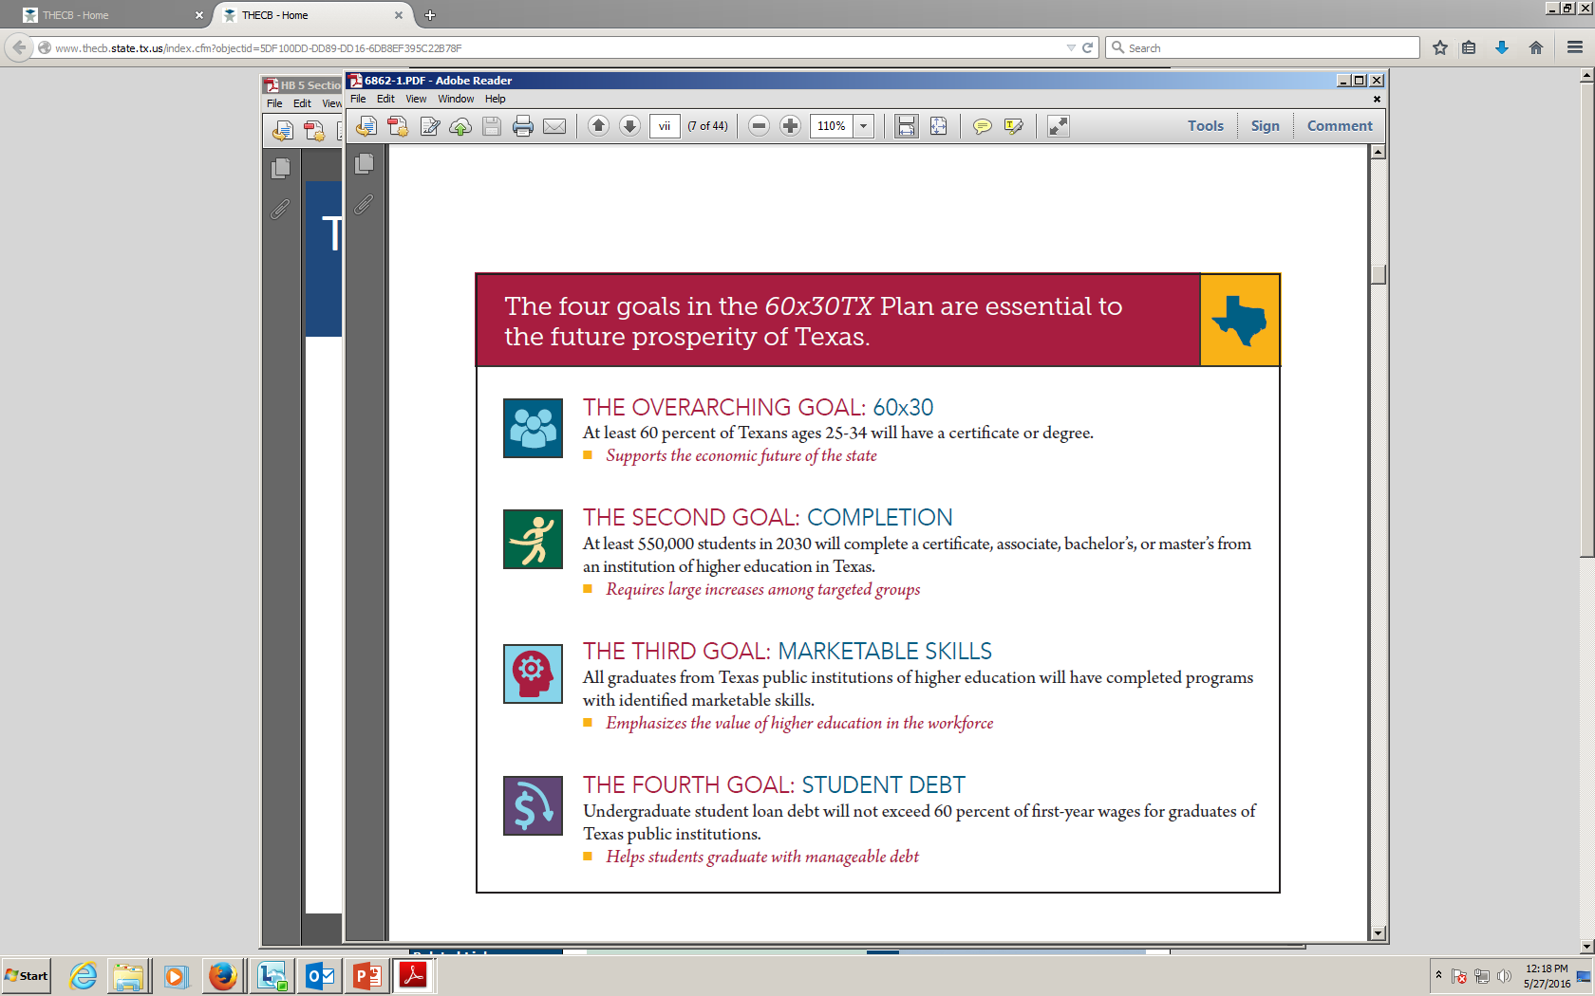
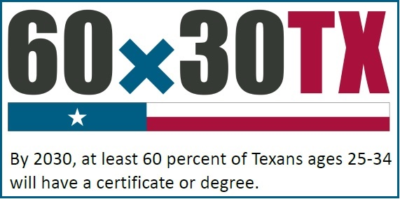
TEXAS GOALS

Slide 8
Region 8 college enrollment data Fall 2015
District | Total Graduates | Enrolled at TC | Enrolled at A&M – T | Enrolled Other IHE (Texas) | Not Enrolled IHE (TX)
Atlanta | 132 | 18 | 5 | 18 | 91
DeKalb | 62 | 16 | 0 | 8 | 38
Hooks | 66 | 22 | 0 | 3 | 41
Hughes Springs | 64 | 0 | 0 | 36 | 28
Liberty-Eylau | 157 | 21 | 7 | 15 | 114
Linden-Kildare | 53 | 7 | 0 | 12 | 34
New Boston | 100 | 25 | 0 | 18 | 57
Pleasant Grove | 152 | 26 | 7 | 20 | 99
Queen City | 77 | 13 | 0 | 17 | 47
Redwater | 71 | 16 | 0 | 13 | 42
Simms | 42 | 11 | 0 | 6 | 25
Texarkana | 436 | 73 | 19 | 65 | 279
TOTALS | 1,412 | 248 | 38 | 231 | 895
Percentages |  | 18% | 3% | 16% | 63%
Source: THECB and TEA

Slide 9


Slide 10
Region 8 Post secondary college ready 2014-2015
 | State | Region 8
College Ready Graduate
ELA
Class of 2014 | 68% | 66%
Class of 2013 | 65% | 64%
Math
Class of 2014 | 67% | 65%
Class of 2013 | 74% | 70%
Source:
TEA Texas Performance Reporting System

Slide 11
Dual Credit enrollment at Texarkana College
 | Math | English
Fall 2014 | 546 | 237
Spring 2015 | 393 | 198
Source: Texarkana College Office of Research and Institutional Effectiveness

Slide 12
HB5 and college preparatory course requirements
Texas Education Code 28.014 – College Preparatory Courses (Handout)
(a) Each school district shall partner with at least one institution of higher education to develop and provide courses in college preparatory mathematics and English language arts. The courses must be designed:
(1) for students at the 12th grade level whose performance on:
(A) an end-of-course assessment instrument required under Section 39.023(c) does not meet college readiness standards; or
(B) coursework, a college entrance examination, or an assessment instrument designated under Section 51.3062(c) indicates that the student is not ready to perform entry-level college coursework; and
(2) to prepare students for success in entry-level college courses.

Slide 13
HB5 and college preparatory course requirements
(b) A course developed under this section must be provided:
(1) on the campus of the high school offering the course; or
(2) through distance learning or as an online course provided through an institution of higher education with which the school district partners as provided by Subsection (a).
(c) Appropriate faculty of each high school offering courses under this section and appropriate faculty of each institution of higher education with which the school district partners shall meet regularly as necessary to ensure that each course is aligned with college readiness expectations.
The commissioner of education, in coordination with the commissioner of higher education, may adopt rules to administer this subsection.

Slide 14
HB5 and college preparatory course requirements
(d) Each school district shall provide a notice to each district student to whom Subsection (a) applies and the student’s parent or guardian regarding the benefits of enrolling in a course under this section.
SAMPLE LETTER PROVIDED IN PACKET
(e) A student who successfully completes an English language arts course developed under this section may use the credit earned in the course toward satisfying the advanced English language arts curriculum requirement for the foundation high school program under Section 28.025(b-1)
(1). A student who successfully completes a mathematics course developed under this section may use the credit earned in the course toward satisfying an advanced mathematics curriculum requirement under Section 28.025 after completion of the mathematics curriculum requirements for the foundation high school program under Section 28.025(b-1)(2).

Slide 15
HB5 and college preparatory course requirements
(f) A course provided under this section may be offered for dual credit at the discretion of the institution of higher education with which a school district partners under this section.
(g) Each school district, in consultation with each institution of higher education with which the district partners, shall develop or purchase instructional materials for a course developed under this section consistent with Chapter 31.
The instructional materials must include technology resources that enhance the effectiveness of the course and draw on established best practices. RESOURCE LIST PROVIDED IN PACKET
(h) To the extent applicable, a district shall draw from curricula and instructional materials developed under Section 28.008 in developing a course and related instructional materials under this section.
A course developed under this section and the related instructional materials shall be made available to students not later than the 2014-2015 school year.
HB 5 Frequently Asked Questions – College Preparatory Courses - HANDOUT PROVIDED

Slide 16

What are student benefits of being college ready?

Slide 17
College ready STUDENT BENEFITS AND SCOPE OF IMPACT
TIME SAVINGS FOR STUDENT
Developmental Math at TC
1 semester of DE (3 hour class)
STEM – 2 8 week courses or Non-STEM – 1 16 week course
Developmental English at TC
2 semesters of DE – second semester is paired with a College Level Composition I Course ( 4 hour classes)

Slide 18
College ready STUDENT BENEFITS AND SCOPE OF IMPACT
FINANCIAL SAVINGS FOR STUDENT
TUITION AND FEES FOR DEVELOPMENTAL EDUCATION AT TEXARKANA COLLEGE | In-District | Out of District | Non-Resident
TSI Tests (3) | $30 | $30 | $30
Tuition and fees 2 DE English Courses (8 hours) | $722 | $1,146 | $1,546
Tuition and fees 2 DE Math Courses (6 hours) | $554 | $872 | $1,172
NCBO fees (7 hours – 3 NCBOs) | $510 | $510 | $510
DE Course fee | $120 | $120 | $120
Textbooks and Lab Access | $276 | $276 | $276
TOTAL | $2,212 | $2,954 | $3,654
Note: An additional DE Fee per credit hour is charged if student takes more than 27 hours of developmental courses. ($75 per credit hour)

Slide 19
College ready STUDENT BENEFITS AND SCOPE OF IMPACT
OTHER AREAS OF CONCERN
Financial Aid Limitations on Courses and Core Hours
Ability to be a Full Time Student (12 hours or more)
Most College Courses Reading Restricted
(Examples: Biology, History, Government, Psychology, Sociology, Speech)

Slide 20
TSI TEST Information
Areas Tested
Reading – Literary Analysis; Main Idea and Supporting Details; Inferences in a Text or Texts; Author’s Use of Language
Writing Multiple Choice - Essay Revision; Agreement; Sentence Structure; Sentence Logic
Writing Essay – Purpose and Focus; Organization and Structure; Development and Support; Sentence Variety and Style; Mechanical Conventions; Critical Thinking
Math – Elementary Algebra and Functions; Intermediate Algebra and Functions; Geometry and Measurement; Data Analysis, Statistics, and Probability
Format
20 questions – determine if student is college ready
40 questions – diagnostic to determine developmental education or adult basic education placement
Time and Cost
2-4 hours testing time per test
$10 per test

Slide 21
Tsi and de placement at Texarkana college
Math Courses STEM Path – Fall 2016
STEM degrees – Biology, Engineering, Physics, Chemistry, Mathematics, Computer Networking, Computer Tech & Info Systems, Business
TSI Score | Placement
310-319 | Refer student to Larry Andrews or Lisa Jones in the library.
320-330 | BASE NCBO 0020 (2 weeks) College Prep Math I 0021/College Prep Math II 0022 (8 weeks each/Modular) PSYC/EDUC 1300
331-344 | College Prep Math I 0021/College Prep Math II 0022 (8 weeks each/Modular) PSYC/EDUC 1300
345-349 | NCBO 0040 (14 weeks) Math 1314 or 1324 (16 weeks) PSYC/EDUC 1300
350+ | Math 1314 or Math 1324

Slide 22
TSI DE placement at Texarkana college
Math Courses Non-STEM Path – Fall 2016
TSI Score | Placement
310-319 | Refer student to Larry Andrews or Lisa Jones in the library.
320-327 | BASE NCBO 0020 (2 weeks) Non-STEM BASE NCBO 0025 (16 weeks) Foundations of Math 0023 (16 weeks) PSYC/EDUC 1300
328-335 | Non-STEM BASE NCBO 0025 (16 weeks) Foundations of Math 0023 (16 weeks) PSYC /EDUC 1300
336-344 | Foundations of Math 0023 (16 weeks) PSYC/EDUC 1300
345-349 | NCBO 0040 (14 weeks) Math 1332 (16 weeks) PSYC/EDUC 1300
350+ | Math 1332 or Math 1442

Slide 23
TSI and de placement at Texarkana college
TSI Score | Placement
Reading 310-323 Writing 310-329, Essay 2 | Refer student to Larry Andrews or Lisa Jones in the library.
Reading 324-330 Writing 330-339, Essay 2 | BASE NCBO 0050 (16 weeks) + English 0041
Reading 331-337 Writing 340-349, Essay 2 | English 0041
Reading 338-345 Writing 350-357, Essay 3 | English 0042 (paired sections) + English 1301 (paired sections)
Reading 346-350 Writing 358-362, Essay 3 | NCBO 0060 (16 weeks) + English 1301
Reading 351+ Writing 363+, Essay 4 or 350+, Essay 5 | English 1301
*Placement is based on lowest score in reading or writing
For any non-native English student who wants extra help with reading/writing | NCBO 0020 (16 weeks)

Slide 24
Forming Partnerships with ISDs
MOUs Memorandum of Understanding between ISD and Texarkana College
Office of Instruction – Vice President Donna McDaniel
2014-2015 Four districts had enrollment in College Preparatory Courses
DeKalb, Queen City, Redwater, Texas High
33 students in math, 45 students in English
2015-2016 Five districts had enrollment in College Preparatory Courses
DeKalb, New Boston, Queen City, Redwater, Texas High

Slide 25
Forming Partnerships with ISDs
Syllabi (Handout)
Student Learning Outcomes (SLOs)
Other Criteria
Resources List (Handout)
Online
Recommended Textbooks
Lab Components
Data Retrieval (Handout)
Student Enrolled and Students College Ready
List of Student Names in a Spread Sheet

Slide 26
College preparatory ISD instructors
District | English Instructor | Math Instructor
DeKalb | Lori Shelton Lori.Shelton@dekalbisd.net | Pam Montgomery Pam.Montgomery@dekalbisd.net
New Boston | Martha Rice mrice@nbschools.net | Martha Winton mwinton@nbschools.net
Queen City | Candy Hall chall@qcisd.net | Sarah Johnson sjohnson@qcisd.net
Redwater |  | Cathryn Diaz cdiaz@redwaterisd.org
Texas High | Jenny Walker Jennifer.walker@txkisd.net | Scott Venable Scott.venable@txkisd.net

Slide 27
Texas AM – Texarkana partnership

Slide 28
Texas AM - Texarkana
Brittany Barnett, Coordinator of TRIO Student Support Services
Freshman Admission Requirements
State of Texas
Exemptions
Required Coursework
Freshman Admission Standards
Alternative Admissions

Slide 29
Preparation
Pre-Assessment Activity (PAA)
Score Requirements
Diagnostic
Texas Success Initiative (TSI)
Exemptions
Fees
$15.00 - 1 Test
$30.00 - 2 Tests
$40.00 - 3 Tests
Fee is nonrefundable.

Slide 30
Texas AM- TEXARKANA
Cost of Attendance 2016-2017 (Handout)
Financial Aid

Slide 31
Counseling
Lea Dooley, DeKalb High School Counselor
Notification to parents about courses (Handout)
Scheduling
Year 1 – College English or CP English Year 2 – CP English/English IV, College English
Year 1 – Algebra 3 = CP Math Year 2 – Algebra 3 or CP Math
PEIMS recording of courses
CP ELA CP110100
CP Math CP111200
Transcript marking of courses (Handouts)
CP ELA
CP Math
Stamp

Slide 32
English
Lori Shelton, DeKalb High School English
Knowledge of what is expected in college level English 1301 and 1302
Students make-up of College Preparatory Course
1301 and 1302 textbooks as resources

Slide 33
Math
Pam Montgomery, DeKalb ISD Math
Collaborative class activities
Student make-up of College Preparatory Course
Algebra III resources

Slide 34
Results from Partnership Meetings
Increase communication between partners
Examine the curriculum
Provide more resources and training
Investigate lab/self-paced materials for math

Slide 35
Tentative teacher training sessions
Thursday, August 11, 2016
8:30 a.m. – 11:30 p.m.
Monday, August 15, 2016
12-3 p.m.

Slide 36
Questions?
“It takes a village to raise a child.”
Counselors/Advisers
Community
Campus Staff
Students
Parents
Administrators
Teachers/
Professors

