Slide 1
College Preparatory Courses as Developmental Education
10th Annual Developmental Education Regional Forum
Tarrant County College
March 27, 2015

Slide 2
Presentation Overview
What is the AVATAR College Preparatory Course Project?
How are College Preparatory and other transitional courses developmental education?
What’s being learned from trailblazing College Preparatory Course (CPC) work in Region 1?

Slide 3

What is the AVATAR College Preparatory Course (CPC) project?

Slide 4
Which AVATAR is funded by THECB?
2009 movie starring Sam Worthington
Academic Vertical Alignment Training and Renewal
A hybrid being more adept than a human
A cartoon game featuring the airbender

Slide 5
Started in 2011-12 by North Texas Regional P-16 Council and housed at University of North Texas

Slide 6
What constitutes an AVATAR Partnership?
A high school and a community college
A P-16 Council and a regional Education Service Center (ESC)
A high school, a community college, a university, a P-16 Council, and a regional ESC
Any confluence of heavenly bodies

Slide 7
High Schools
2 Year IHEs
Scaffolding
Student
Success
4 Year IHEs
Regional ESCs
Regional P-16
Councils
AVATAR is a Partnership of Regional Leaders from these institutions

Slide 8
The purpose of AVATAR?
All except:
Sustain life on other planets
Assure success for students as they move from high school to college and the workforce
Vertically align the curriculum of courses in selected disciplines
Base alignment decisions on local needs and interests

Slide 9
AVATAR is a Process
Creates and builds relationships through ongoing critical conversations
Uses regional data to make alignment decisions
Develops shared understanding of college and career readiness and success for students
Identifies and implements intentional actions to promote student success
Evaluates, sustains, and shares vertical alignment work

Slide 10
Which is not true of CPC’s as defined by HB 5 ?
Offered in English language arts and Mathematics by school districts in collaboration with colleges
Offered for high school students who are not college ready
Administered by regional ESCs
May enable students to be exempt from the TSI (Texas Success Initiative)

Slide 11
College Preparatory Courses
Districts must partner with at least one IHE to develop college prep courses in math and ELA for 12th grade students who do not meet college readiness standards or whose performance indicates they are not ready for entry-level college coursework.
Effective 2013-2014 (with courses to be provided no later than 2014-2015)
High school and IHE faculty must meet regularly as necessary to ensure courses are aligned with college readiness expectations.
http://untavatar.org
Notes:
HB 5, Section 10 (TEC 28.014); LBB p. 115
Notes:
This is specific to mathematics and ELA courses.
Not meeting college readiness standards is automatically indicated if the student fails an EOC exam.

Slide 12
What’s true about CPC implementation in 2014-15?
More students are enrolled in English language arts than in Mathematics.
Most eligible high school seniors are enrolled in one or both courses.
In some regions ISDs are offering CPC’s, but students are not enrolled.
Student enrollment is weakest along the border.

Slide 13
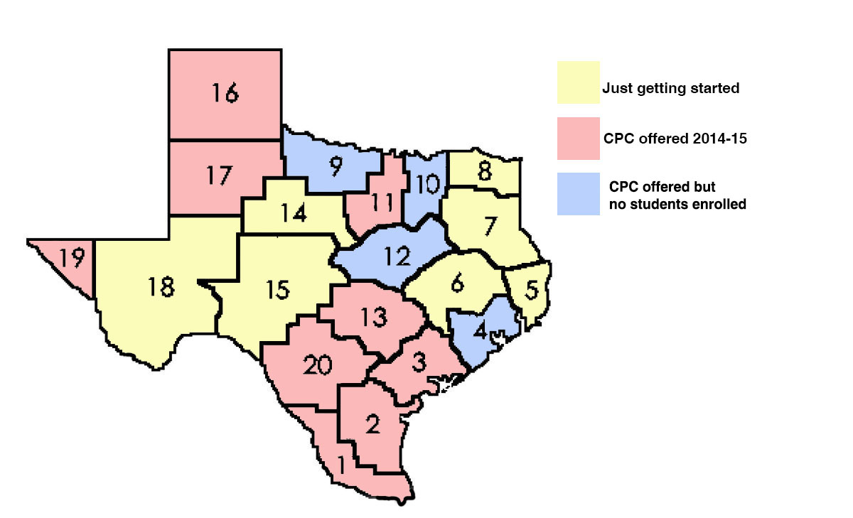
CPC Status by Region, 2/2015

Slide 14

CPC and Transitional Courses as Developmental Education
http://untavatar.org

Slide 15
Rationale for Transitional Courses
Almost half of students nationally place into at least one remedial course at college entry.
Even academically prepared students may lack “college knowledge” and critical skills.
Vertical alignment of curriculum is supported by research in a standards-based environment.
The earliest possible intervention is the least costly in public and individual resources.
Reference: Barnett, E. A., Fay, M. P., Trimble, M. J., & Pheatt, L. (2013) Reshaping the College Transition: Early College Readiness Assessments and Transition Curricula in Four States. NY: Community College Research Center, Teachers College, Columbia University.

Slide 16
Transition Courses as a National Trend
Offered in 29 states, all efforts recent.
8 states have statewide initiatives led by an SEA or higher education agency.
Courses are offered in English and, more often, mathematics and are offered face to face and online, with curriculum usually developed by local high schools. There is no definitive research but leading work in El Paso.
Implementation of Common Core and related assessments pushes focus on student performance.

Slide 17
Differences among states:
NY, TN, CA, WV (Barrett et al.)
Types of assessments used, how results are used, and the influence of the Common Core standards
The courses offered to students (math or English or both) and whether they meet state Common Core standards
Student placement policies and whether the courses meet high school graduation requirements
Local vs. statewide initiatives and funding provided
Higher vs. K-12 led and types of partnerships
Place of state in the process of accountability based school reform

Slide 18
Most Common Issues (Barrett et al.)
How to define college readiness
Should transition course focus on helping the student pass the placement test or on the bigger picture of readiness to work at the college level?
Which students? Can one course serve both those who narrowly missed the benchmark and those who are markedly underprepared?
Does high school graduation mean college readiness?
Community College Research Center (Jan. 2014). Early Assessments and Transition Curricula: What States Can Do. CCRC Policy Brief, pp. 1-2. http://ccrc.tc.columbia.edu.

Slide 19

Learning as We Build in Region 1
http://untavatar.org

Slide 20






Region One Consortium

Slide 21

Regional Approach
House Bill 5 required LEA partnership with IHEs to create locally developed college preparatory courses.
In response, Region 1 ESC partnered with RGV Focus, Local IHEs and LEAs to support and facilitate the creation of CPCs for Mathematics and English.
Course objectives were created by LEAs, IHEs, and Region I.
UTPA professors designed online course materials and sites using objectives determined by group.
Professional development was designed by UTPA professors with help of IHEs.

Slide 22


College Prep Course Timeline
MOU sent to IHE Presidents for legal Review
June 9 – July 11
March 5th
Region I hosted meeting of IHE/ISD to plan CPC.
April 10th
Region I shared CPC process with Curriculum Advisory Council.
Develop of Syllabi/Homework/ Online Supports
June 3-12
April 15th
IHE Faculty & Leaders finalize draft MOU and learning outcomes
IHE discusses eligibility for course/
placement guidelines
April 17th
Region I shared process with Regional Advisory Council
April 25th
RGV FOCUS Leadership Team reviews MOU and learning outcomes
April 30th
IHE Faculty /Leaders present to ISD Advisory Team
May 7th
IHE/ISD review student learning outcomes and recommend guidelines and action plan
District
Staff/
Teacher Work Session/
Training
August 11 - 13
IHE Finalizes MOU for ISD Review
Scope & Sequence/
Clarification/
Validation of Learning Objectives
June 3
Course Implementation Fall 2014
Development of the Assessment (IHE)
June 3-16
IHE Faculty/ISD Teams review Syllabi/Homework/ Assessments
June 23-24
$$© 2014 RGV FOCUS$$

Slide 23

Regional Goals
Collaboratively create two courses providing an opportunity for students to demonstrate college readiness in mathematics and/or English Language Arts while still in high school
Ensure students are able to begin taking credit bearing courses their first year of college

Slide 24








You’re Invited … Save the Date
Signing Ceremony for the HB 5 College Prep Courses
Friday, August 22, 2014
10:00 AM
South Texas College
Mid-Valley Campus
400 N. Border
Weslaco, Texas 78596
All School District ISDs present signed the MOU
$$© 2014 RGV FOCUS$$

Slide 25
Professional Development for Teachers
General Session- ½ day only August 11, 2014 – Region 1 ESC
One day follow-up workshop of which teachers could attend either:
  August 12, 2014 – University of Texas-Pan American
  August 13, 2014 – TSTC University Center (Lower Valley)
Monthly online meetings using ZOOM
  31 districts were grouped by location and assigned an hour to attend morning ELA OR afternoon Math PD
  Not well attended
  Same people attended each time and were on target

Slide 26
Frequently Asked Questions
Is College Prep Course (CPC) a TSI exemption option for dual enrollment courses?
  No
Can students take this course prior to their 12th grade year to be eligible for dual enrollment courses?
  No
Can a student who remains on the current Recommended High School Program (RHSP) or the Distinguished Achievement Program (DAP) earn credit for a college preparatory course?
  No
Will the CPC be offered as a dual enrollment course at any of the RGV IHEs?
  No

Slide 27
More Frequently Asked Questions
1. Are students required to enroll in CPC this year?
No
2. Can the CPC be used as an advanced English or mathematics course for an endorsement?
Yes
3. Are teachers of the CPC required to have a Master’s Degree?
No
4. Are teachers supposed to be highly qualified?
Yes

Slide 28

Challenges
Teachers are assigned to teach CPC at last minute—no training
Counselors enroll or remove students irregularly
Course is an elective that does not count towards graduation in all districts
Teachers cannot or do not participate in training
Fidelity of curriculum compromised by not teaching according to plan
Teachers do not like online professional development
Districts need the teachers in their classrooms
Teachers lack knowledge about the writing process

Slide 29
Challenges
Some school districts or high schools are misinterpreting the course as Test-Prep
Some school districts are approaching IHEs or non-profits independently to develop a course to satisfy the requirement
Student participation and teacher engagement has been lowest from some of the largest districts.

Slide 30

Partnership Team believes we need to:
  provide a course timeline
  seek IRB approval or expand MOU to allow classroom observation, video, and focus group interviews
  create more teacher professional development opportunities
  use a “trainer of trainers” model out in the districts
  clarify with teachers and counselors the purpose of the course

Slide 31

Questions and Comments

Slide 32
Contact Information
Mary M Harris
M Jean Keller
Shirley J Mills
Regent Professor Emerita
Co-director, AVATAR
University of North Texas
Denton, TX
Mary.harris@unt.edu
940 367-3026
Professor and Acting Vice President
Director, AVATAR
University of North Texas
Denton, TX
Jean.keller@unt.edu
940 565-3427
Associate Vice Provost for Curriculum, Training, and Assessment
Regional Coordinator, AVATAR
University of Texas-Pan American
Edinburg, TX
mills@utpa.edu
956-665-7247

