Slide 1
College Preparatory Course Project
North Texas Community College Consortium,
Spring Leadership Conference
January 30, 2015

Slide 2
Presentation Overview
Vertical alignment and AVATAR model
Highlights of HB 5
AVATAR College Preparatory Course (CPC) Project
AVATAR CPC: a leadership and student success strategy

Slide 3

Vertical alignment and AVATAR

Slide 4
Foundations of AVATAR
  Closing the Gaps
  Student Participation
  Student Success
Source: Closing the Gaps Progress Report, June 2012
Retrieved from: http://www.thecb.state.tx.us/index.cfm?objectid=858D2E7C-F5C8-97E9-0CDEB3037C1C2CA3

Slide 5
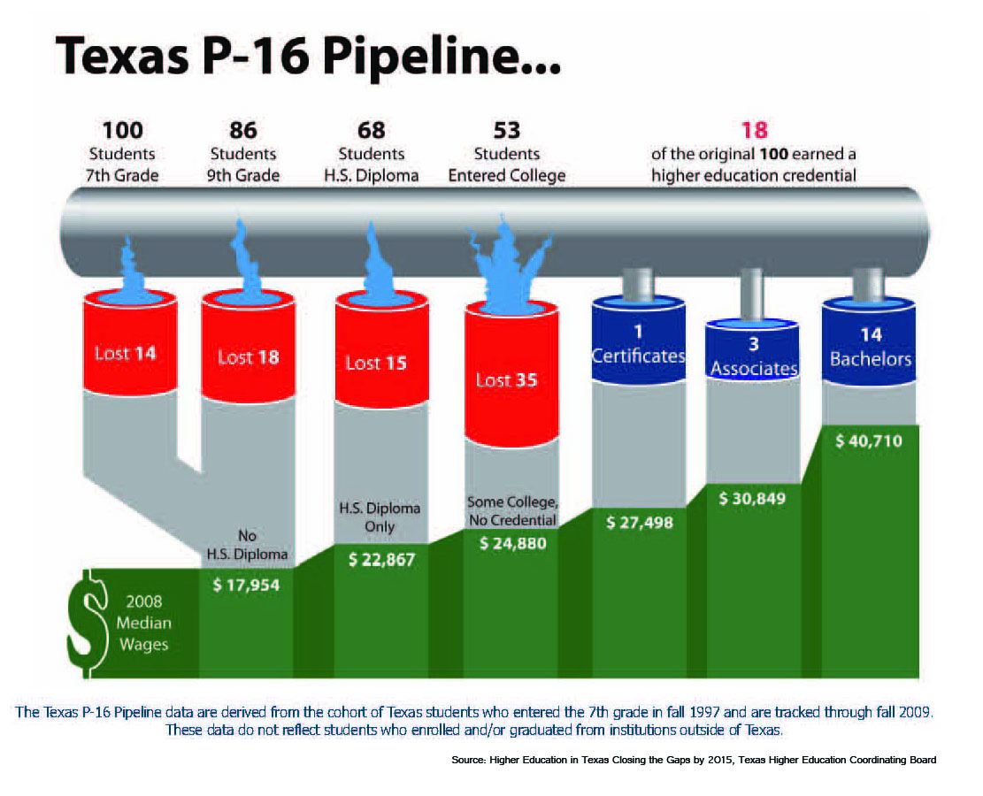
The Texas P-16 Pipeline, 2007

Slide 6
TAPR Data from TEA
Percent College Ready High School Graduates, 2013-2014
Public High School Graduates Class of 2013 N=301,418 | All | African American | Hispanic | White | Asian
ELA | 65 | 53 | 58 | 75 | 80
Mathematics | 74 | 60 | 69 | 83 | 90
Both subjects | 56 | 41 | 48 | 69 | 77
  Other Descriptors of Student Body in Percentages:
http://untavatar.org

Slide 7
TAPR Data from TEA
Percent Advanced Course Dual Credit Completion in 2013-14
  Other Descriptors of Student Body in Percentages:
Public High School Students, 2013-2014 | All | African American | Hispanic | White | Asian
2013 | 31.4 | 24.2 | 28.5 | 35.6 | 57
2012 | 30.5 | 24.0 | 26.2 | 34.9 | 55.7
http://untavatar.org

Slide 8
TAPR Data from TEA
Percent AP/IB Enrollees Tested and Meeting Criteria in 2013-14
  Other Descriptors of Student Body in Percentages:
Public High School Students | All | African American | Hispanic | White | Asian
Tested | 22.1 | 13.7 | 19.5 | 24.9 | 53.6
Met Criteria | 50.9 | 27.3 | 37.5 | 64.3 | 72.5
http://untavatar.org

Slide 9
Percent 2012 Graduates Enrolled in IHE and Completing One Year without Remediation
  Other Descriptors of Student Body in Percentages:
Public High School Graduates Class of 2012 | All | African American | Hispanic | White | Asian
Enrolled | 57.3 | na | na | na | na
Completed One Year no Remediation | 69.0 | na | na | na | na
http://untavatar.org

Slide 10
What is Alignment?
  Alignment assumes a standards-based system of curriculum and assessment. Vertical alignment attends to articulation of curriculum across levels of education and requires willingness to focus instruction, assessment, staff development, and management so that students succeed. Horizontal alignment attends to student learning in every section of the same grade or class.
  Reference: Squires, D. A. (2009). Curriculum Alignment: Research-Based Strategies for Increasing Student Achievement. Thousand Oaks, CA, Corwin,

Slide 11
Alignment Research
  Squires (2009) reviews research and concludes:
  Alignment improves student outcomes.
  Alignment is a powerful tool for assuring the written, taught and tested curriculum are the focus of instruction, assessment, and faculty development.
  Reference: Squires, D. A. (2009). Curriculum Alignment: Research-Based Strategies for Increasing Student Achievement. Thousand Oaks, CA, Corwin,

Slide 12
AVATAR: Academic Vertical Alignment Training
And
Renewal

Slide 13
High Schools
2 Year IHEs
Scaffolding
Student
Success
4 Year IHEs
Regional ESCs
Regional P-16
Councils
AVATAR is a Partnership of Regional Leaders from these institutions

Slide 14
AVATAR Partners
Partnerships: Leaders and educators representing regional
Independent school districts (ISDs)
Community colleges,
Universities,
P-16 councils,
and education service centers (ESCs)
are committed to vertical alignment to support students’ college and career readiness and success.
http://untavatar.org

Slide 15
AVATAR
Vertical Alignment Teams
Vertical Alignment Teams (VATs): Educators and leaders representing AVATAR partners who are committed to addressing discipline specific course needs to create environments where students can make successful transitions between and among regional educational systems.
http://untavatar.org

Slide 16
The AVATAR Process
Creates and builds relationships through ongoing critical conversations
Uses regional data to make alignment decisions
Develops shared understanding of college and career readiness and success for students
Identifies and implements intentional actions
Evaluates, sustains, and shares vertical alignment work
http://untavatar.org

Slide 17
AVATAR enables Critical Conversations
Secondary
Post-Secondary
Graduate College/Career Ready
Graduate Career Ready
Impact of Developmental Education and
Texas Success Initiative
Dual Credit, Early College High Schools
Student Support Services
Educational Policies & Practices
Classroom Instruction, Textbooks
Grading, etc.
Discipline Reference Course
Profiles
College & Career Readiness
Standards
Student Success Assessments
Dual Credit, Early College High Schools
Student Support Services
Educational Policies & Practices
Classroom Instruction, Textbooks
Grading, etc.
Discipline Specific Course Curriculum
Texas Essential Knowledge and Skills

Slide 18
The Statewide Network
Mathematics
ESC 2, Citizens for Educational Excellence, Education to Employment Partners P-16 Council, TAMU-Corpus Christi, TAMU-Kingsville, Del Mar College, Coastal Bend College, Robstown ISD, Odem-Edroy ISD, Corpus Christi ISD, & Calallen ISD.
ESC 9, Region 9 P-16 Council, Midwestern State University, Vernon College, Burkburnett ISD, Wichita Falls ISD, Iowa Park CISD, and Vernon ISD.
ESC 10, North Texas Regional P-16 Council, University of North Texas , Dallas CCCD, Brookhaven College, Carrolton Farmers Branch ISD& Dallas ISD.
ESC 12, Heart of TX P-20 Council, McLennan Community College, Texas State Technical College, Waco ISD, La Vega ISD, Midway ISD, Robinson ISD, Rapoport Academy, Reicher Catholic School, & Baylor University.
ESC 15. San Angelo P-16+ Partnership, Howard College, Angelo State University, San Angelo ISD & TLC Charter School.
ESC 16, Panhandle P-16 Council, West Texas A&M University, Amarillo College, Clarendon College, Frank Phillips College, Amarillo ISD, Borger ISD, & Canyon ISD.
Region 20, P16 Plus Council of Greater Bexar County, UT-San Antonio, Alamo Colleges, Palo Alto College, & Harlandale ISD.
2013-2014
English Language Arts
ESC 6, Sam Houston State University P-16 Council , Sam Houston State University, Lone Star College System, Huntsville ISD, & Sam Houston State University Regional P-16 Council (Huntsville).
ESC 9, Region 9 P-16 Council, Midwestern State University, Vernon College, Burkburnett ISD, Vernon ISD, Iowa Park CISD, Windthorst ISD, & Wichita Falls ISD.
ESC 11, North Texas Regional P-16 Council, Tarleton State University, Hill College, Burleson ISD, Cleburne ISD, Godley ISD, & Joshua ISD.
ESC 12, Heart of TX P-20 Council, McLennan Community College, Texas State Technical College, Waco ISD, La Vega ISD, Midway ISD, Robinson ISD, Rapoport Academy, Reicher Catholic School, West Midway & Baylor University.
ESC 15, San Angelo P-16+ Partnership, Howard College, Angelo State University, Eden CISD, Wall ISD & San Angelo ISD.
Region 20, P16 Plus Council of Greater Bexar County, UT-San Antonio, Alamo Colleges, Palo Alto College, & Harlandale ISD.
Science
ESC 1, Upper Rio Grande Valley P-16, UT-Pan Am, South Texas College, South Texas ISD, Missions ISD, Weslaco ISD, McAllen ISD, & Pharr San Juan Alamo ISD.
ESC 10, North Texas Regional P-16 Council, University of North Texas , Dallas CCCD, Brookhaven College, Carrolton Farmers Branch & Dallas ISD.
College Awareness
ESC 7, Deep East Texas P-16 Council/Stephen F. Austin University, Kilgore College, Kilgore ISD, Panola Charter, & Tyler Junior College.
Notes:
46

Slide 19
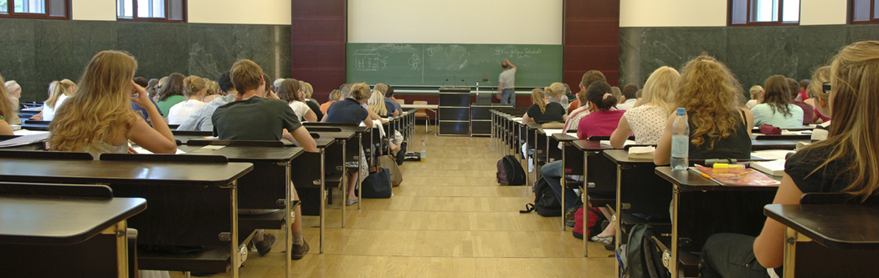
House Bill 5:
Some Important Provisions for College People to Know

Slide 20
Graduation Requirements
Reduced number of End of Course tests required for graduation from 15 to five.
Changed high school graduation programs from minimum, recommended, and distinguished to Foundation Program with options for:
  Endorsements;
  Distinguished Level of Achievement; and/or
  Performance Acknowledgements.
. http://untavatar.org
Notes:
Clearly identify that Performance acknowledgements can be earned on any of the graduation options-Foundation, Foundation with Endorsement, or Distinguished

Slide 21
Endorsement Options
Endorsements
STEM (Science, Technology, Engineering, and Mathematics)
Business and Industry
Public Services
Arts and Humanities
Multidisciplinary Studies
http://untavatar.org
Notes:
Notes:
HB 5 requires that the endorsement will be placed on the diploma and transcript.
SBOE can choose to include specific course requirements in each of the endorsement areas but we do not know yet if they will do this. They have the authority to do so.
HB 5 requires that students must have multiple options for earning each endorsement, including, to the greatest extent possible, coherent sequences of courses. Additionally, the statute requires that student must be permitted to enroll in courses under more than one endorsement curriculum before the student’s junior year.
STEM – least complicated endorsement in statute. TEA has talked with SBOE about possible CTE courses for this area.
Business and Industry – aligns a lot to the current career clusters in CTE. TEA has visited with SBOE about possibly aligning these to the current coherent sequences in clusters.
Public Services – Per TEA’s conversation with SBOE, Culinary Arts & Hospitality may be moved from this endorsement to the Business and Industry endorsement.
Arts and Humanities – Per TEA’s conversation with SBOE, Political Science may be moving to Public Services – as that is more closely aligned with where courses reside within current course clusters.

Slide 22
Performance Acknowledgements
Any student may earn a performance acknowledgement for outstanding performance
    In dual credit course
    In bilingualism and biliteracy
    On AP/IB exam
    On PSAT, ACT-Plan, SAT, or ACT
  For earning a nationally or internationally recognized business or industry certification /license
http://untavatar.org
Notes:
Notes:
It appears that ANY student can earn a performance acknowledgement (under the Foundation High School Program with or without endorsement(s) and distinguished level of achievement).
Performance Acknowledgements will also be noted on the diploma and the transcript.
Scores, etc. required to earn Performance Acknowledgements are TBD by SBOE. Nothing in statute recognizes state licenses or certification, and TEA has found very few internationally recognized certifications or licenses at this point. Therefore, TEA has stated they are unsure what this will look like. However, it is within the realm of possibility that a student could earn multiple performance acknowledgements because in statute it appears each bullet is distinct and SBOE cannot require a combination for a performance acknowledgements.

Slide 23
Locally Developed CTE Courses/Activities
Districts may offer courses or other activities, including apprenticeships, needed for industry-recognized credential or certificates
http://untavatar.org
Notes:
Section 8, 28.002(g-1); LBB p. 54
Conditions required:
The district develops a program under which the district partners with a public or private institution of higher education and local business, labor, and community leaders to develop and provide the course; and
The course or other activity allows the student to enter:
A CTE training program in the district’s region of the state;
An IHE without remediation;
An apprenticeship training program; or
An internship required as part of the accreditation toward an industry-recognized credential or certificate for course credit.
28.002 (g-2) Reporting
District must annually report to TEA names of the courses, programs, IHE, and internships in which the students have enrolled under (g-1) and TEA must make this information available to other districts

Slide 24
College Preparatory Courses
Districts must partner with at least one IHE to develop college prep courses in math and ELA for 12th grade students who do not meet college readiness standards or whose performance indicates they are not ready for entry-level college coursework.
Effective 2013-2014 (with courses to be provided no later than 2014-2015)
High school and IHE faculty must meet regularly as necessary to ensure courses are aligned with college readiness expectations.
http://untavatar.org
Notes:
HB 5, Section 10 (TEC 28.014); LBB p. 115
Notes:
This is specific to mathematics and ELA courses.
Not meeting college readiness standards is automatically indicated if the student fails an EOC exam.

Slide 25

AVATAR College Preparatory Course Project, 2014-15

Slide 26
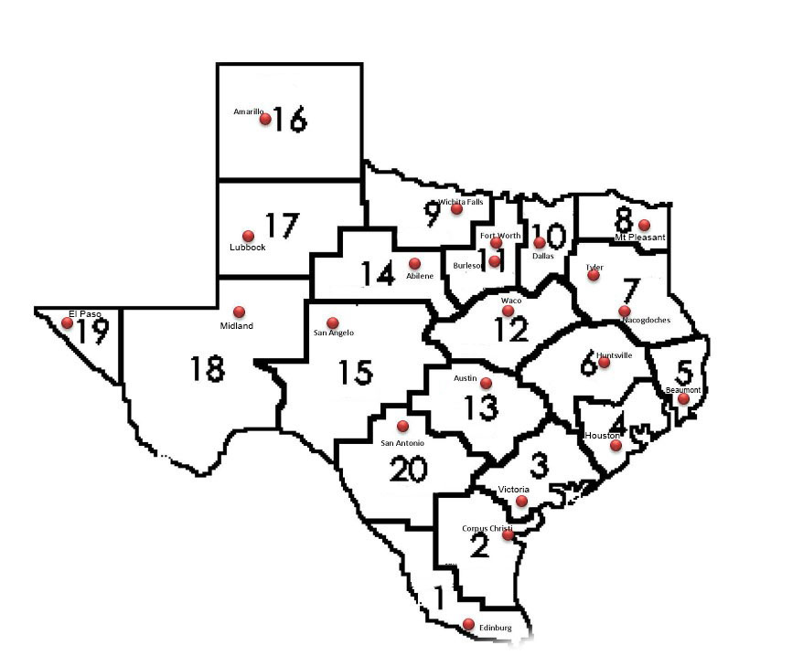
Where?
http://untavatar.org

Slide 27
High Schools
2 Year IHEs
Scaffolding
Student
Success
4 Year IHEs
Regional ESCs
Regional P-16
Councils
Who?

Slide 28
How: The AVATAR Process
Creates and builds relationships through ongoing critical conversations
Uses regional data to make alignment decisions
Develops shared understanding of college and career readiness and success for students
Identifies and implements intentional actions
Evaluates, sustains, and shares vertical alignment work
http://untavatar.org

Slide 29

What is going on in the regions?
Results of December 2014
AVATAR Survey
http://untavatar.org

Slide 30
CPC Survey Results
Status of College Preparatory Courses by Region

Slide 31
Overview of the Courses
English Language Arts
Mathematics
Offered by 4 partnerships
3 face to face; 1 online
1 offered for one semester; 3, two semesters
3 offered for high school credit, 1 not for credit, no dual credit
All meet high school graduation requirements
Offered by 5 partnerships
4 face to face; 1 online
All 5 offered for two semesters
4 offered for high school credit; 1 not for credit, no dual credit
4 meet high school graduation requirements; 1 does not

Slide 32
Overview of Enrolled Students (Regions 1, 2, 16, 19, 20)
English Language Arts
Mathematics
Seniors
Not TSI ready in Reading and Writing
Mainly Hispanic
At least 750 in 4 regions
Seniors and some juniors
Not TSI ready in Mathematics
Mainly Hispanic
At least 1100 in 5 regions

Slide 33
Sample academic criteria
English Language Arts College Readiness
Mathematics College Readiness
75% or higher course grade and a score of at least 3 on the STAAR writing rubric for each of the 5 assigned essays
80% or higher course grade
70% of higher course grade
70% or higher in course and on final exam
75% or higher in course and at least 60% on the final exam

Slide 34

What are your concluding observations?

Slide 35
Our Concluding Observations
In Texas, College Preparatory Courses are most implemented on the border.
Defining local partnerships is harder and riskier in more populous and diverse regions of the state.
By providing for College Preparatory Courses, Texas joined 37 other states that are exploring transitional courses as an alternative to developmental or remedial education.
http://untavatar.org

Slide 36
Our Concluding Observations
Create partnerships with the ISDs that are your largest feeders.
  Study students’ college and career needs and how they might be addressed.
  Consider the various provisions of HB5 that call for collaboration between school districts and colleges – CPC, CTE, endorsements, dual credit, ECHS, etc.
Academic collaboration requires thoughtful participation of both faculty, staff, and administrators.
http://untavatar.org

Slide 37
Presenters
Mary M. Harris
M. Jean Keller
Regent Professor Emerita
Co-director, AVATAR
University of North Texas
Denton, TX
Mary_harris@unt.edu
940 367-3026
Professor and Acting Vice President
Director, AVATAR
University of North Texas
Denton, TX
Jean_keller@unt.edu
940 565-3427

