Slide 1
College Preparatory Course Project
Results of Survey 1
January 30, 2015

Slide 2
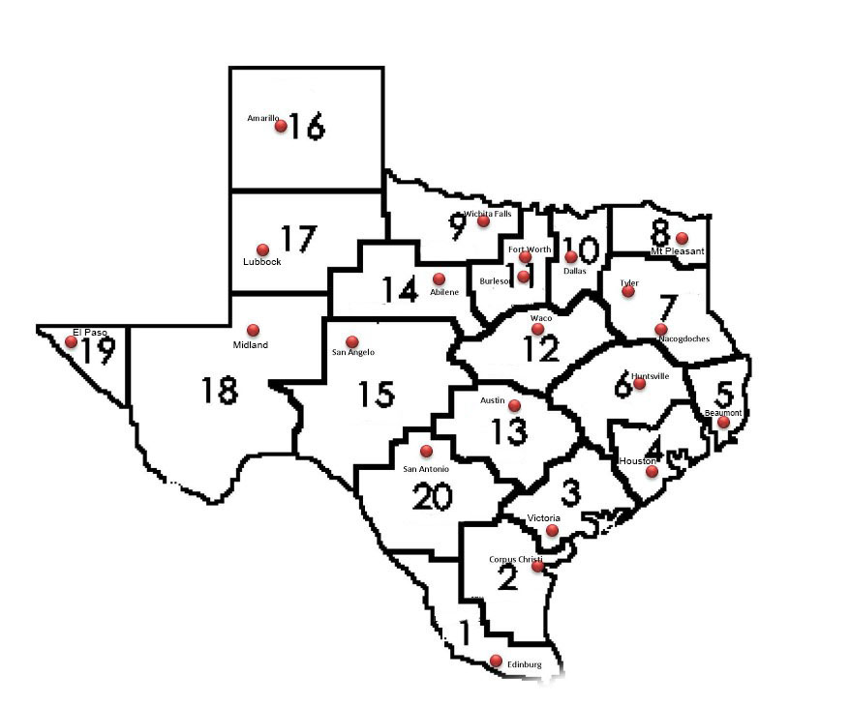
Participants: AVATAR coordinators in 18 0f 20 regions
http://untavatar.org

Slide 3

What is going on in the regions?
Results of December 2014
AVATAR Survey
http://untavatar.org

Slide 4
CPC Survey Results
Status of College Preparatory Courses by Region

Slide 5
Overview of the Courses
English Language Arts
Mathematics
Offered by 4 partnerships
3 face to face; 1 online
1 offered for one semester; 3, two semesters
3 offered for high school credit, 1 not for credit, no dual credit
All meet high school graduation requirements
All taught by high school faculty
Offered by 5 partnerships
4 face to face; 1 online
All 5 offered for two semesters
4 offered for high school credit; 1 not for credit, no dual credit
4 meet high school graduation requirements; 1 does not
All taught by high school faculty

Slide 6
Overview of Enrolled Students (Regions 1, 2, 16, 19, 20)
English Language Arts
Mathematics
Seniors
Not TSI ready in Reading and Writing
Mainly Hispanic
At least 750 in 4 regions
Seniors and some juniors
Not TSI ready in Mathematics
Mainly Hispanic
At least 1100 in 5 regions

Slide 7
Sample academic criteria
English Language Arts College Readiness
Mathematics College Readiness
75% or higher course grade and a score of at least 3 on the STAAR writing rubric for each of the 5 assigned essays
80% or higher course grade
70% of higher course grade
70% or higher in course and on final exam
75% or higher in course and at least 60% on the final exam

Slide 8
Some Concluding Observations
In Texas, College Preparatory Courses are most implemented on the border.
Defining local partnerships is harder and riskier in more populous and diverse regions of the state.
Related literature shows that in providing for College Preparatory Courses, Texas joined 37 other states that are exploring transitional courses as an alternative to developmental or remedial education.
http://untavatar.org

Slide 9
Presenters
Mary M. Harris
M. Jean Keller
Regent Professor Emerita
Co-director, AVATAR
University of North Texas
Denton, TX
Mary_harris@unt.edu
940 367-3026
Professor and Acting Vice President
Director, AVATAR
University of North Texas
Denton, TX
Jean_keller@unt.edu
940 565-3427

