Slide 1

Region 9
  2012-2013
  Student Performance Data

Slide 2
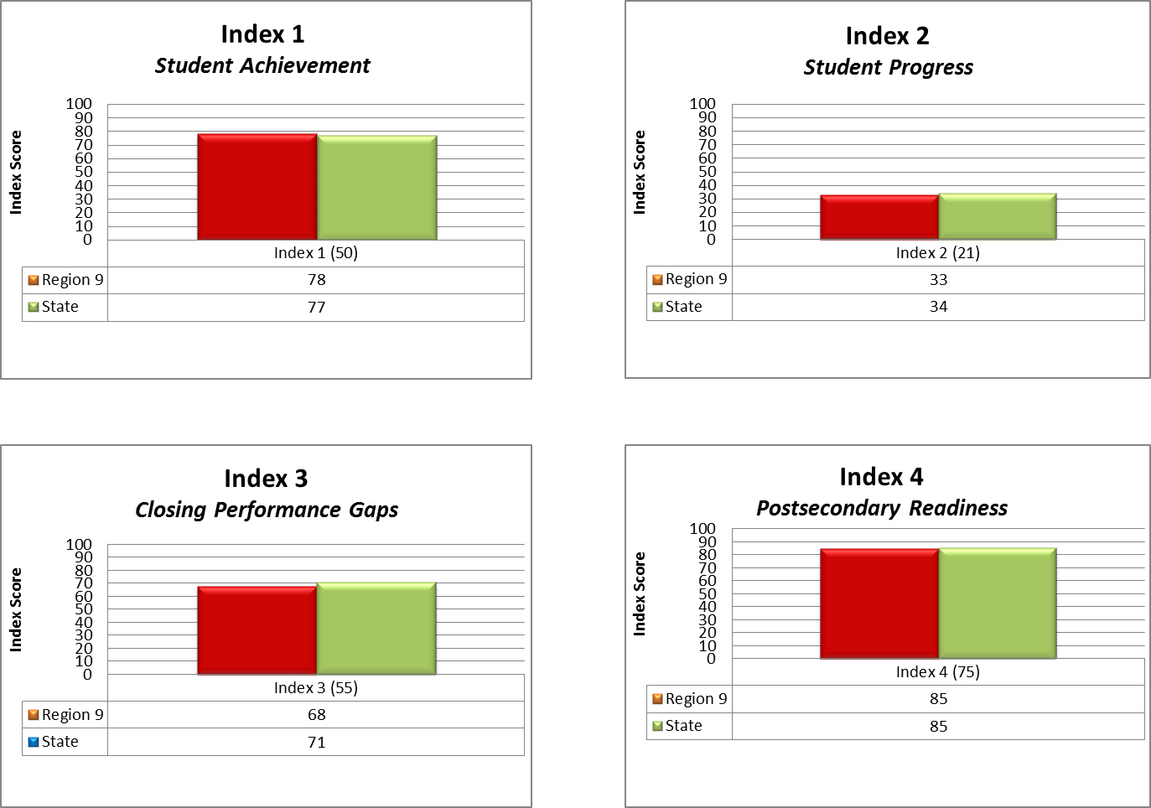

Region 9
Index Score Averages
Based on Preliminary Data
2013 Accountability Region 9/State Comparison

Slide 3
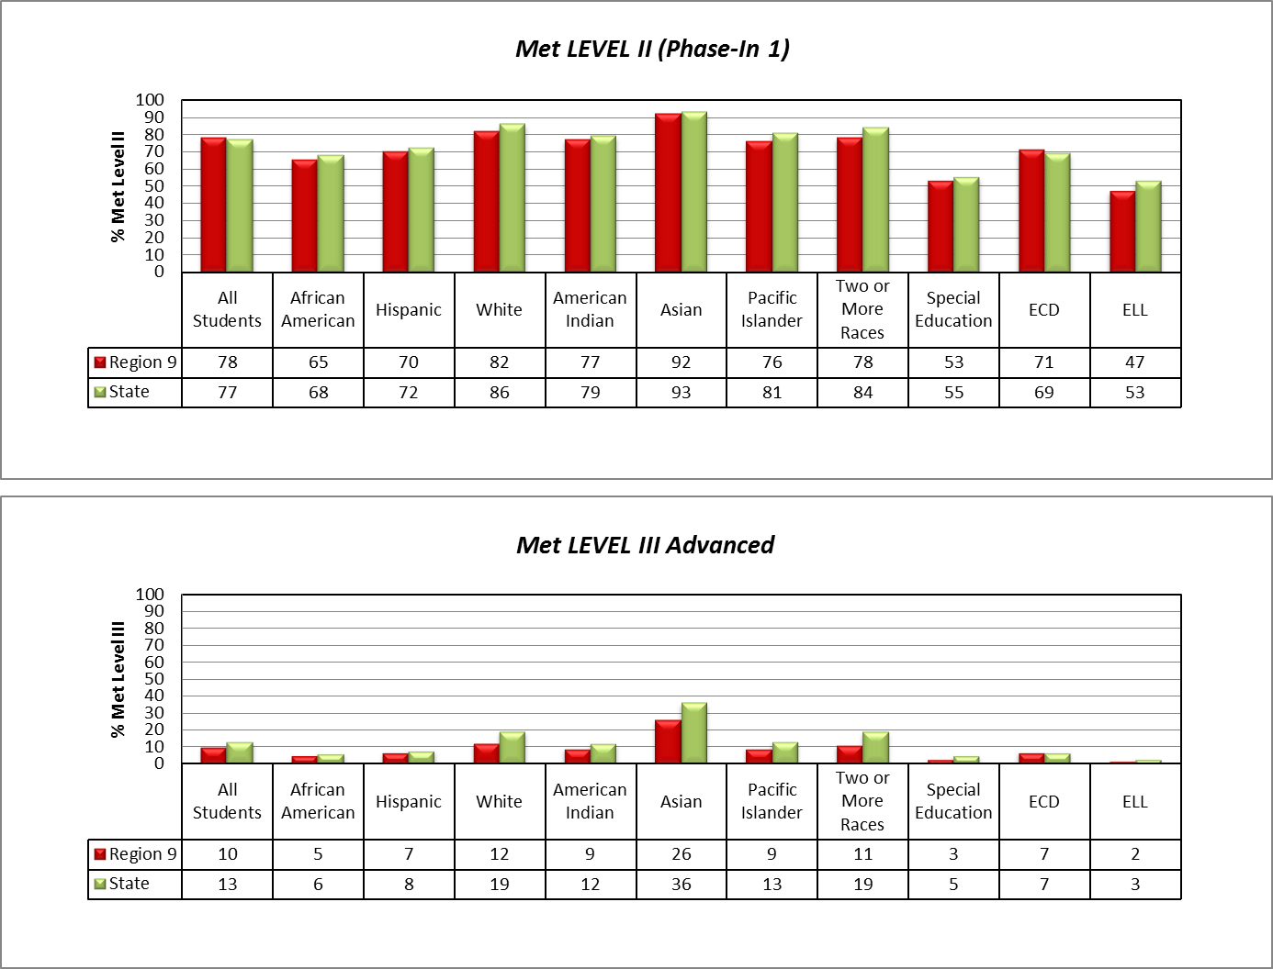
Region 9
All Subjects
Based on Preliminary Data
2013 Accountability Region 9/State Comparison

Slide 4
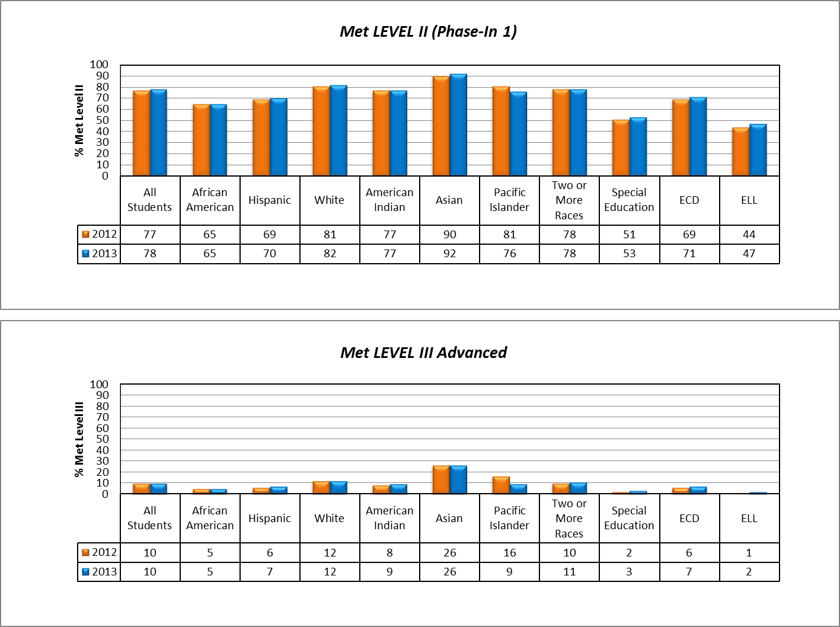
Region 9
All Subjects
Based on Preliminary Data
2013 STAAR Region 9 Multi-Year Comparison

Slide 5
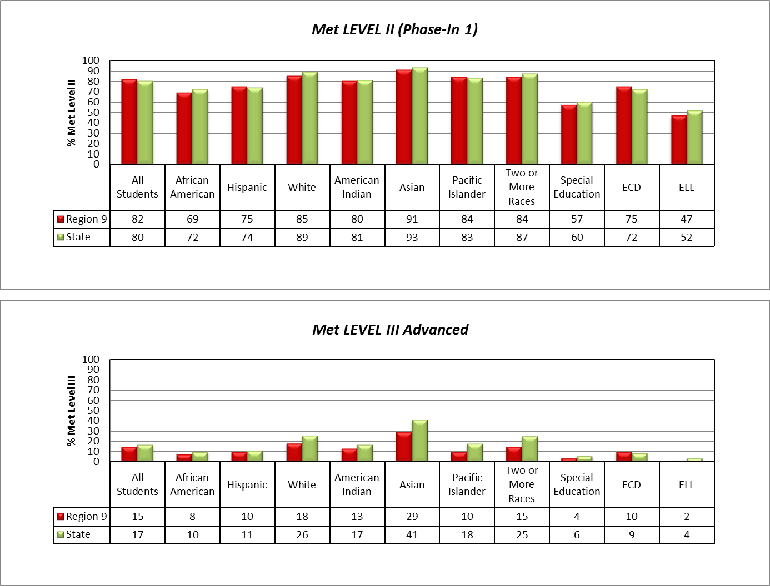
Region 9
Reading
Based on Preliminary Data
2013 Accountability Region 9/State Comparison

Slide 6
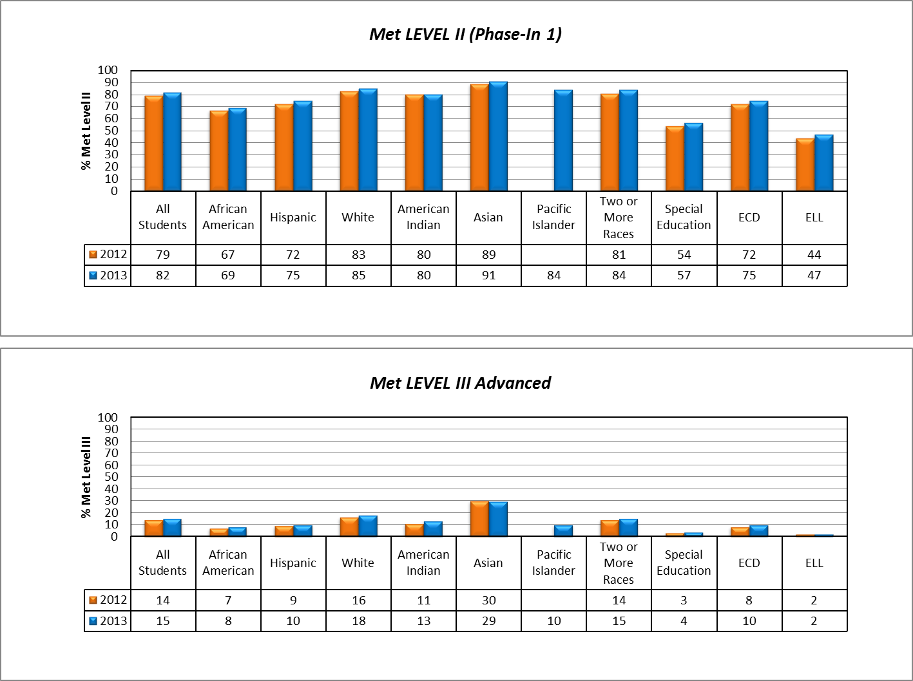
Region 9
Reading
Based on Preliminary Data
2013 STAAR Region 9 Multi-Year Comparison

Slide 7
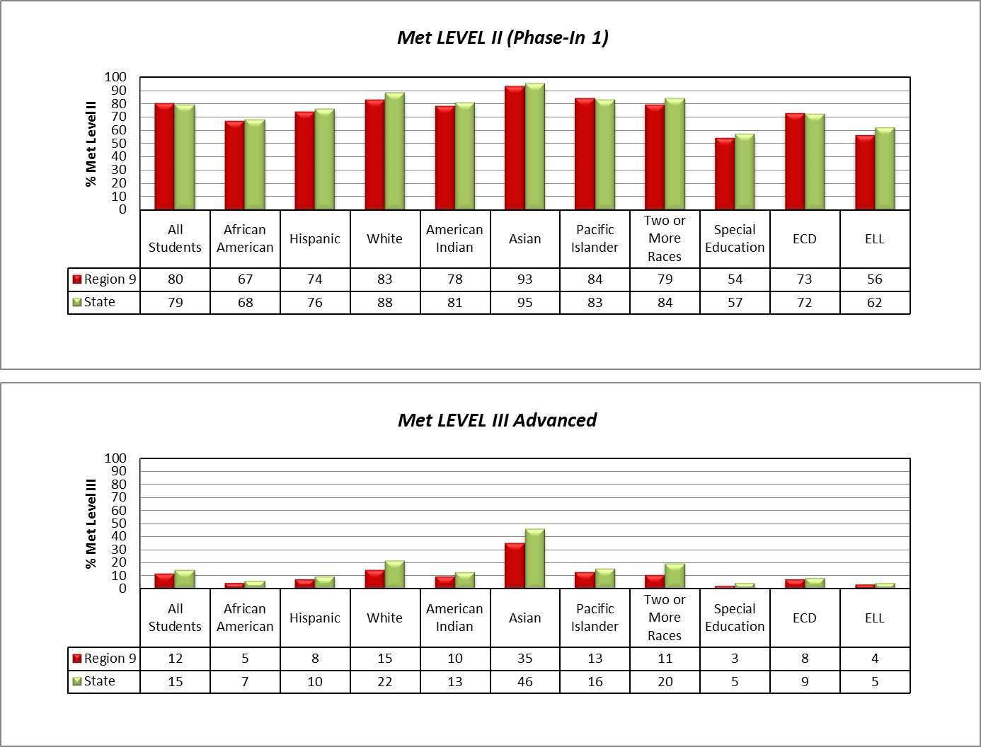
Region 9
Math
Based on Preliminary Data
2013 Accountability Region 9/State Comparison

Slide 8
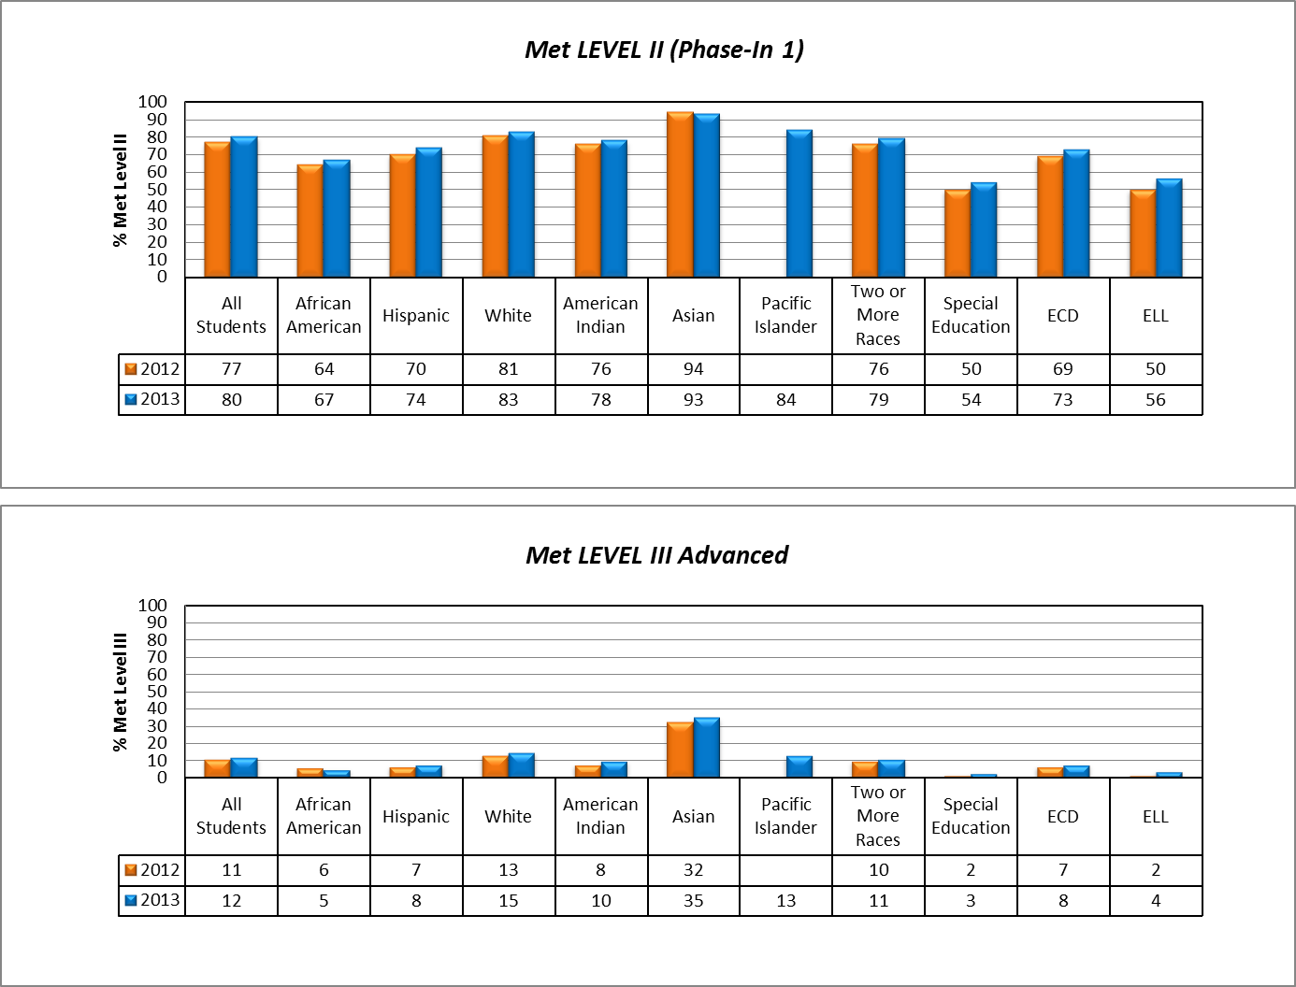
Region 9
Math
Based on Preliminary Data
2013 STAAR Region 9 Multi-Year Comparison

Slide 9
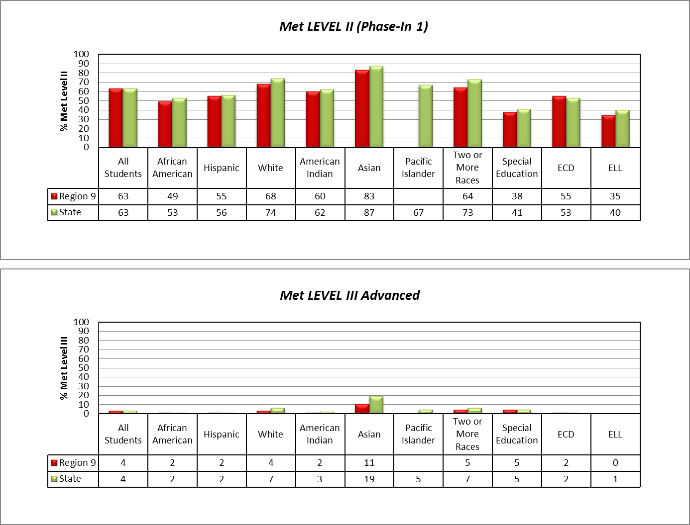
Region 9
Writing
Based on Preliminary Data
2013 Accountability Region 9/State Comparison

Slide 10
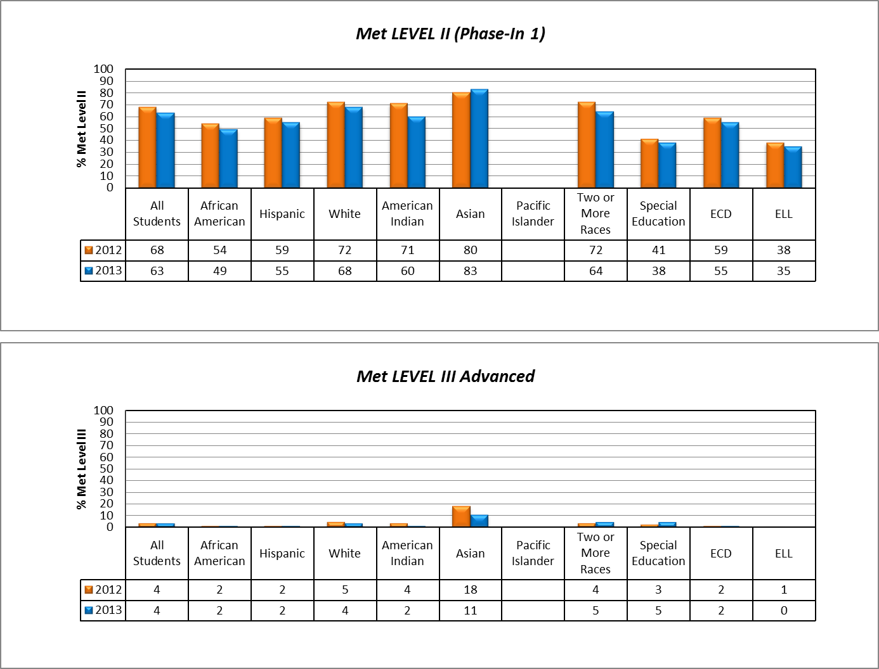
Region 9
Writing
Based on Preliminary Data
2013 STAAR Region 9 Multi-Year Comparison

Slide 11
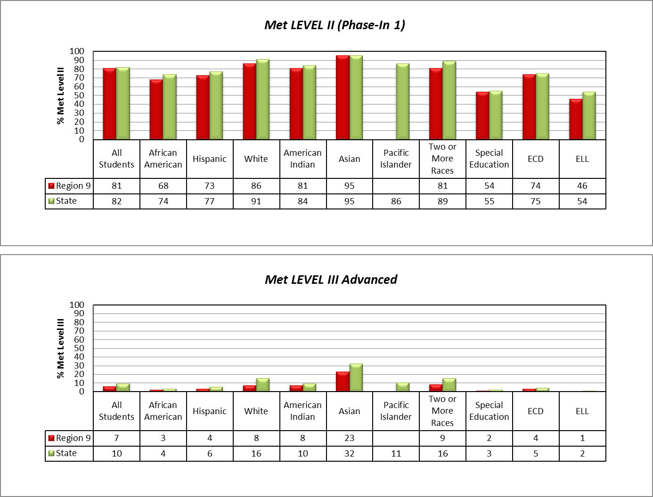
Region 9
Science
Based on Preliminary Data
2013 Accountability Region 9/State Comparison

Slide 12
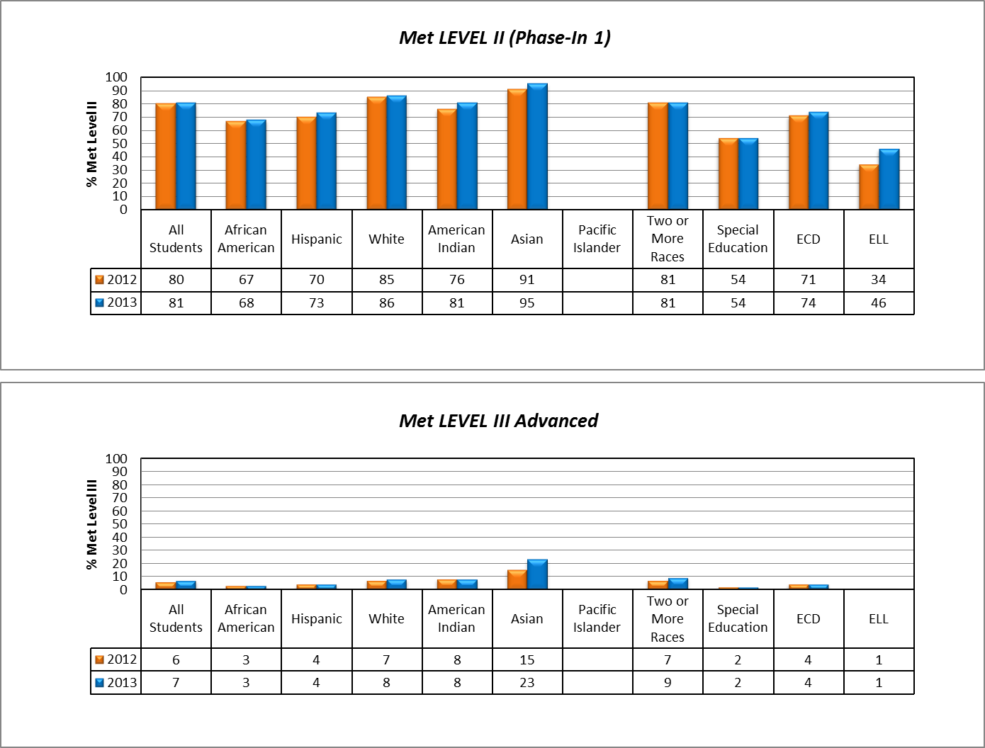
Region 9
Science
Based on Preliminary Data
2013 STAAR Region 9 Multi-Year Comparison

Slide 13
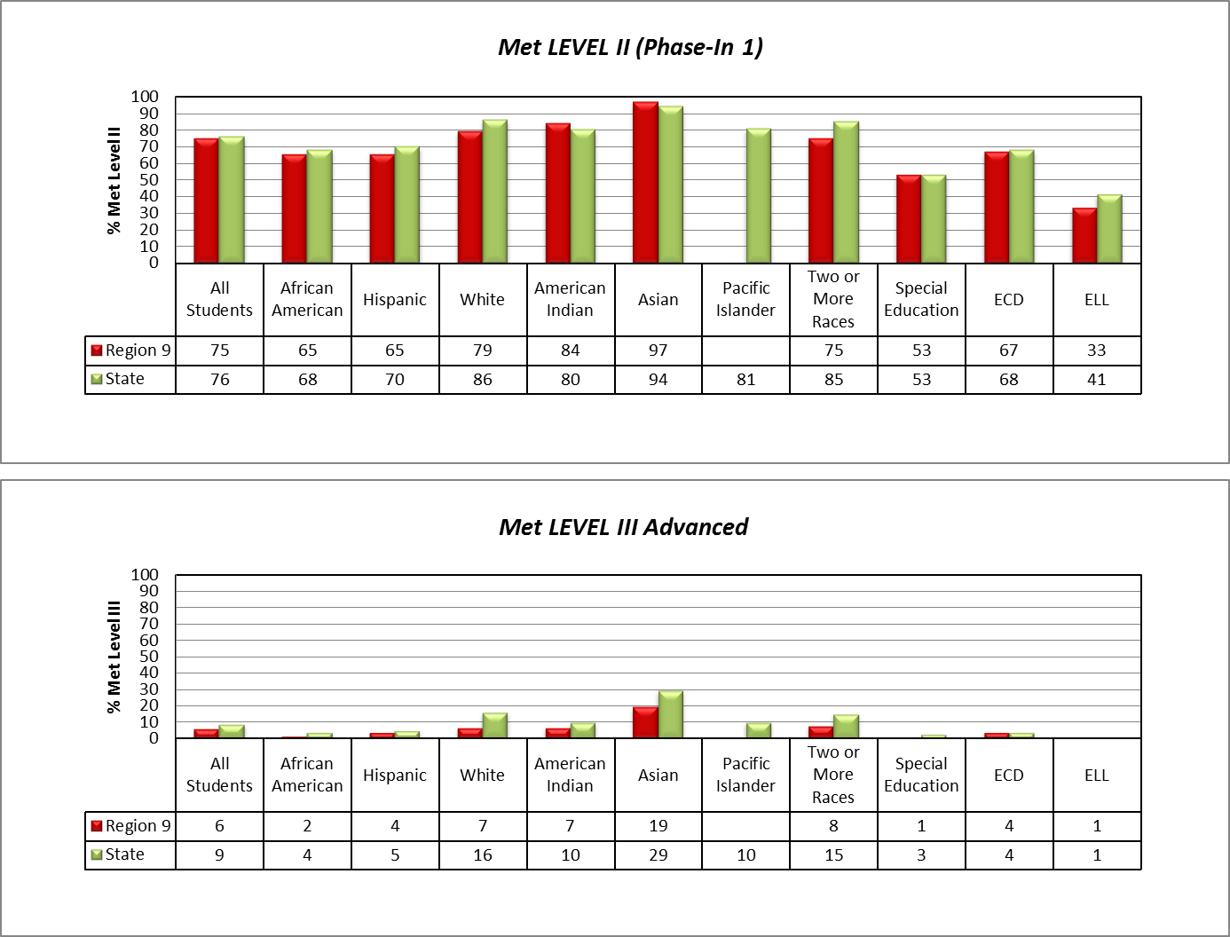
Region 9
Social Studies
Based on Preliminary Data
2013 Accountability Region 9/State Comparison

Slide 14
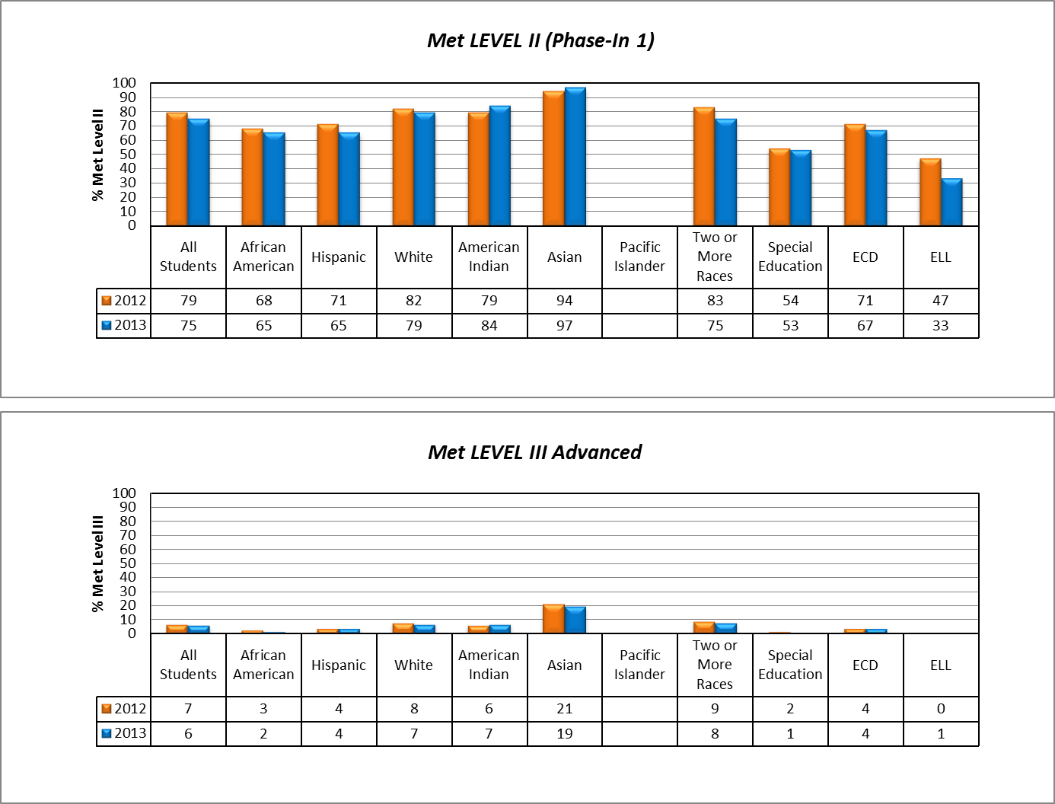
Region 9
Social Studies
Based on Preliminary Data
2013 STAAR Region 9 Multi-Year Comparison

Slide 15
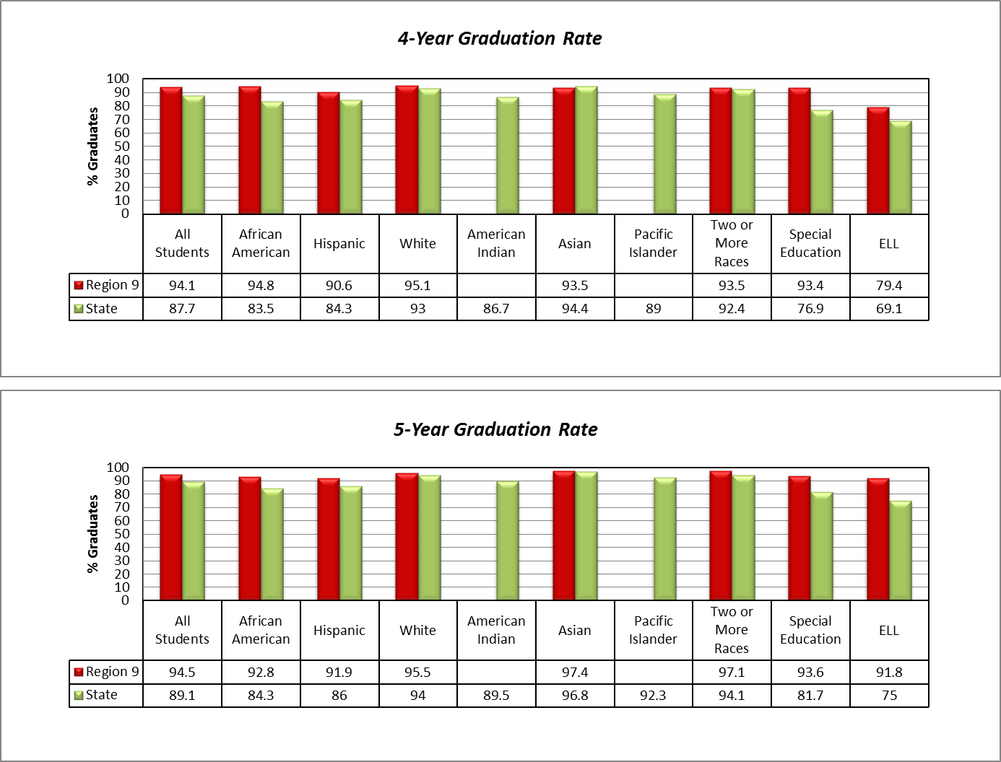
Region 9
Graduation Rates
Based on Preliminary Data
2013 Accountability Region 9/State Comparison

Slide 16
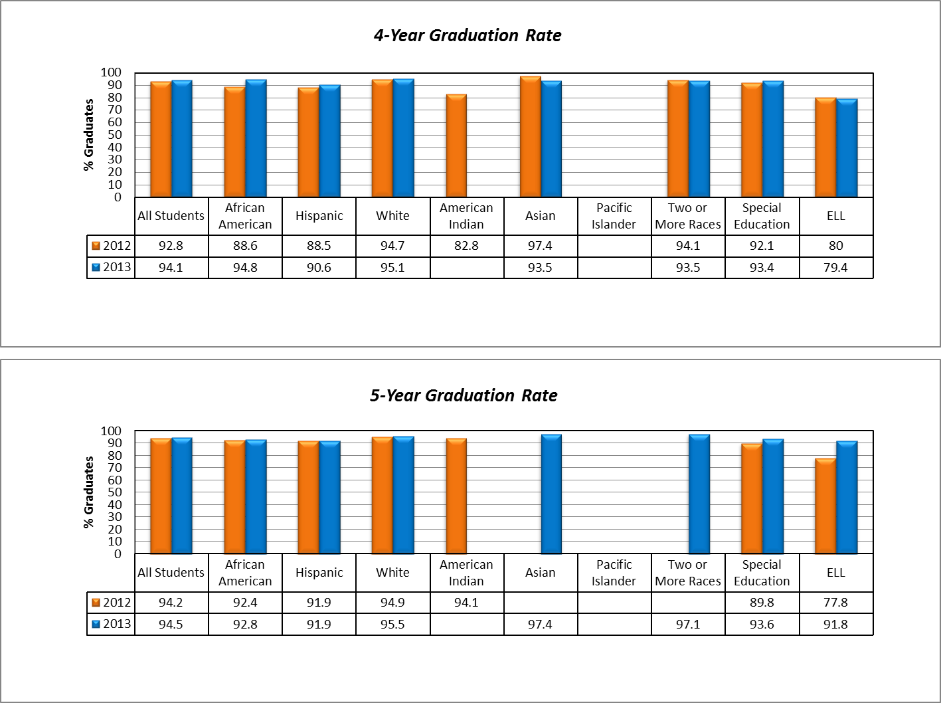
Region 9
Graduation Rates
Based on Preliminary Data
2013 Region 9 Multi-Year Comparison

Slide 17
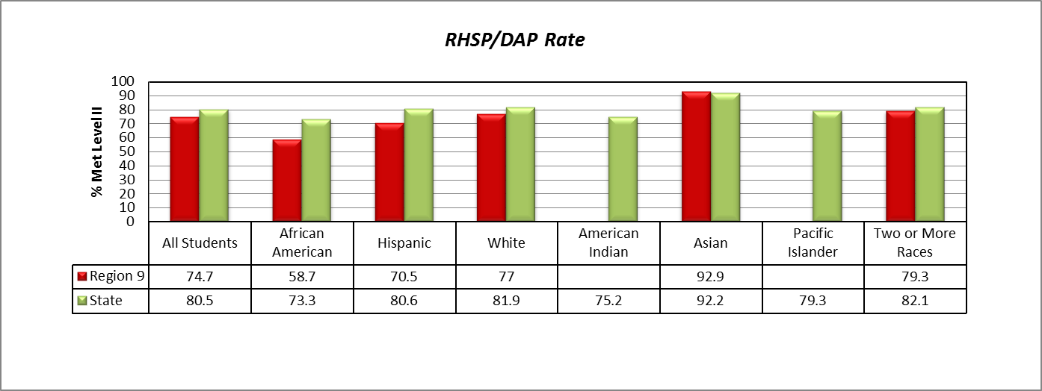
Region 9
Graduation Plans
Based on Preliminary Data
2013 Accountability Region 9/State Comparison

Slide 18
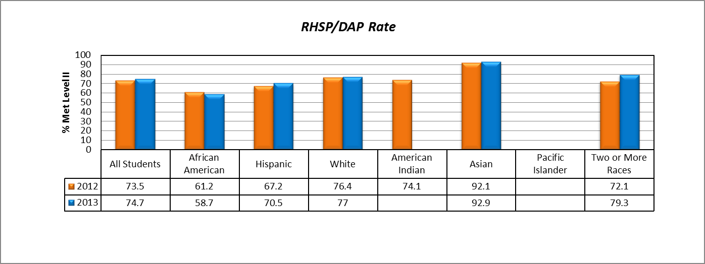
Region 9
Graduation Plans
Based on Preliminary Data
2013 Region 9 Multi-Year Comparison

Slide 19

2008-2013 ACCOUNTABILITY
DISTRICT |  | Exemplary | Recognized | Acceptable | Unacceptable
 | 2008 | 2 (5.1%) | 12 (30.8%) | 25 (64.1%) | 0 (0%)
 | 2009 | 6 (15.4%) | 16 (41%) | 16 (41%) | 1 (2.6%)
 | 2010 | 8 (20.5%) | 25 (64.1%) | 6 (15.4%) | 0 (0%)
 | 2011 | 2 (5.1%) | 13 (33.4%) | 22 (56.4%) | 2 (5.1%)
 |  | Met Standard |  |  | Improvement Required
 | 2013 | 35 (92.1%) |  |  | 3 (7.9%)
CAMPUS |  | Exemplary | Recognized | Acceptable | Unacceptable
 | 2008 | 9 (8.0%) | 51 (45.1%) | 53 (46.9%) | 0 (0%)
 | 2009 | 33 (29.7%) | 49 (44.1%) | 27 (24.3%) | 2 (1.8%)
 | 2010 | 34 (30.6%) | 59 (53.2%) | 17 (15.3%) | 1 (0.9%)
 | 2011 | 9 (8.0%) | 37 (33.0%) | 58 (51.9%) | 8 (7.1%)
 |  | Met Standard |  |  | Improvement Required
 | 2013 | 97 (92.4%) |  |  | 8 (7.6%)
Based on Preliminary Data

